Slide 1
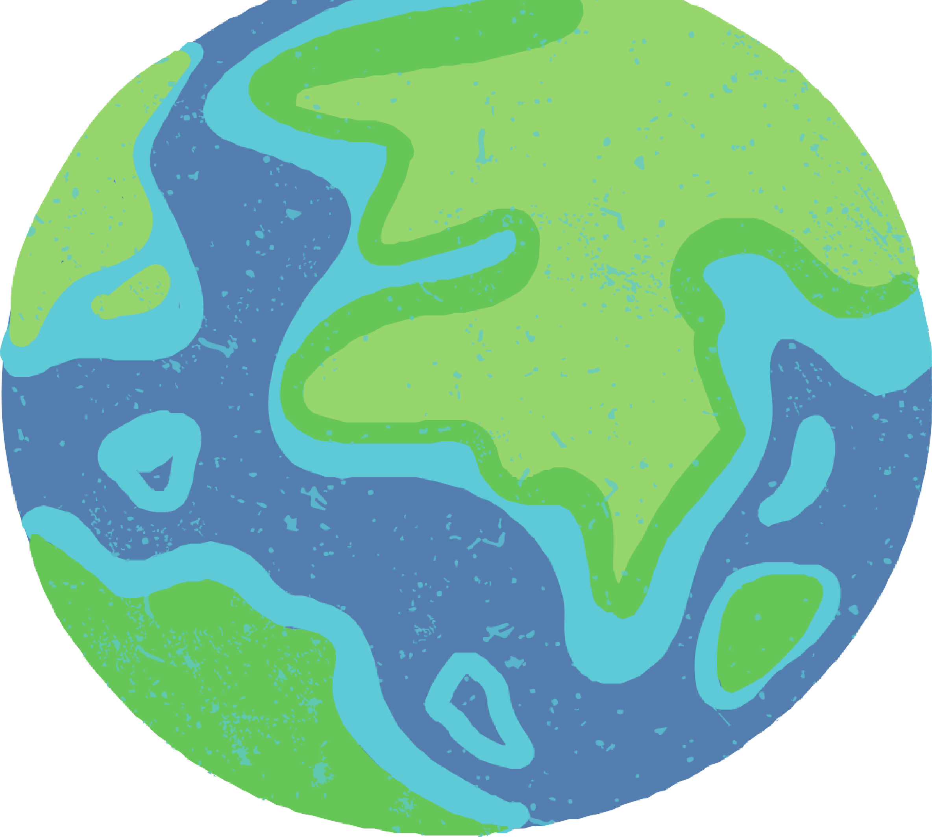



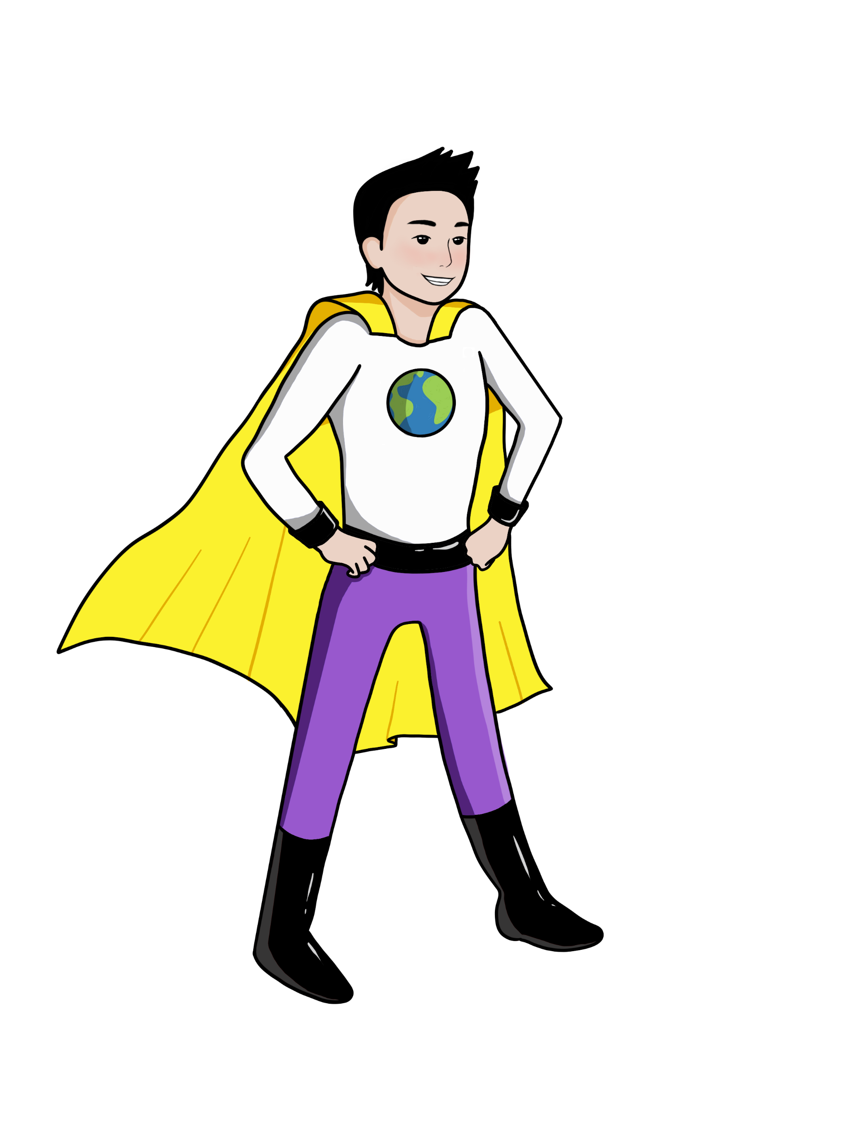




LESSON 9
Food Processing & Packaging
{
{
{

Slide 2


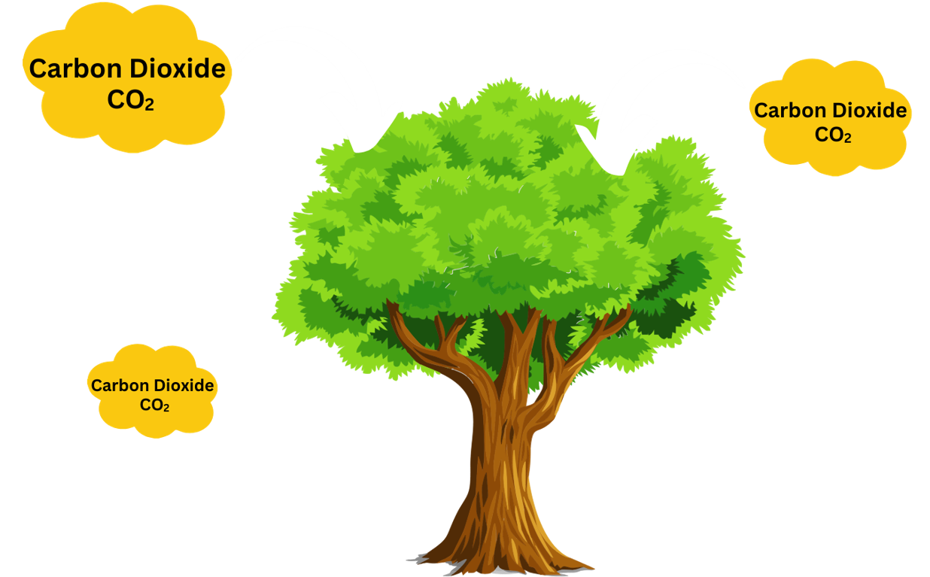
What did we learn about last class?
Eating patterns use different amounts of inputs (land and water) and result in different amounts of outputs (greenhouse gases)
Deforestation is the intentional clearing of forested land or swamps.
We will now talk about Processed Foods and how processing adds greenhouse gases to our atmosphere as well
Recap!

Slide 3

What are processed foods? What does processing involve?
The steps involved in food processing can cause the greenhouse gas emissions for these foods to be higher.
Processed foods tend to be sold in packaging that can be harmful to the environment.
Big Ideas
&
Questions of the Day

Slide 4
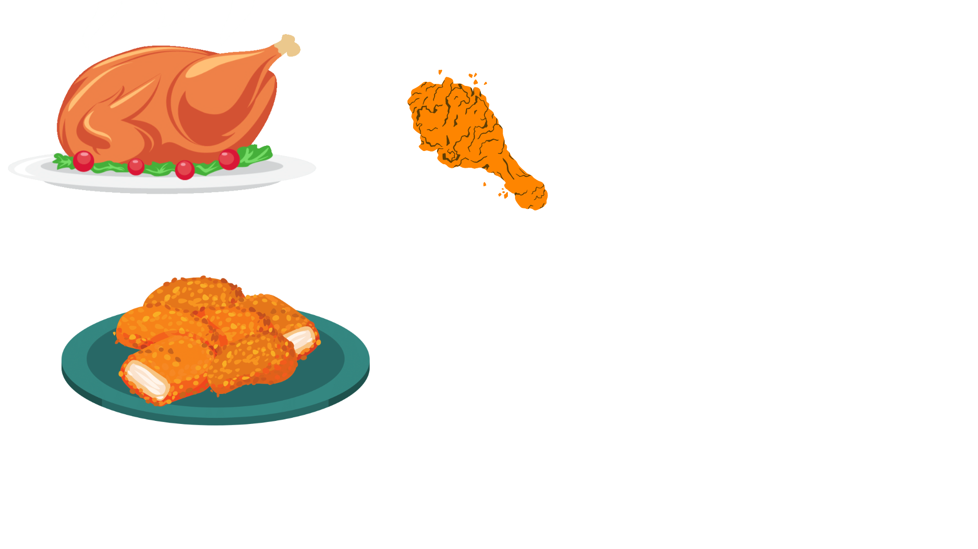
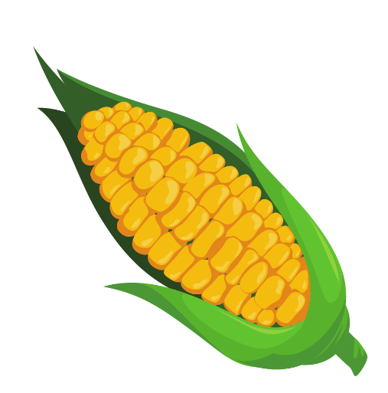
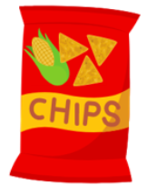
Today we will learn about…
production → processing → distribution → consumption → waste management
Do you think all foods are processed the same way?
  We can eat chicken as baked chicken, fried chicken, chicken nuggets, frozen chicken nuggets
Do you think the corn results in the same amount of greenhouse gases as the corn chip?
  Why or Why Not?

Slide 5
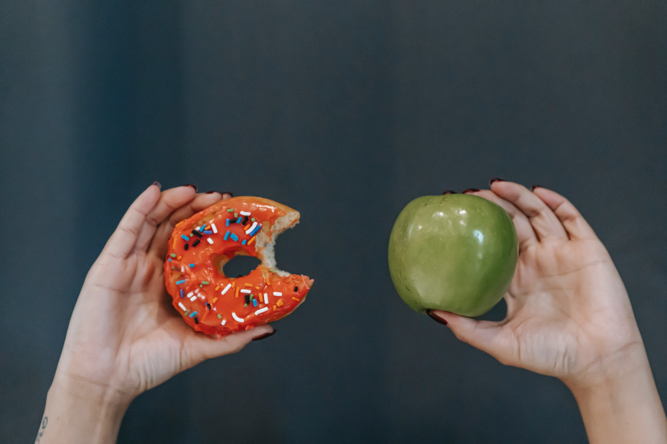
Observable Phenomena
Notice and Wonder
What do you notice about these two foods?
What do you wonder?

Slide 6
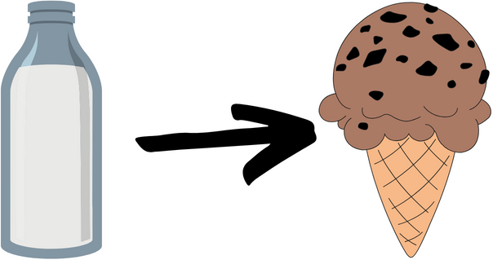
What does “processed food” mean?
Processed foods are…
foods that start off from natural whole ingredients but are then changed in some way by adding other ingredients or changing the original form of the food
What was
added to milk
to make this chocolate chip ice cream?

Slide 7
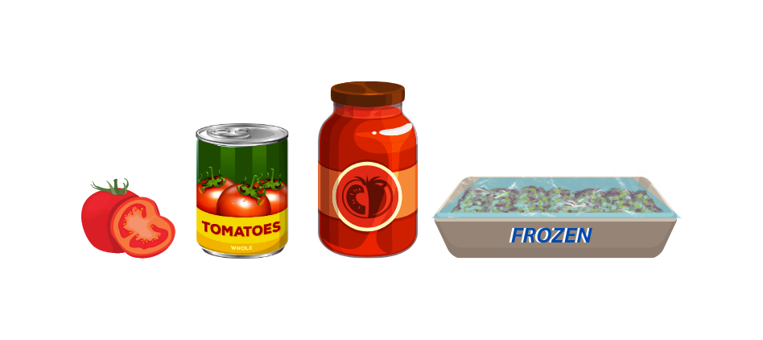

Why do we process foods?
This is done for a few reasons:
  Processed foods last longer and do not spoil as quickly
  Processed foods appeal to our taste buds because they have added additional ingredients like fat, salt, and sugar

Slide 8
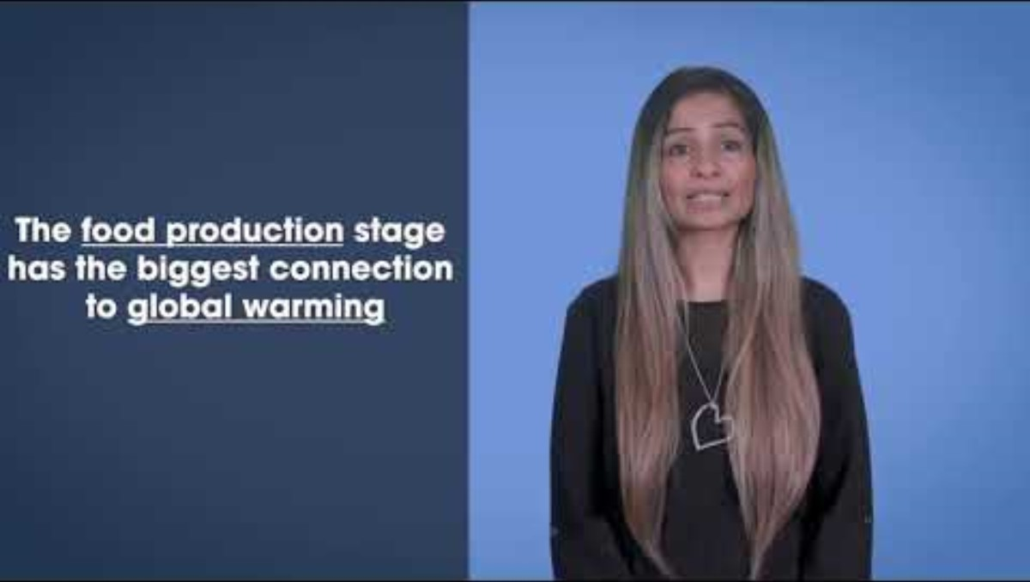
Video Lesson
https://www.youtube.com/watch?v=vnLXBQoaj9s&list=PLKx8NLAujm_nCPmzHM3eUKiaqMvaH55Zw&index=5
Notes:
Pause at 1:11 mins, pause at 4:23

Slide 9
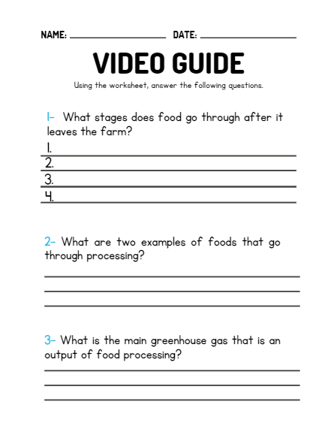

Video Recap

Slide 10
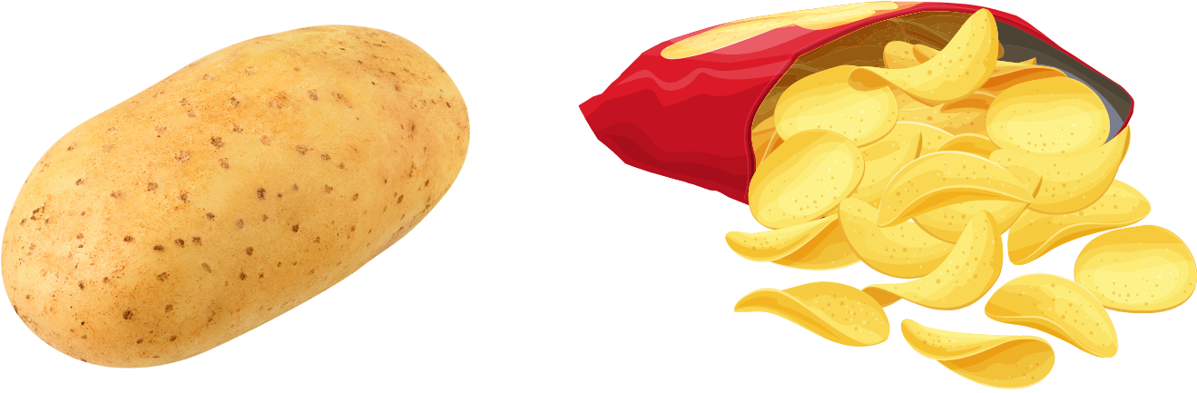
Because processed foods use multiple ingredients, and ingredients travel to us from all over the world, processed foods require more food miles
More Food Miles = More Greenhouse Gas
Think about how a whole potato is processed to make a potato chip..
What ingredients are used?
Where do those ingredients come from?
Notes:
Ingredients: potatoes, salt, oil

Slide 11
Processing example
Potato to Chips
Ingredients: Potatoes, Salt, Oil
Where do the ingredients come from?

Slide 12
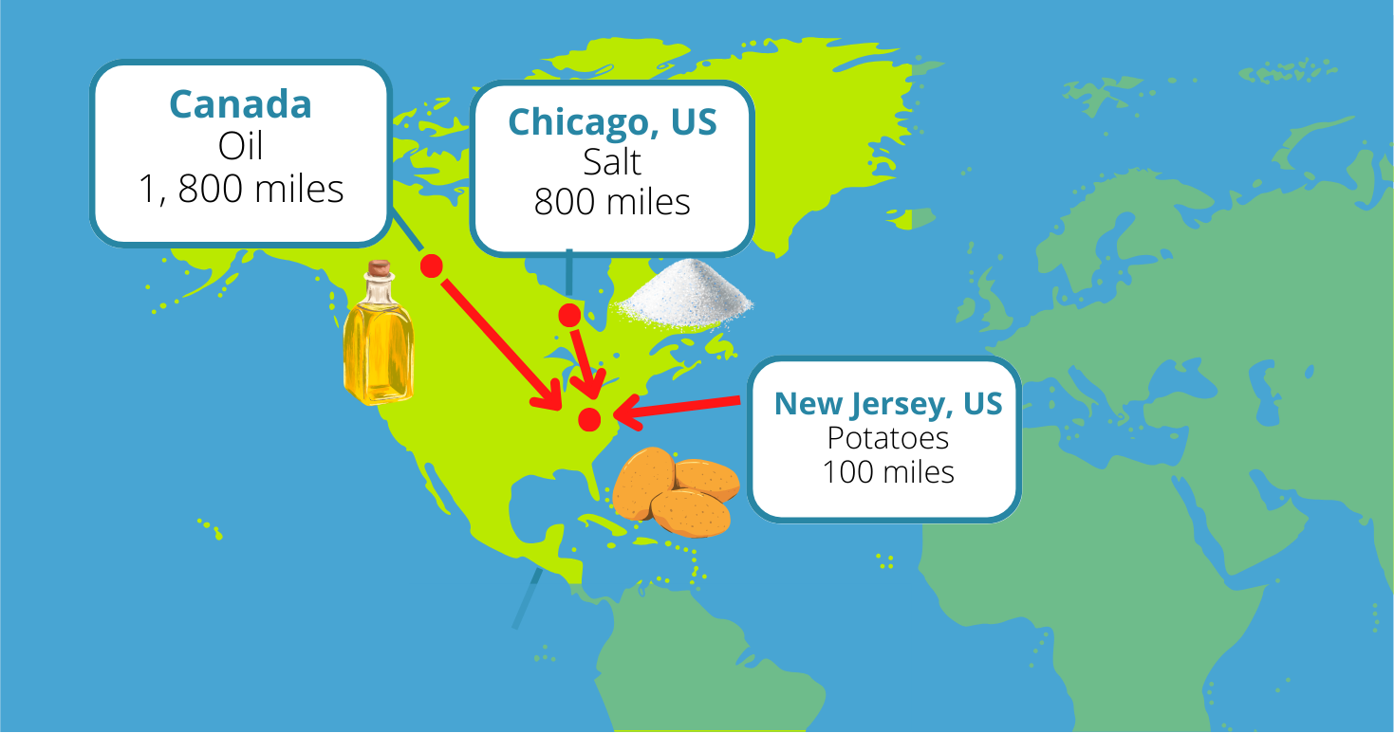
Processing example
Potato to Chips
Ingredients: Potatoes, Salt, Oil

Slide 13

Time for an Activity!

Slide 14
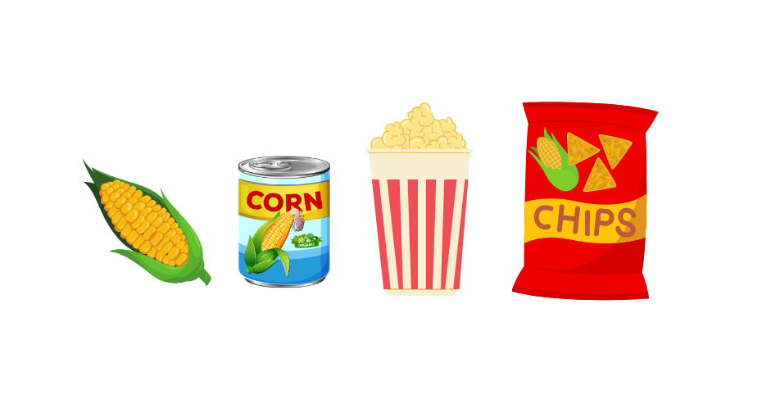
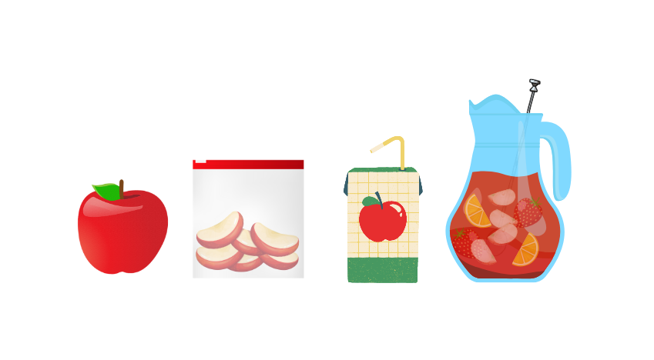
GROUP
ACTIVITY!
ACTIVITY
As a class, put the foods in order from least to most greenhouse gas emissions after the ingredients leave the farm.
QUESTIONS
Explain the reasoning behind your ranking.

Slide 15
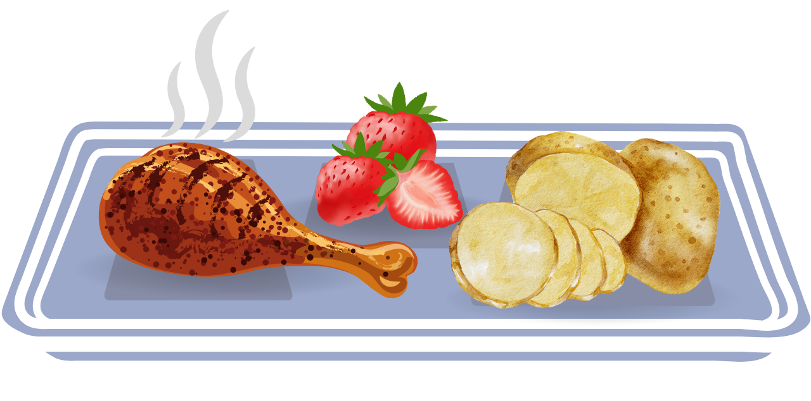
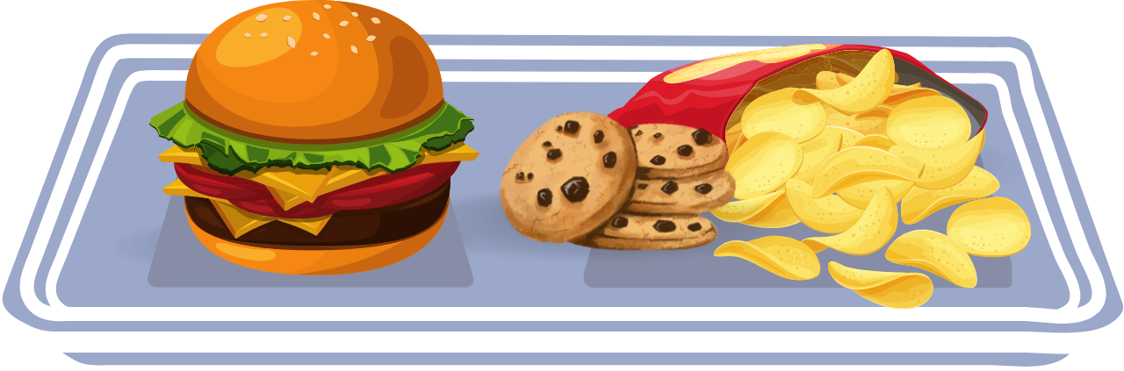
LESSON TEN: LUNCH
Based on what you have learned,
Which lunch plate resulted in more greenhouse gas emissions? Why?
Tray 1
Tray 2
Notes:
How far do you think your food travels. Let’s look at this meal and try to trace where each ingredient came from.
But why do we have to get our food from all over the world? Can we buy some of these ingredients in NJ? What about in your city or County?

Slide 16
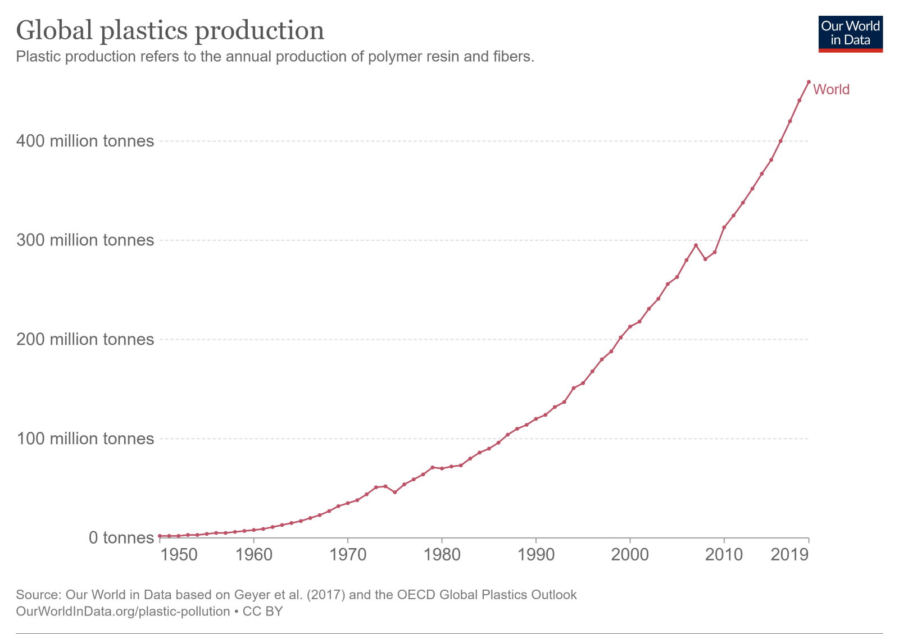

Processed foods often come in packaging
Containers and packaging contribute over
23%
of the trash in landfills in the U.S.

Slide 17

The litter that you may see on beaches and in bodies of water is often food packaging and food containers
How is this harmful to wildlife?
Animals mistake the litter for actual food and might eat the litter, which harms the animals
The litter also makes it harder for boats to sail safely

Slide 18


To help reduce the environmental impact of food packaging:
Eat more whole foods instead of processed foods that come in bags and containers
When you do consume packaged foods, recycle or reuse the packaging instead of throwing it out in the regular trash
This can make a huge difference!

Slide 19



REUSE
RECYCLE
What are some ways you can reuse a plastic water bottle?
What are some ways you can reuse a cereal box?
What are some food or drink packages that you can recycle?

Slide 20
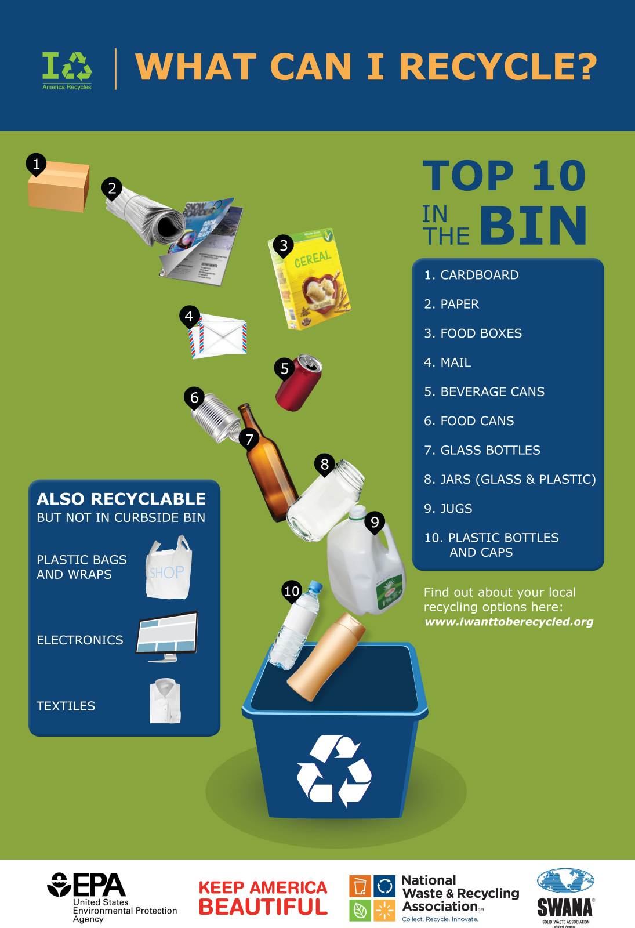

What can we recycle?

Slide 21
Time for an Activity!

Slide 22

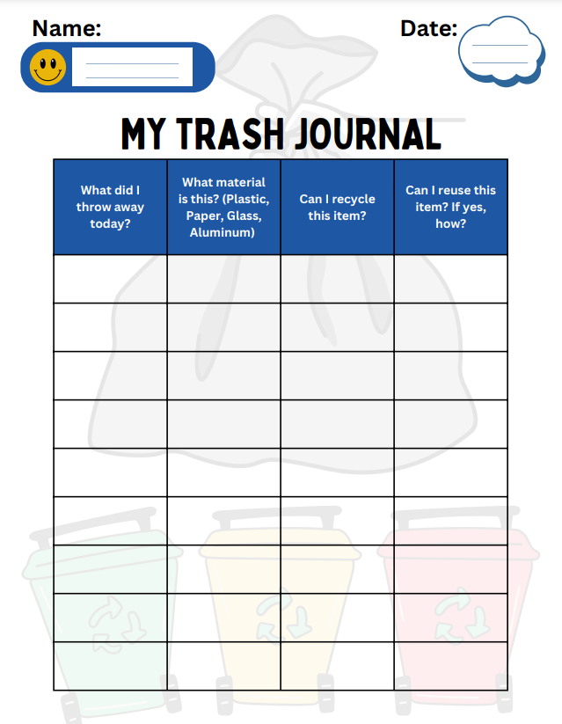
My Trash Journal
Think about food or beverage packages and containers that you and your classmates throw out in the garbage every day.
Can you recycle these items next time?
Can you reuse these items next time?

Slide 23
Summary
Production of highly processed foods typically results in more greenhouse gases compare to whole foods.
Processed foods are often packaged in plastic, which we know can harm the planet, including our oceans and the marine life, like sea turtles that live in them.

Slide 24
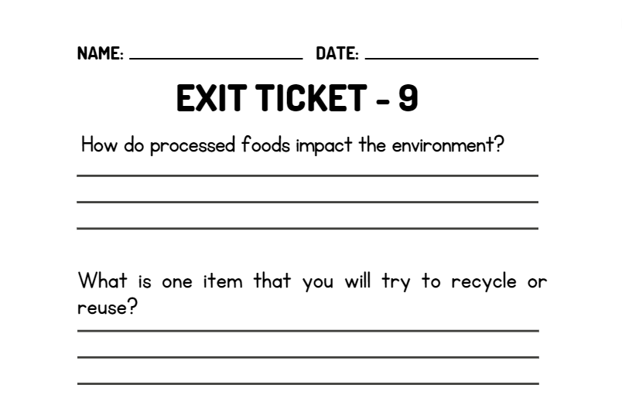
WRAP UP
On your EXIT TICKET write...
Notes:
Once the students have completed the exit ticket, collect them and make minor adjustments to the next lesson based on the data received

