Slide 1
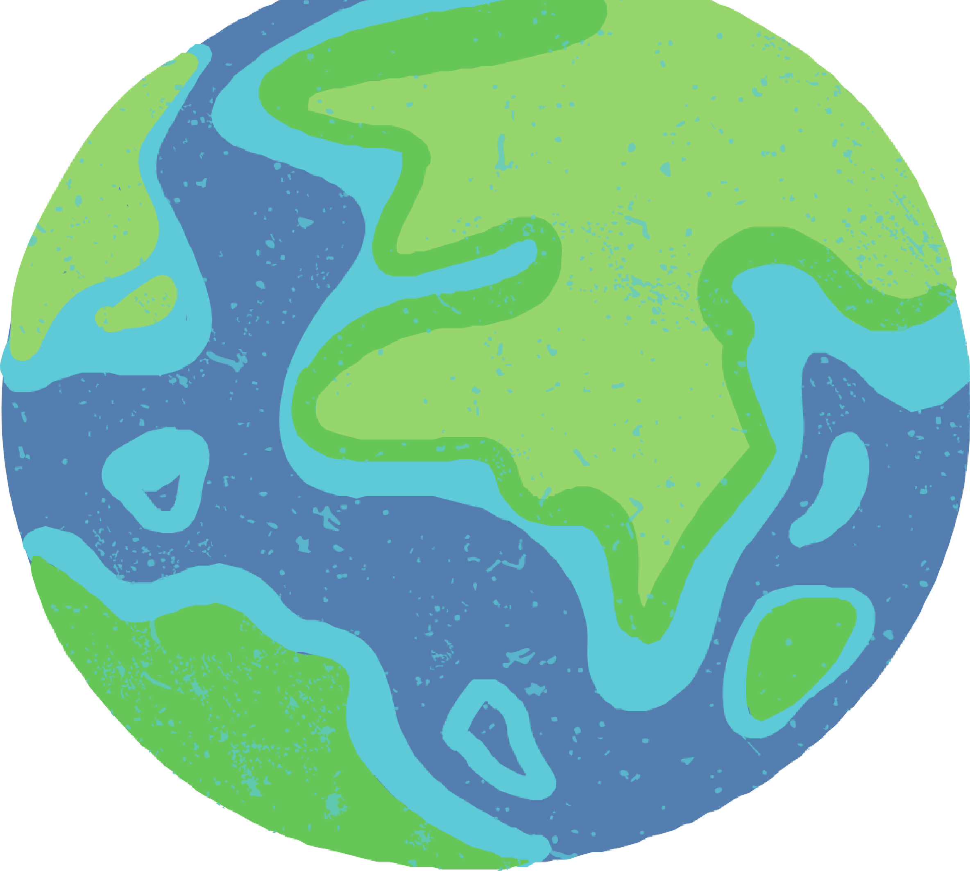



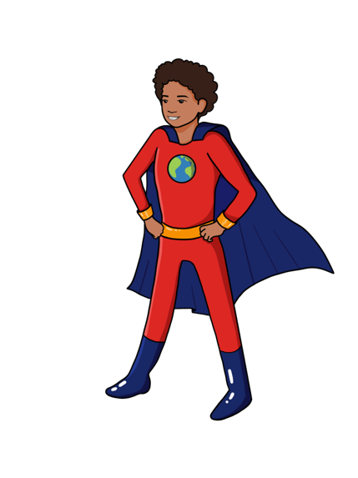




LESSON 8
Food, Water, Land and Greenhouse Gases
{
{
{

Slide 2



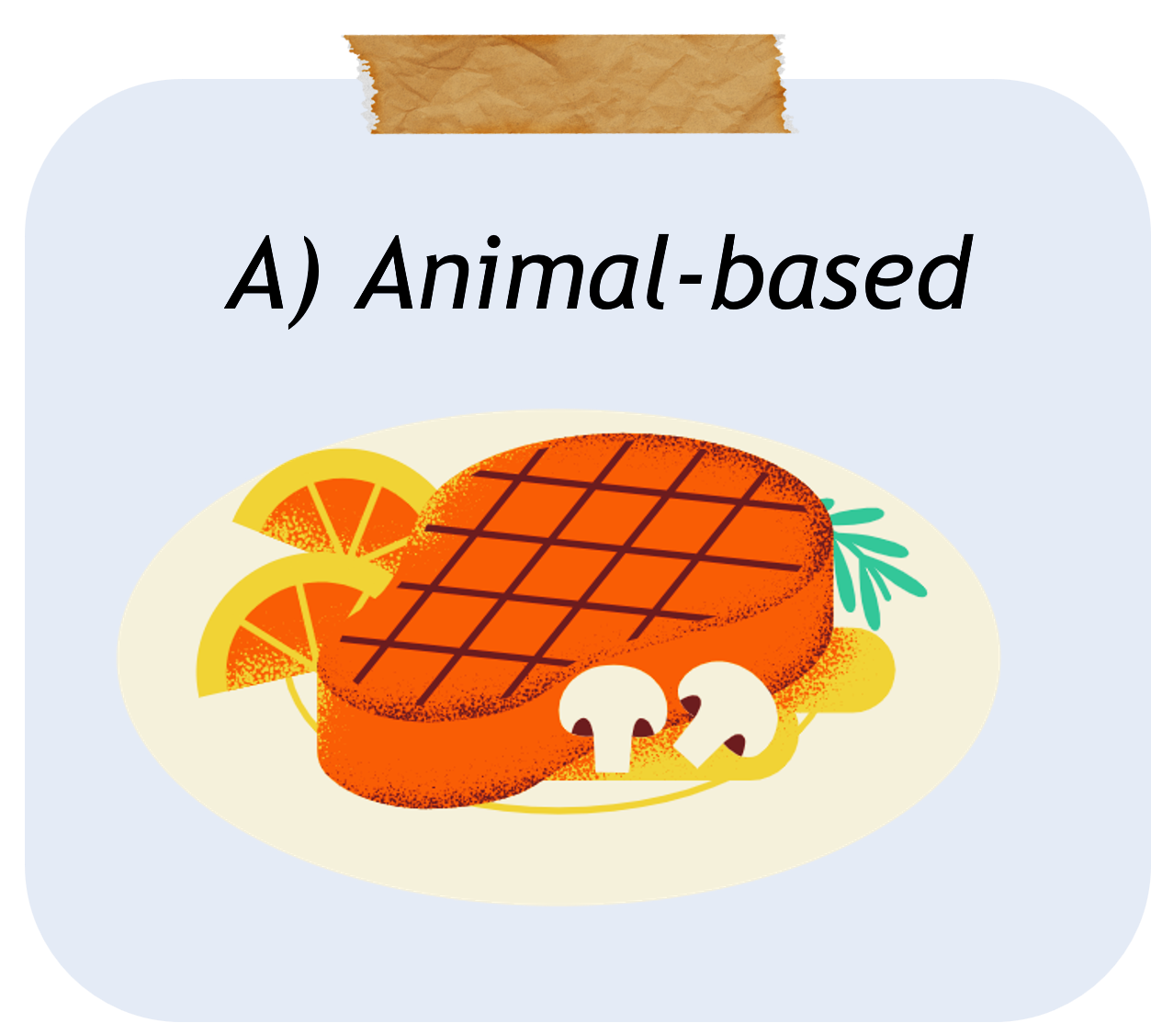
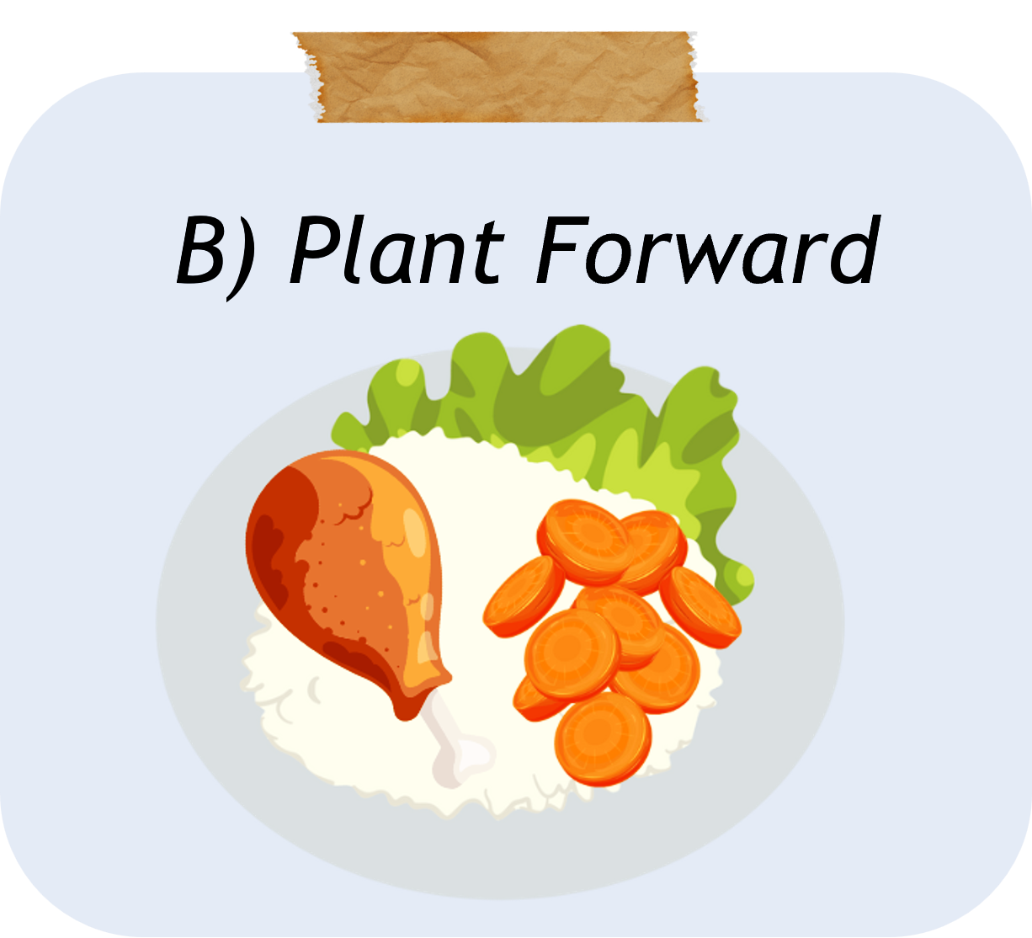
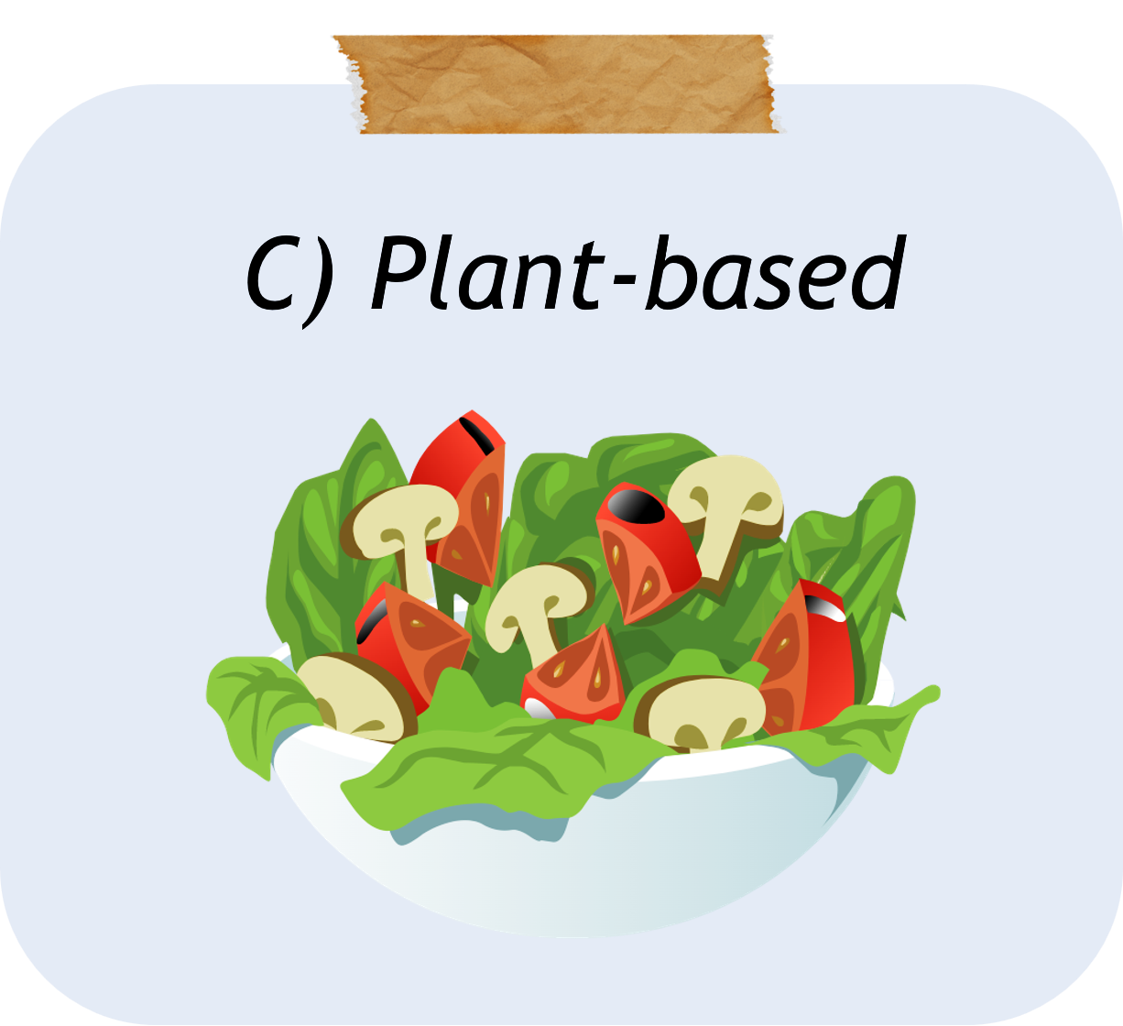
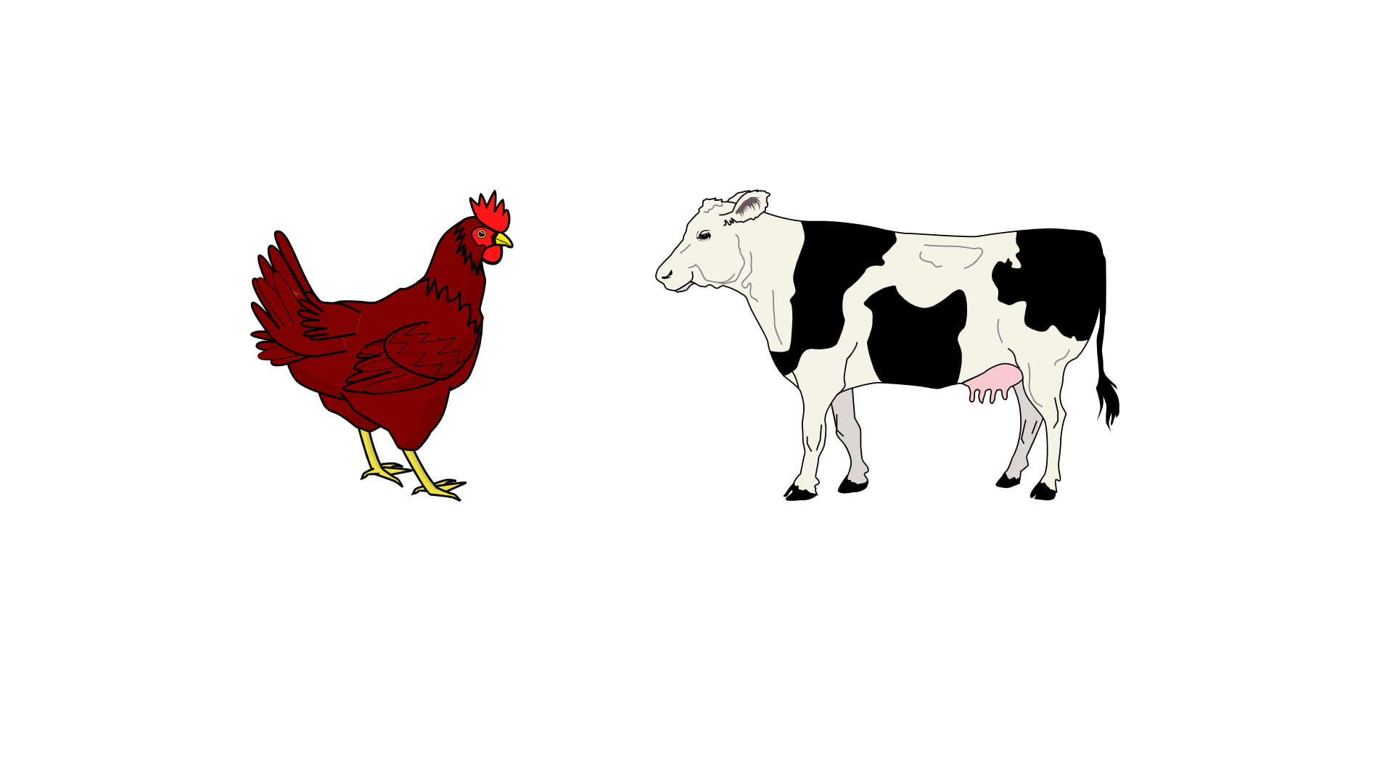

What did we learn about last class?
The three eating patterns and the resources or inputs needed to produce different foods
We also learned about land use, water use and greenhouse gas emissions and how they relate to the types of eating patterns
Recap!
VS.
Notes:
Previous text:
We also learned that when we lose forests and swamps to farms, we lose our ability to reduce carbon dioxide from the atmosphere.

Slide 3

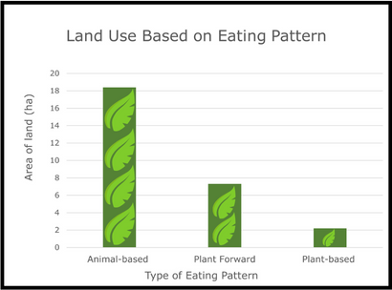
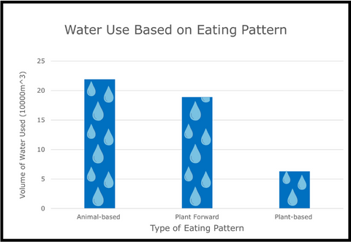
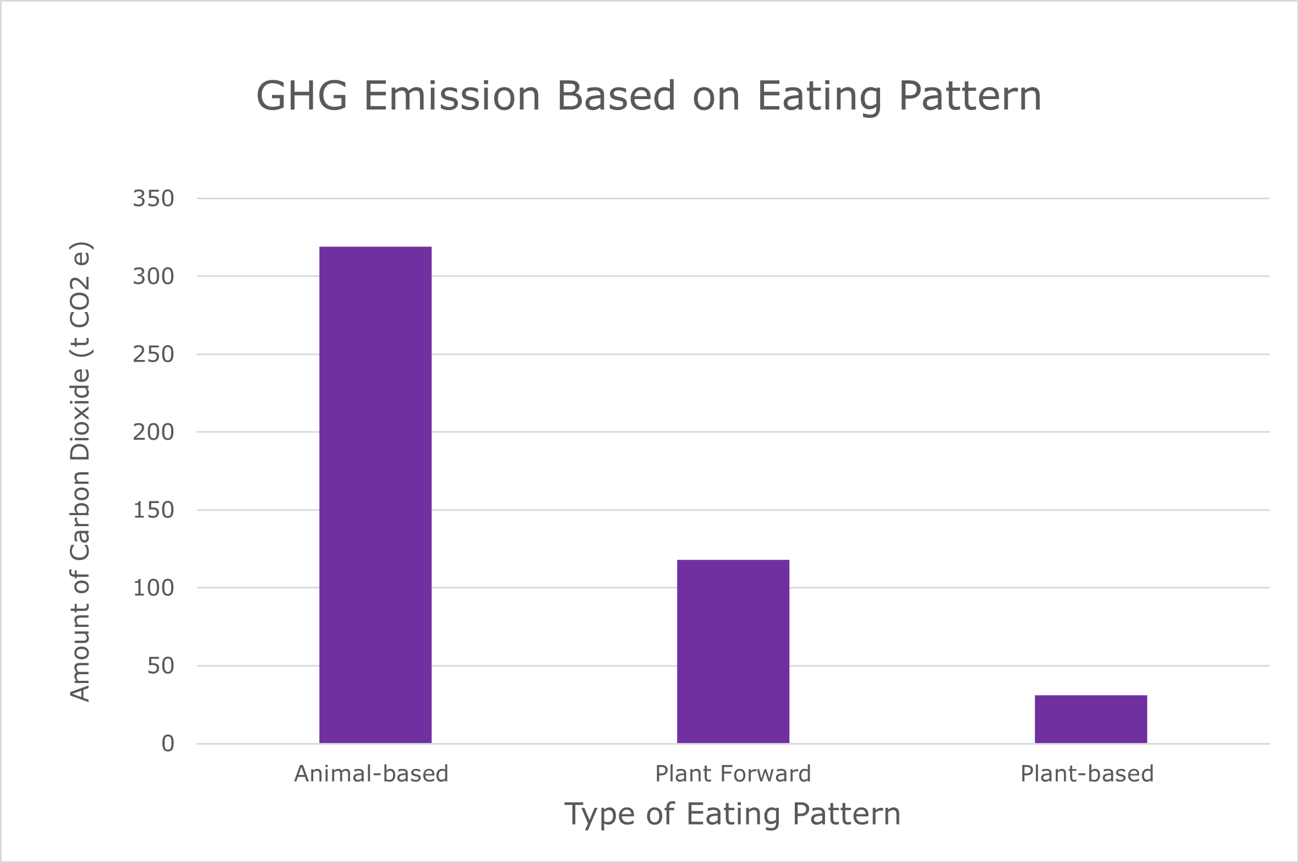

Today we will learn about…
HOW do eating patterns use different amounts of inputs (land and water) and result in different amounts of outputs (greenhouse gases)?
How do this impact the climate system?
Big Ideas &
Questions
of the Day

Slide 4
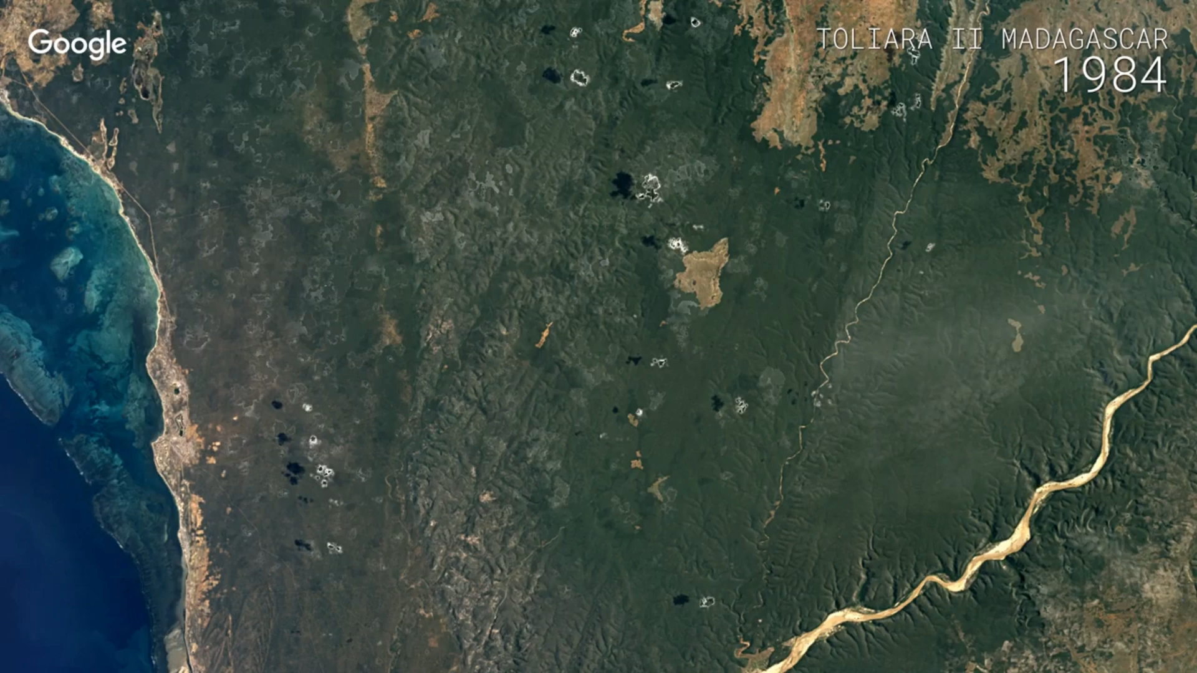
Notice
And
Wonder
LESSON EIGHT PHENOMENON
Source: Google Earth YT channel, Google Timelapse: Toliara II, Madagasca. https://www.youtube.com/watch?v=BulnGm82jow

Slide 5
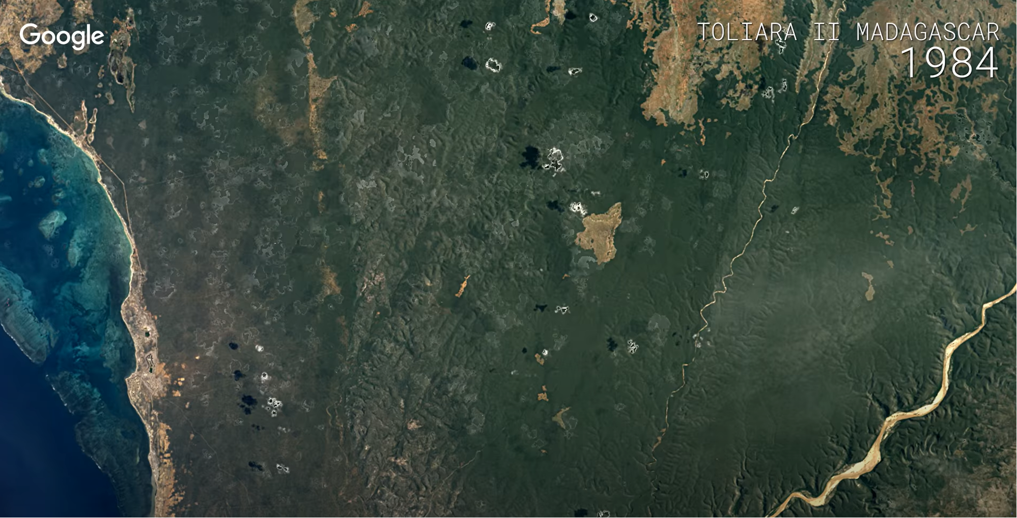
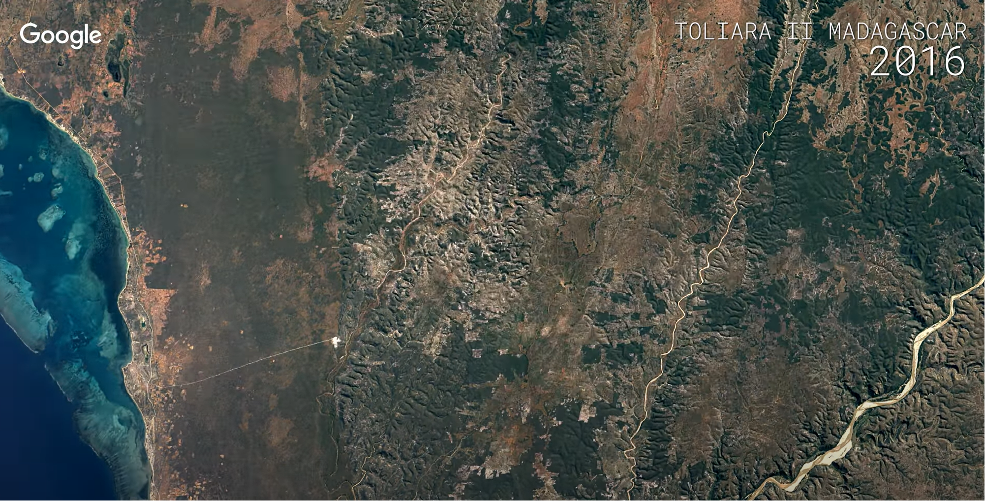
What did you Notice? What did you Wonder?
Before
After

Slide 6

Let’s Talk about:
LAND & Eating Patterns

Slide 7
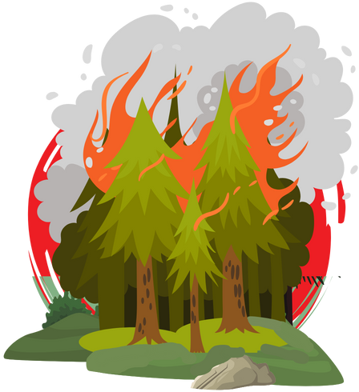
What you saw in the video is called Deforestation
Deforestation is the intentional clearing of forested land or swamps.
It is done by either burning or cutting down trees
Deforestation often happens to make space for more farms
Why do you think this is bad for the climate system?

Slide 8
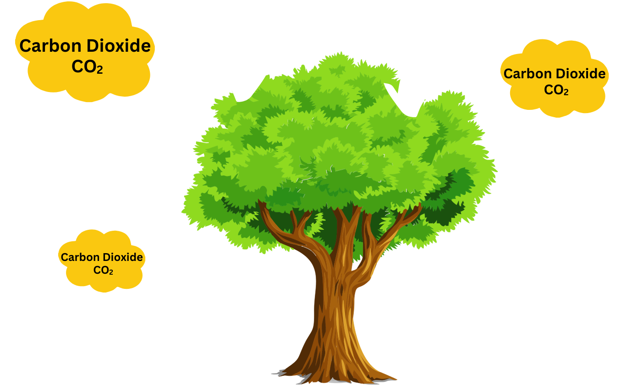
THE IMPORTANCE OF TREES
trees take in Carbon Dioxide

Slide 9
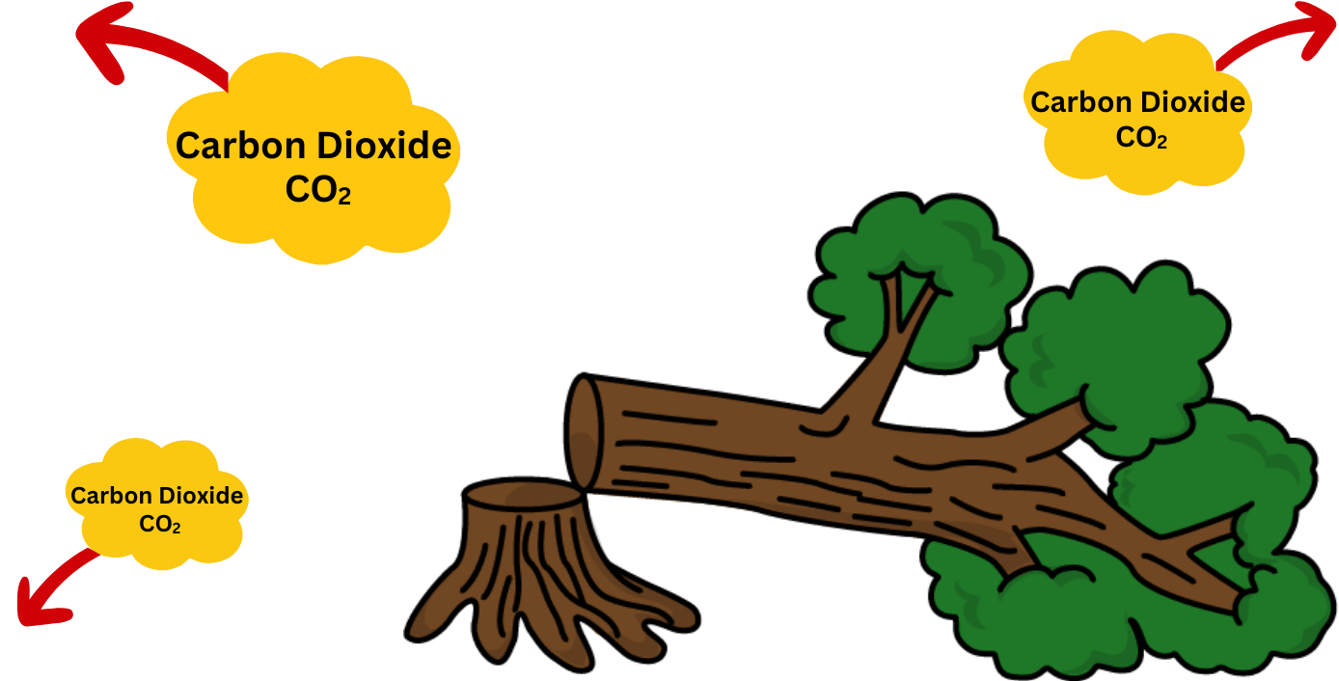
THE IMPORTANCE OF TREES
When a tree is cut down, it can no longer take in Carbon Dioxide, leaving Carbon Dioxide in the atmosphere

Slide 10
Now we will learn about…
LAND, WATER, GHG’S & Eating Patterns

Slide 11
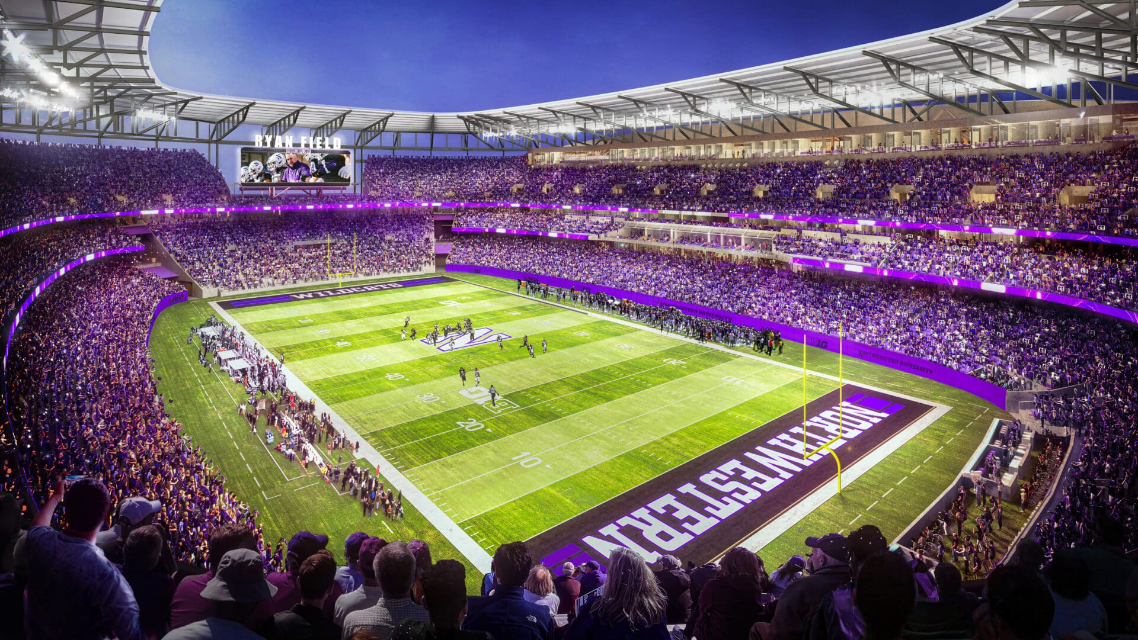


Has anyone been to a football field?
Notes:
Photo cred: https://venuesnow.com/ryan-field-rebuild-fewer-seats-roof-canopy/

Slide 12
How much land does
animal-based foods use?
Notes:
Based on PNAS graph per million kilocalories consumed
18 ha *3 fbf = 54 total

Slide 13


How much land does
animal-based foods use?
54 football fields
Notes:
Based on PNAS graph per million kilocalories consumed
18 ha *3 fbf = 54 total

Slide 14
How much land does
plant-based food use?

Slide 15
How much land does
plant-based foods use?
6 football fields

Slide 16
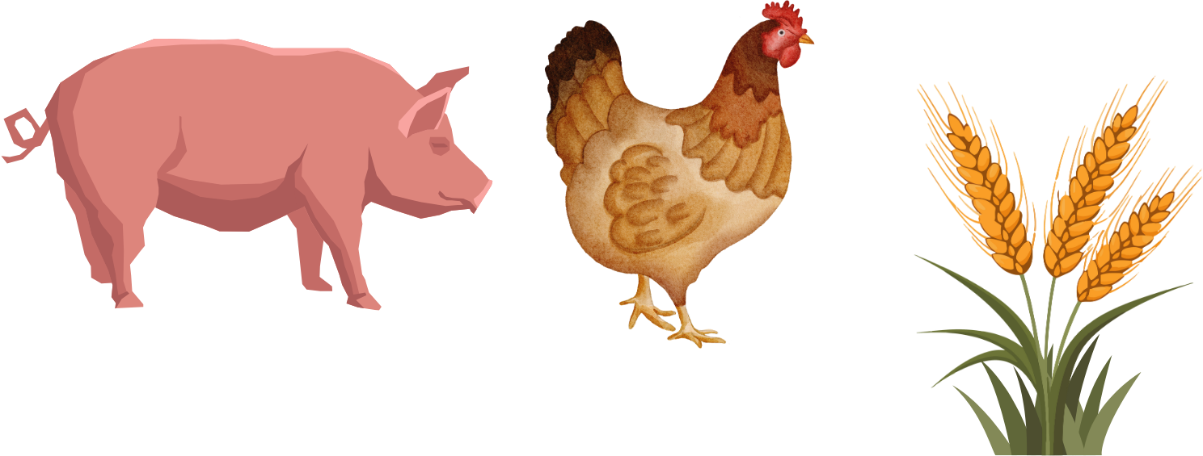
Why does animal-based foods use more land?
AND land to grow food for the animals
It needs land to raise the animals
Notes:
Based on PNAS graph per million kilocalories consumed
18 ha *3 fbf = 54 total

Slide 17

How does plant-based foods use LESS land?
Plants only need land to grow
Notes:
Based on PNAS graph per million kilocalories consumed
18 ha *3 fbf = 54 total

Slide 18
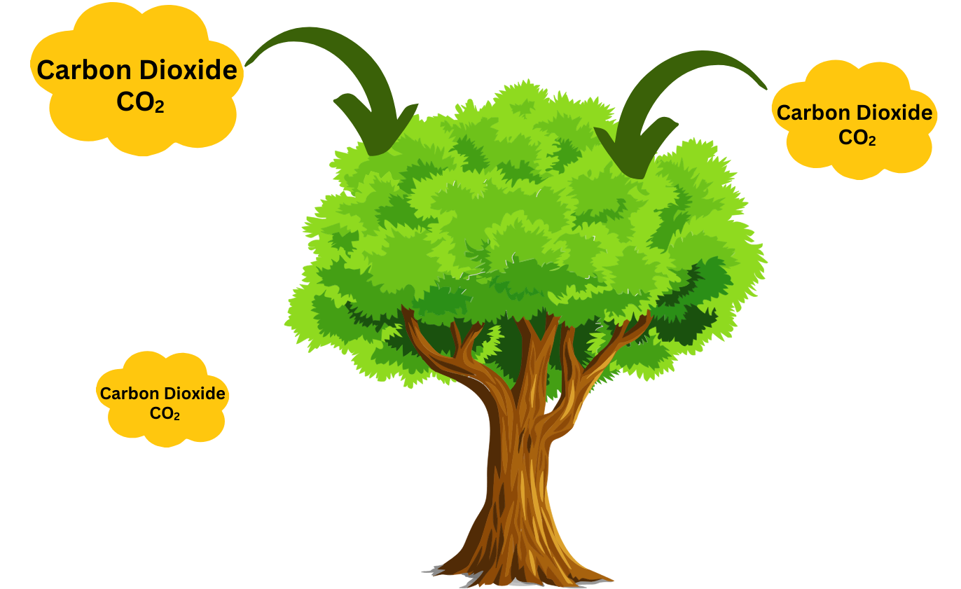
Forests and swamps help take carbon out of the atmosphere, but many are burned to make room for farmland. This releases more greenhouse gases.
Raising animals as food for people uses much more land and other resources than raising plant foods for people.
LAND
Recap

Slide 19

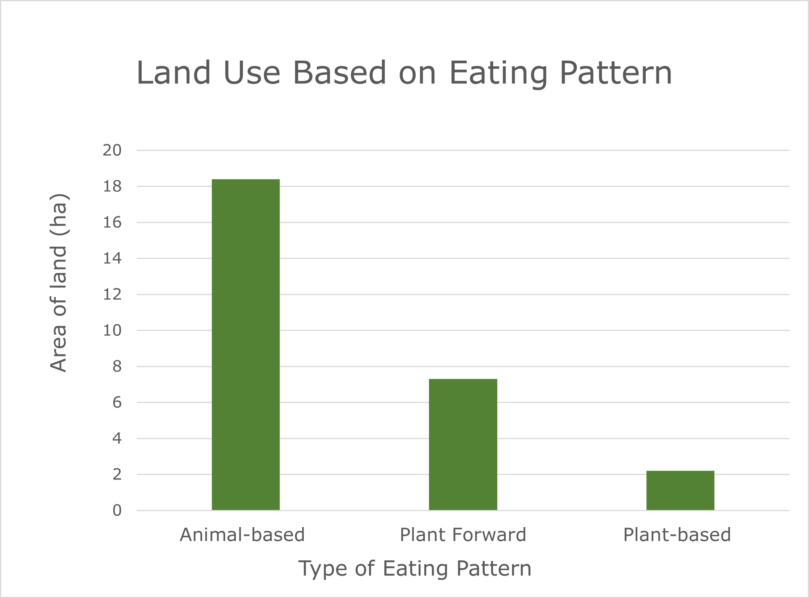

Resources Used Based on the Eating Pattern:
LAND
Which eating pattern uses the most of this resource/input?

Slide 20
Let’s Talk about:
WATER & Eating Patterns

Slide 21




Take a guess!
How many gallons of water does it take to produce 1 hamburger?
WATER

Slide 22
Take a guess!
How many gallons of water does it take to produce 1 hamburger?
WATER
660 gallons of water!
(5-hour shower)

Slide 23
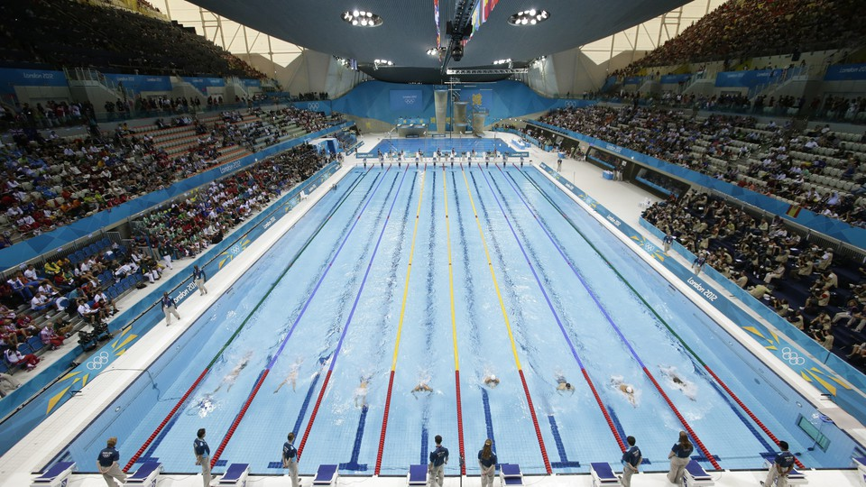
Has anyone seen an Olympic swimming pool?
Notes:
Photo cred: https://www.theatlantic.com/technology/archive/2015/09/apples-cash-reserves-would-fill-93-olympic-swimming-pools/404452/

Slide 24
How much water does
animal-based foods use?
Notes:
220,000,000 liters
Olympic sized pool = 2.5 million liters
220 / 2.5 = 88 Olympic sized pools

Slide 25

How much water does
animal-based foods use?
88 Olympic size swimming pools
Notes:
220,000,000 liters
Olympic sized pool = 2.5 million liters
220 / 2.5 = 88 Olympic sized pools

Slide 26
How much water does
plant-based food use?
Notes:
60,000,000 liters
/ 2.5 million = 24 Olympic sized pools

Slide 27

How much water does
plant-based food use?
24 Olympic size
swimming
pools​
Notes:
60,000,000 liters
/ 2.5 million = 24 Olympic sized pools

Slide 28
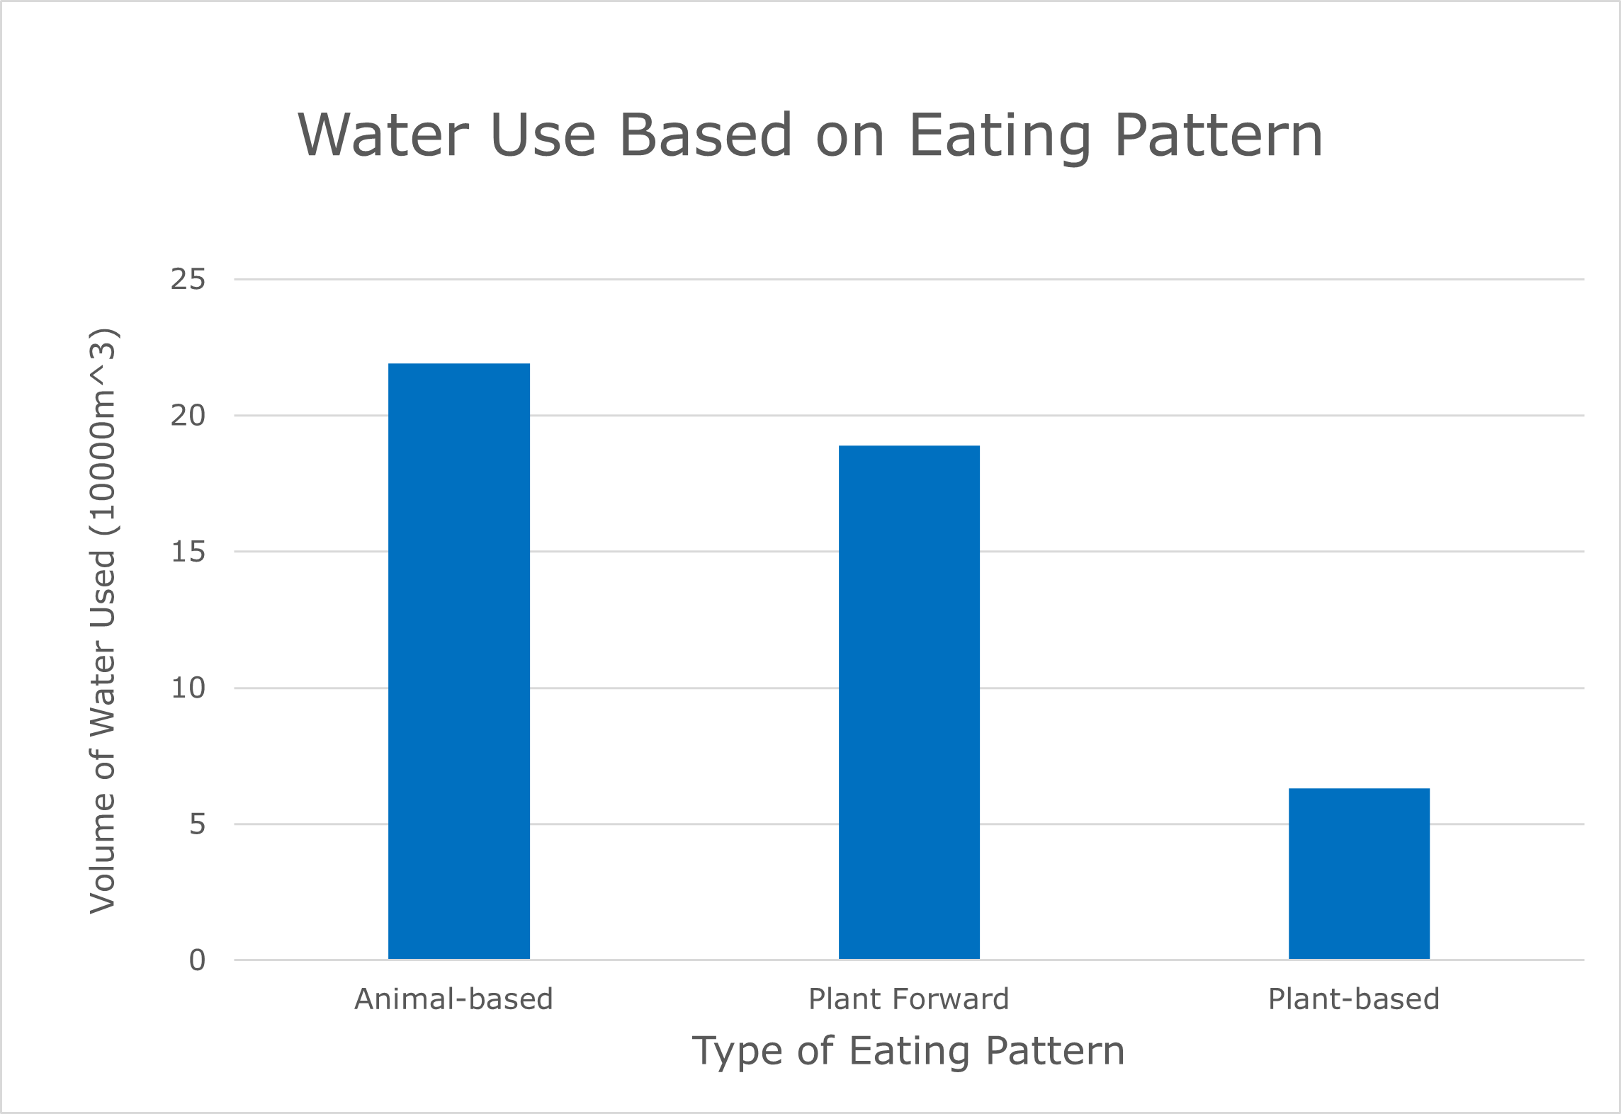

Resources Used Based on the Eating Pattern:
WATER
Which eating pattern uses the most of this resource/input?

Slide 29
Let’s Talk about:
Greenhouse Gases & Eating Patterns

Slide 30
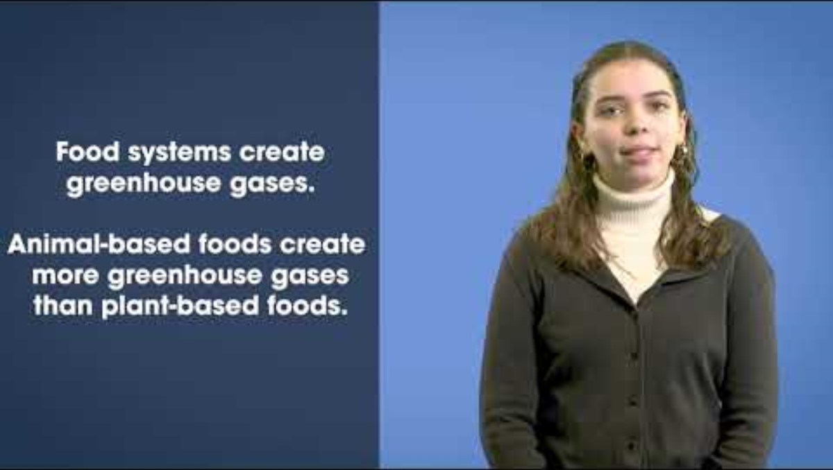
Video Lesson
https://www.youtube.com/watch?v=nt6JX_CDQAA&list=PLKx8NLAujm_nCPmzHM3eUKiaqMvaH55Zw&index=3
Notes:
The video will give instructions on when to pause and what to discuss.
(Video is 11:27 mins, pause at 1:19 mins, pause 3:23 mins, pause 8:36)

Slide 31
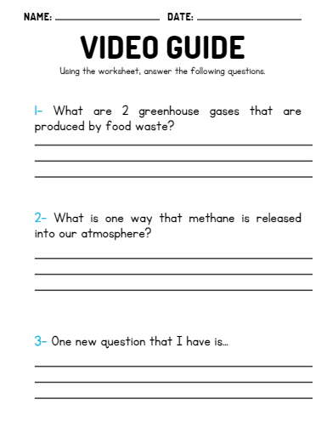

Video Recap

Slide 32

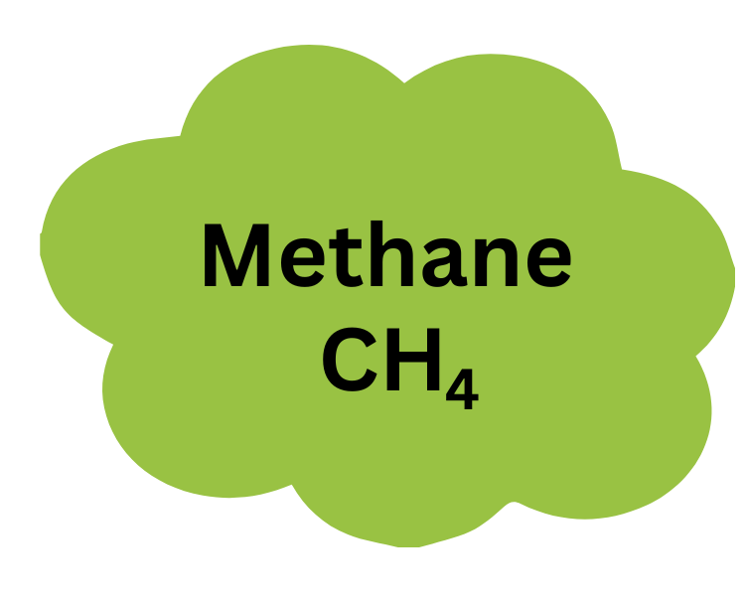
GREENHOUSE GASES
Carbon Dioxide - CO₂
Methane - CH₄
Making and burning fossil fuels
Decaying trash
Landfills
Burning fossil fuels
Burning coal, oil, or natural gas
Notes:
The teacher explains that while these three greenhouse gases are all bad for the environment and increase climate change, some are worse than others.
The teacher asks students to guess which greenhouse gas is the strongest and weakest. The teacher can have students vote on which is the strongest and worst greenhouse gas, and which is the weakest greenhouse gas. Teachers can count the votes and write the rankings on the board.

Slide 33
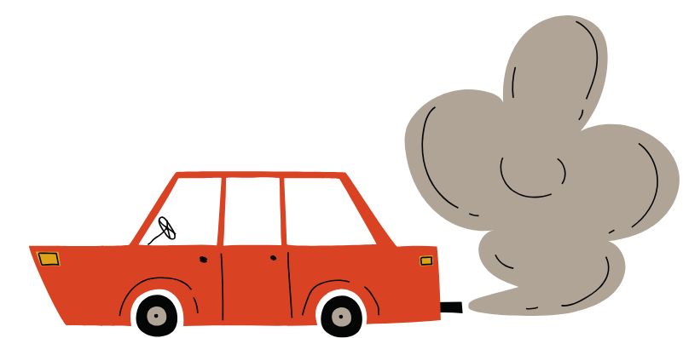

WHERE DOES CARBON DIOXIDE
COME FROM?
Carbon Dioxide - CO₂
Burning fossil fuels
Burning coal, oil, or natural gas

Slide 34
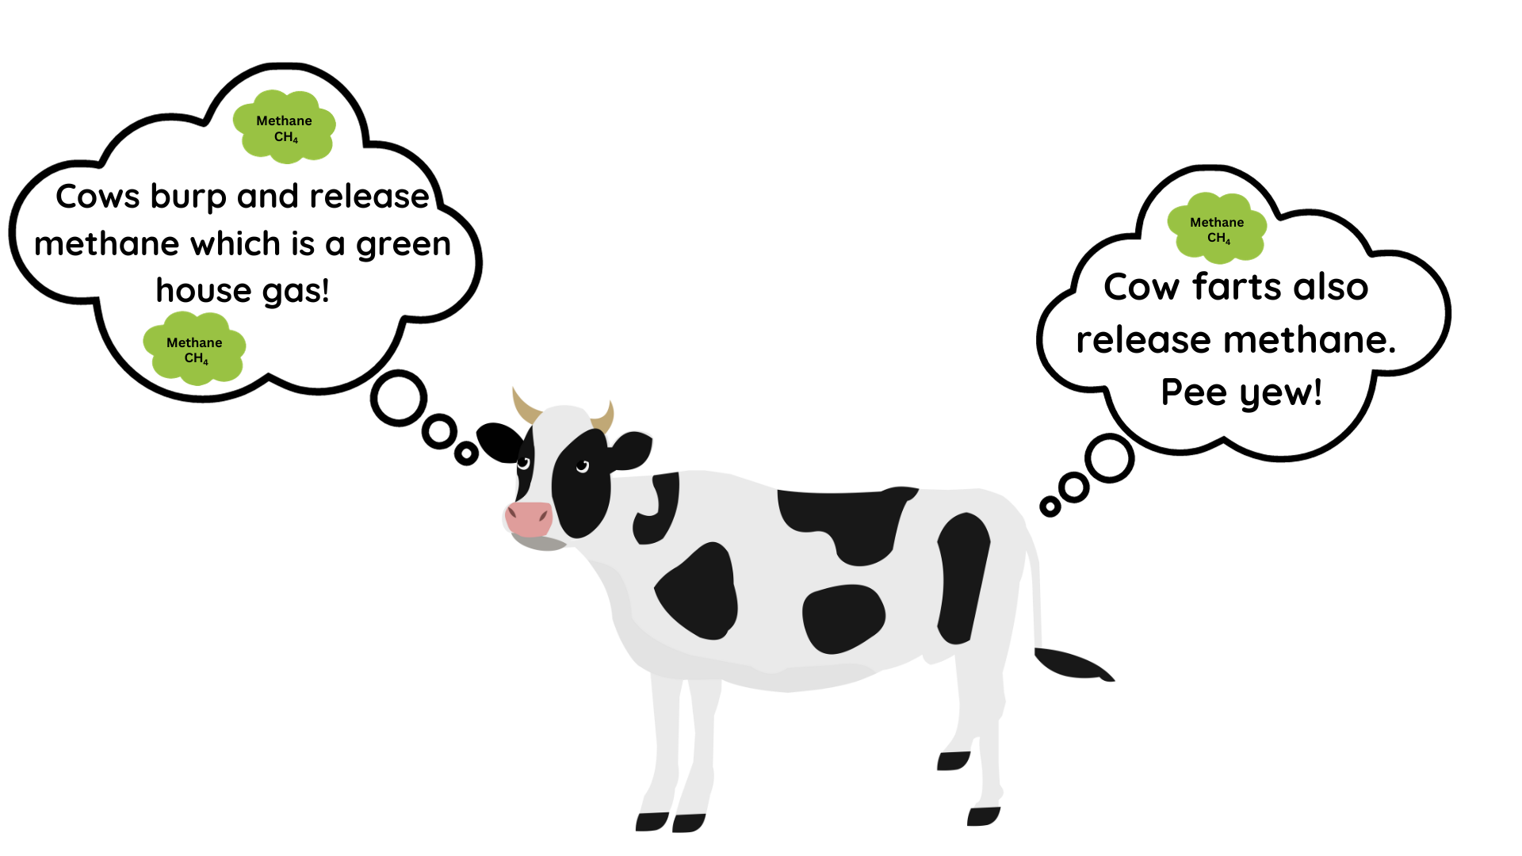
WHERE DOES METHANE
COME FROM?
Methane - CH₄
Making and burning fossil fuels
Decaying trash
Landfills

Slide 35
How much GHG does
animal-based foods produce?
Notes:
320 tons of CO2 emissions
On average, you emit one ton of CO2 for about every 2,500 miles you drive—about the distance from Boston, Massachusetts to Salt Lake City, Utah. (https://climate.mit.edu/ask-mit/how-much-ton-carbon-dioxide)
320 / 5 = 64 cars

Slide 36
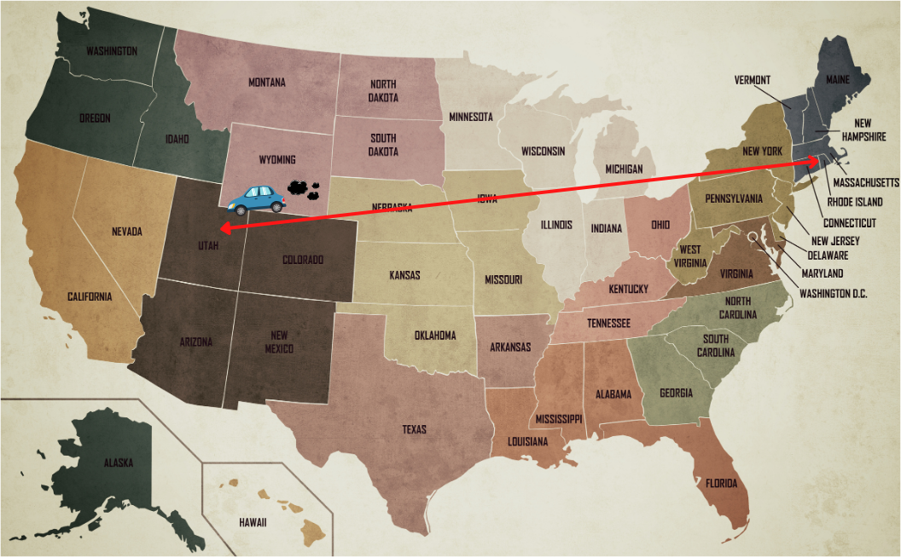
How much GHG does
animal-based foods produce?
320 cars
driving from Massachusetts to Utah
Notes:
320 tons of CO2 emissions
On average, you emit one ton of CO2 for about every 2,500 miles you drive—about the distance from Boston, Massachusetts to Salt Lake City, Utah. (https://climate.mit.edu/ask-mit/how-much-ton-carbon-dioxide)

Slide 37

How much GHG does
animal-based foods produce?
320 cars
driving from Massachusetts to Utah

Slide 38
How much GHG does
plant-based food produce?
Notes:
25 tons

Slide 39
How much GHG does
plant-based food produce?
25 cars
driving from Massachusetts to Utah
Notes:
25 tons

Slide 40
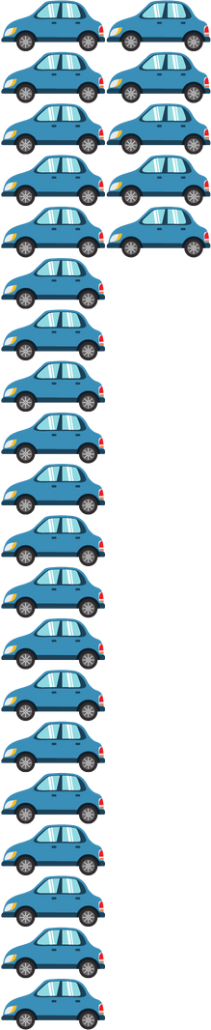
How much GHG does
plant-based food produce?
25 cars
driving from Massachusetts to Utah

Slide 41
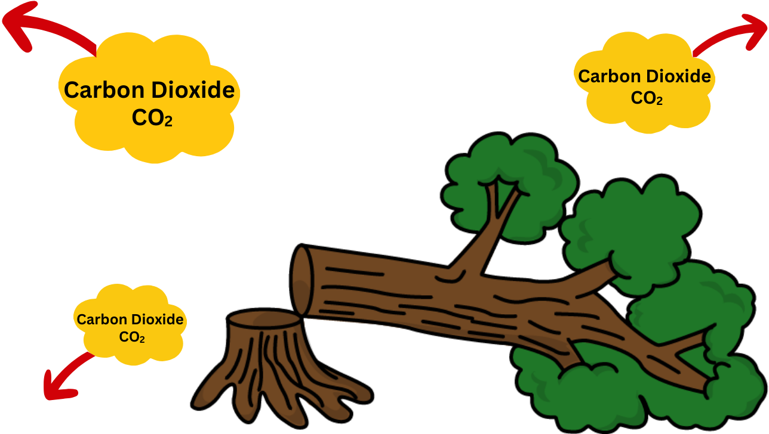
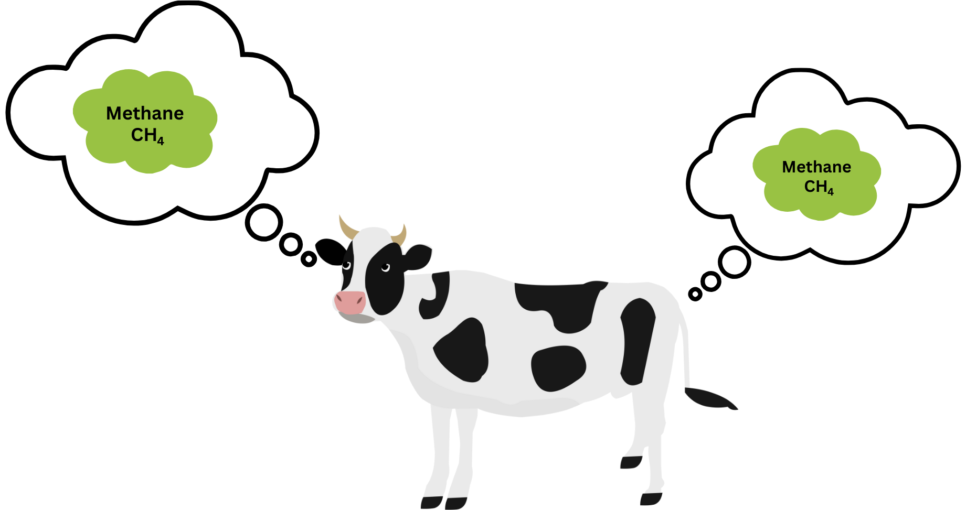
Deforestation to make room for farmland to raise animals as food for people releases greenhouse gases.
Animals, like cows and sheep, produce a lot of methane in their burps and farts.
GHG EMISSIONS
recap
Animal-based foods produce the most greenhouse gases.

Slide 42
Resources Used Based on the Eating Pattern:
GREENHOUSE GAS PRODUCTION
Which eating pattern produces the most greenhouse gases?

Slide 43
Let's play eLearning Game! Food, Water, Land and Greenhouse Gas Emissions
add new e-learning game once it's created

Slide 44
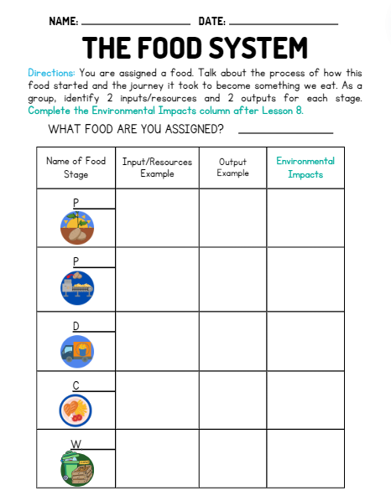
GO BACK TO YOUR LESSON FIVE HANDOUT AND COMPLETE THE ENVIRONMENTAL IMPACTS COLUMN

Slide 45
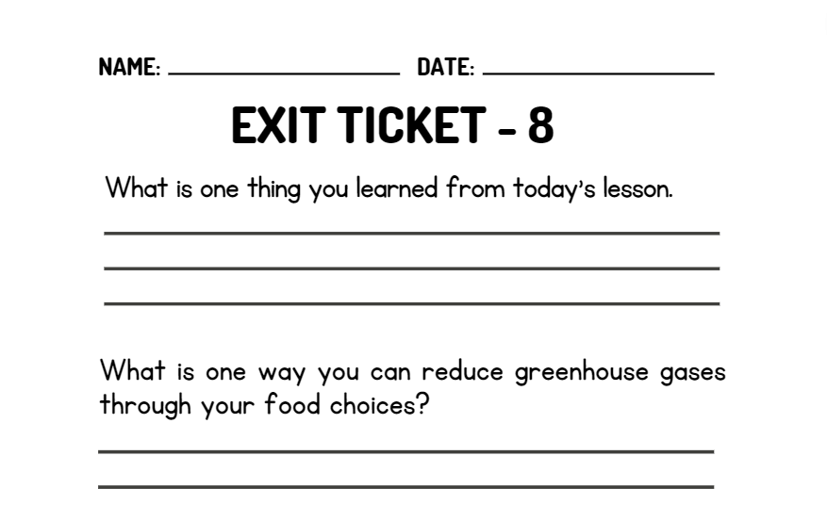
WRAP UP
On your EXIT TICKET write...
Notes:
Once the students have completed the exit ticket, collect them and make minor adjustments to the next lesson based on the data received

