Slide 1









LESSON 7
Environmental Impact of Eating Patterns
{
{
{

Slide 2


Big Ideas
&
Questions of the Day
How do the different eating patterns impact the environment?
Different eating patterns use different amounts of water and land and produce different amounts of greenhouse gases

Slide 3


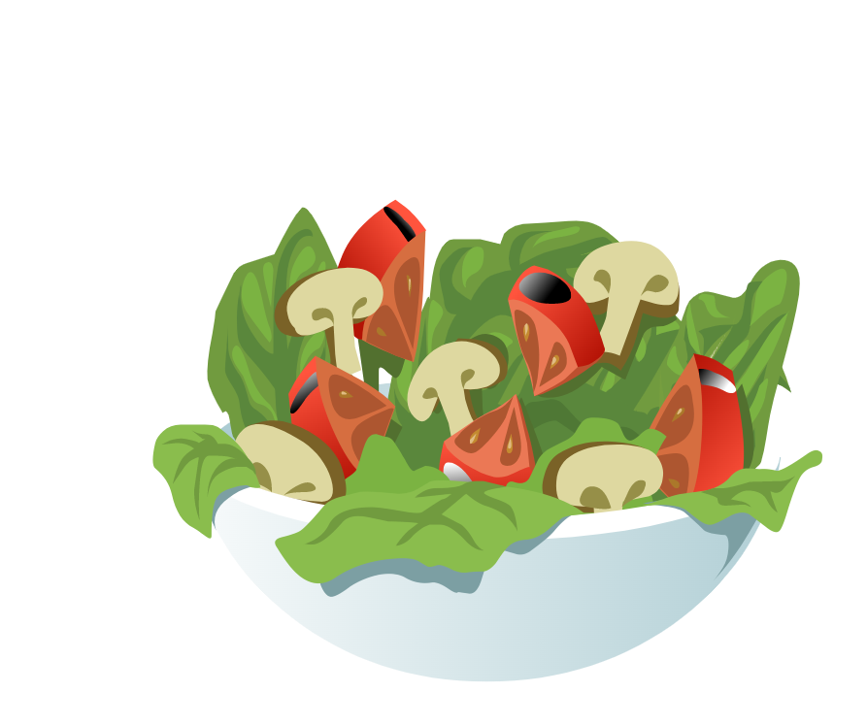
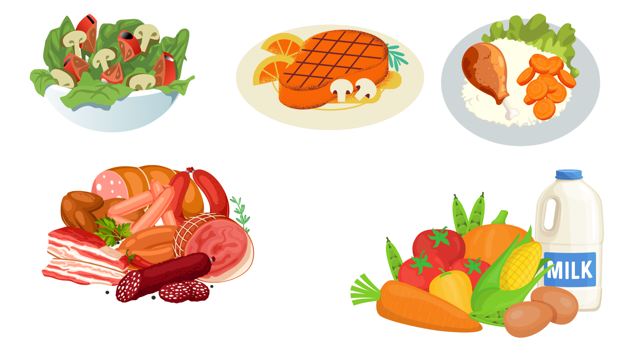
What did we learn about last class?
Different foods need different resources or inputs in the food system (some need more or less)
Eating Patterns
Can you remember the three examples that were discussed?
What types of foods are included in each eating pattern?
Recap!
Lesson 3

Slide 4
LET’S REVIEW
Eating Patterns
Animal-based
Plant Forward
Plant-based

Slide 5
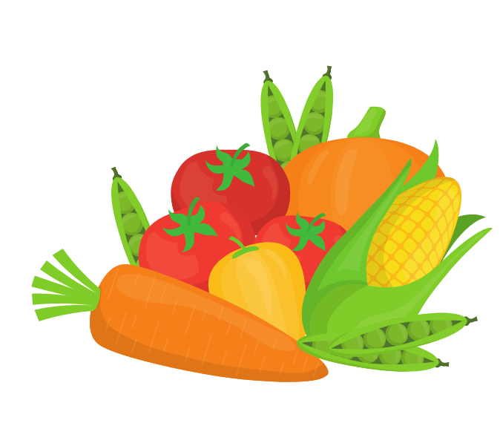
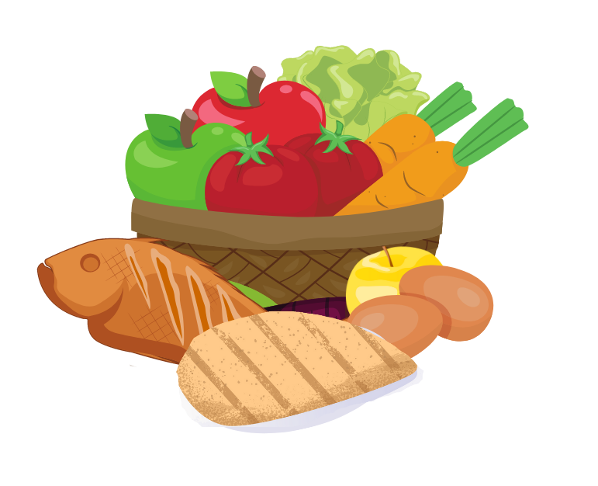
LET’S COMPARE:
Types of foods
Animal-based Foods
Plant Forward
Plant-based Foods
Includes small quantities of animal foods with
no red meat.
**Can include small amounts of fish, chicken, and eggs in every meal.
Can include red meat in every meal.
**Red meat includes cows, sheep, goats, deer, and buffalo.
Does not include animal products. More whole foods that are not processed as much.

Slide 6
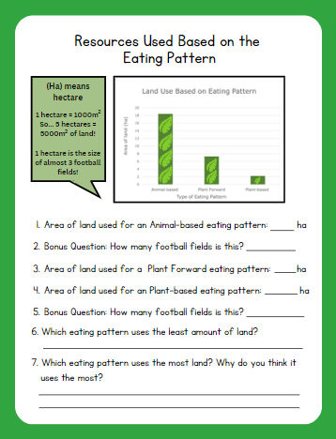
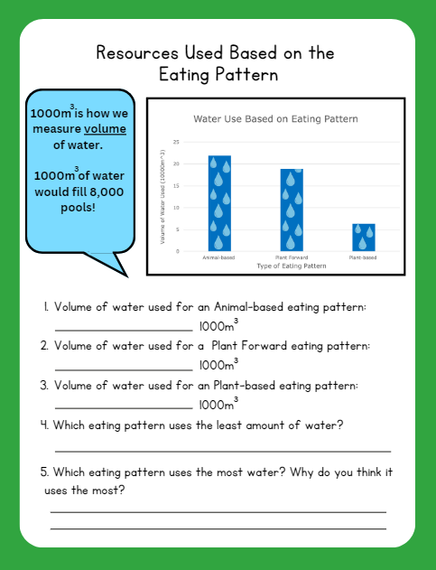
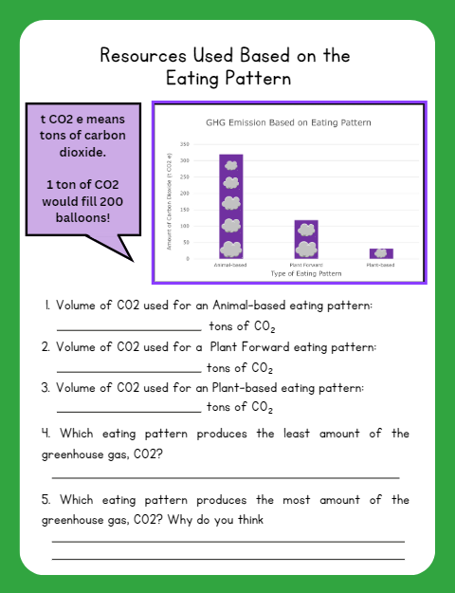

Time for an Activity!

Slide 7

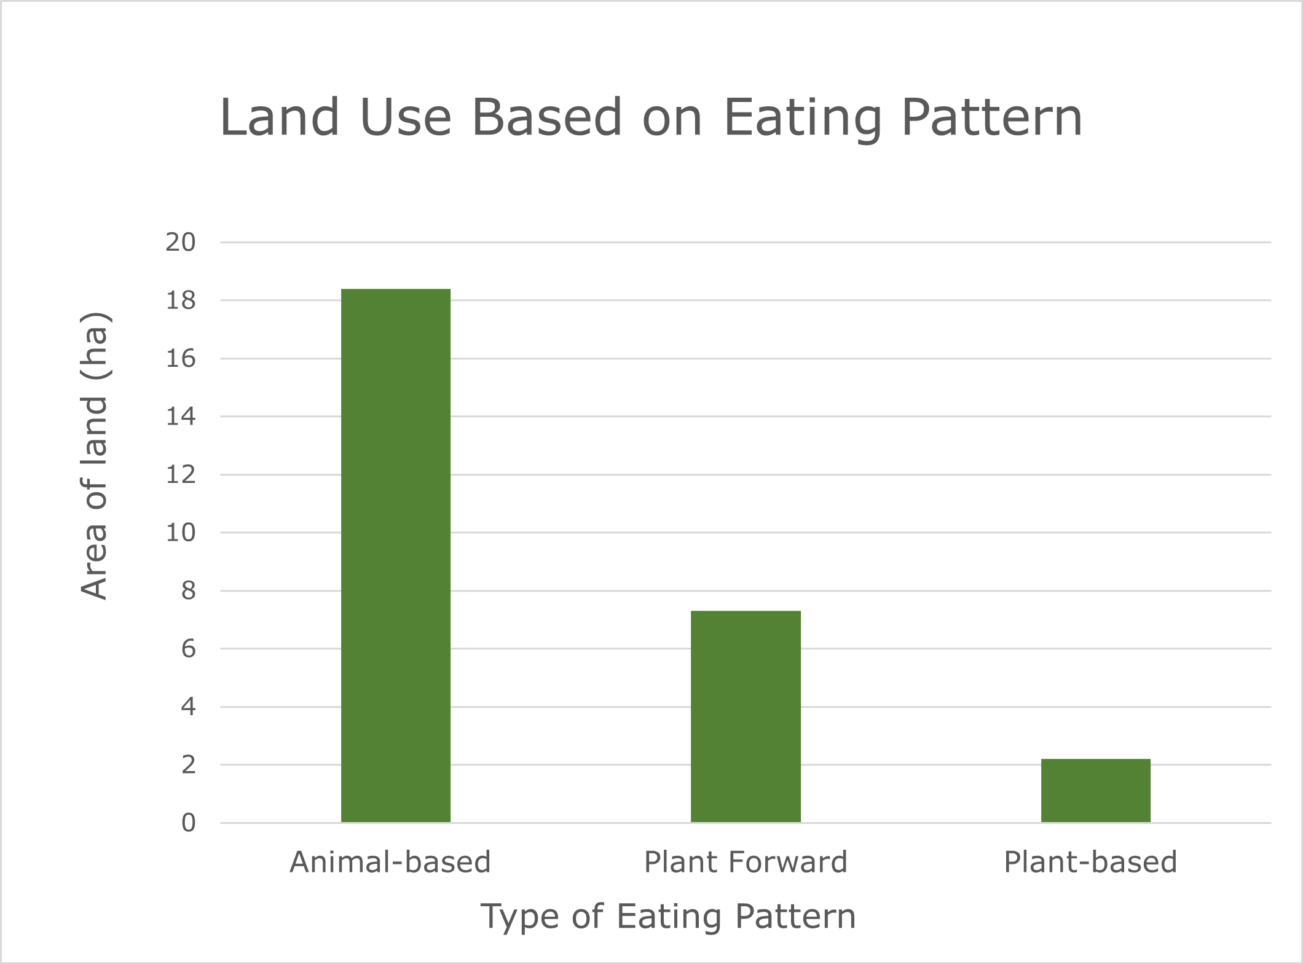

Resources Used Based on the Eating Pattern:
LAND
Which eating pattern uses the most of this resource?

Slide 8
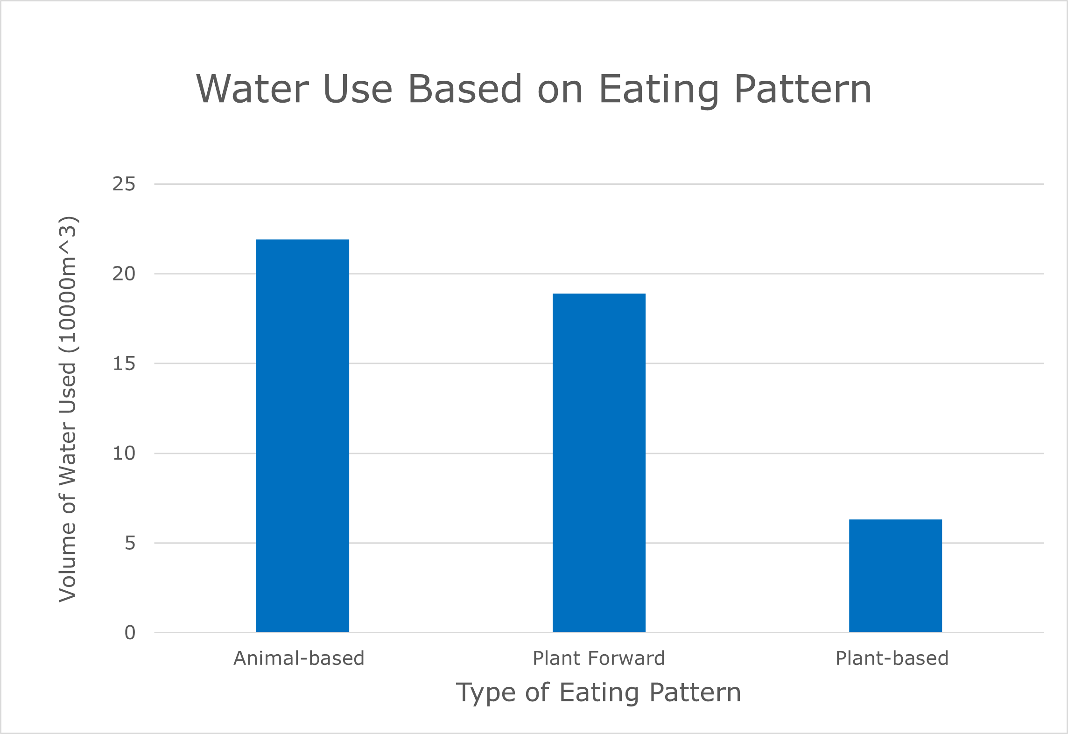

Resources Used Based on the Eating Pattern:
WATER
Which eating pattern uses the most of this resource?

Slide 9
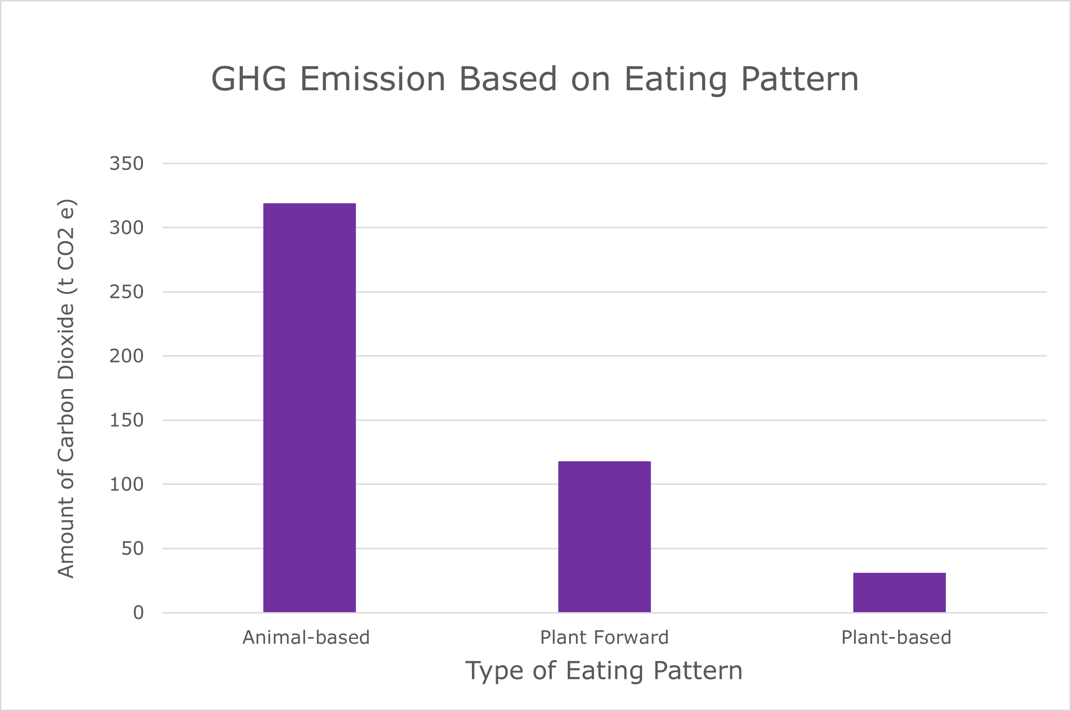

Resources Used Based on the Eating Pattern:
GREENHOUSE GAS PRODUCTION
Which eating pattern produces the most GHG’s?

Slide 10


LET’S DISCUSS

Slide 11
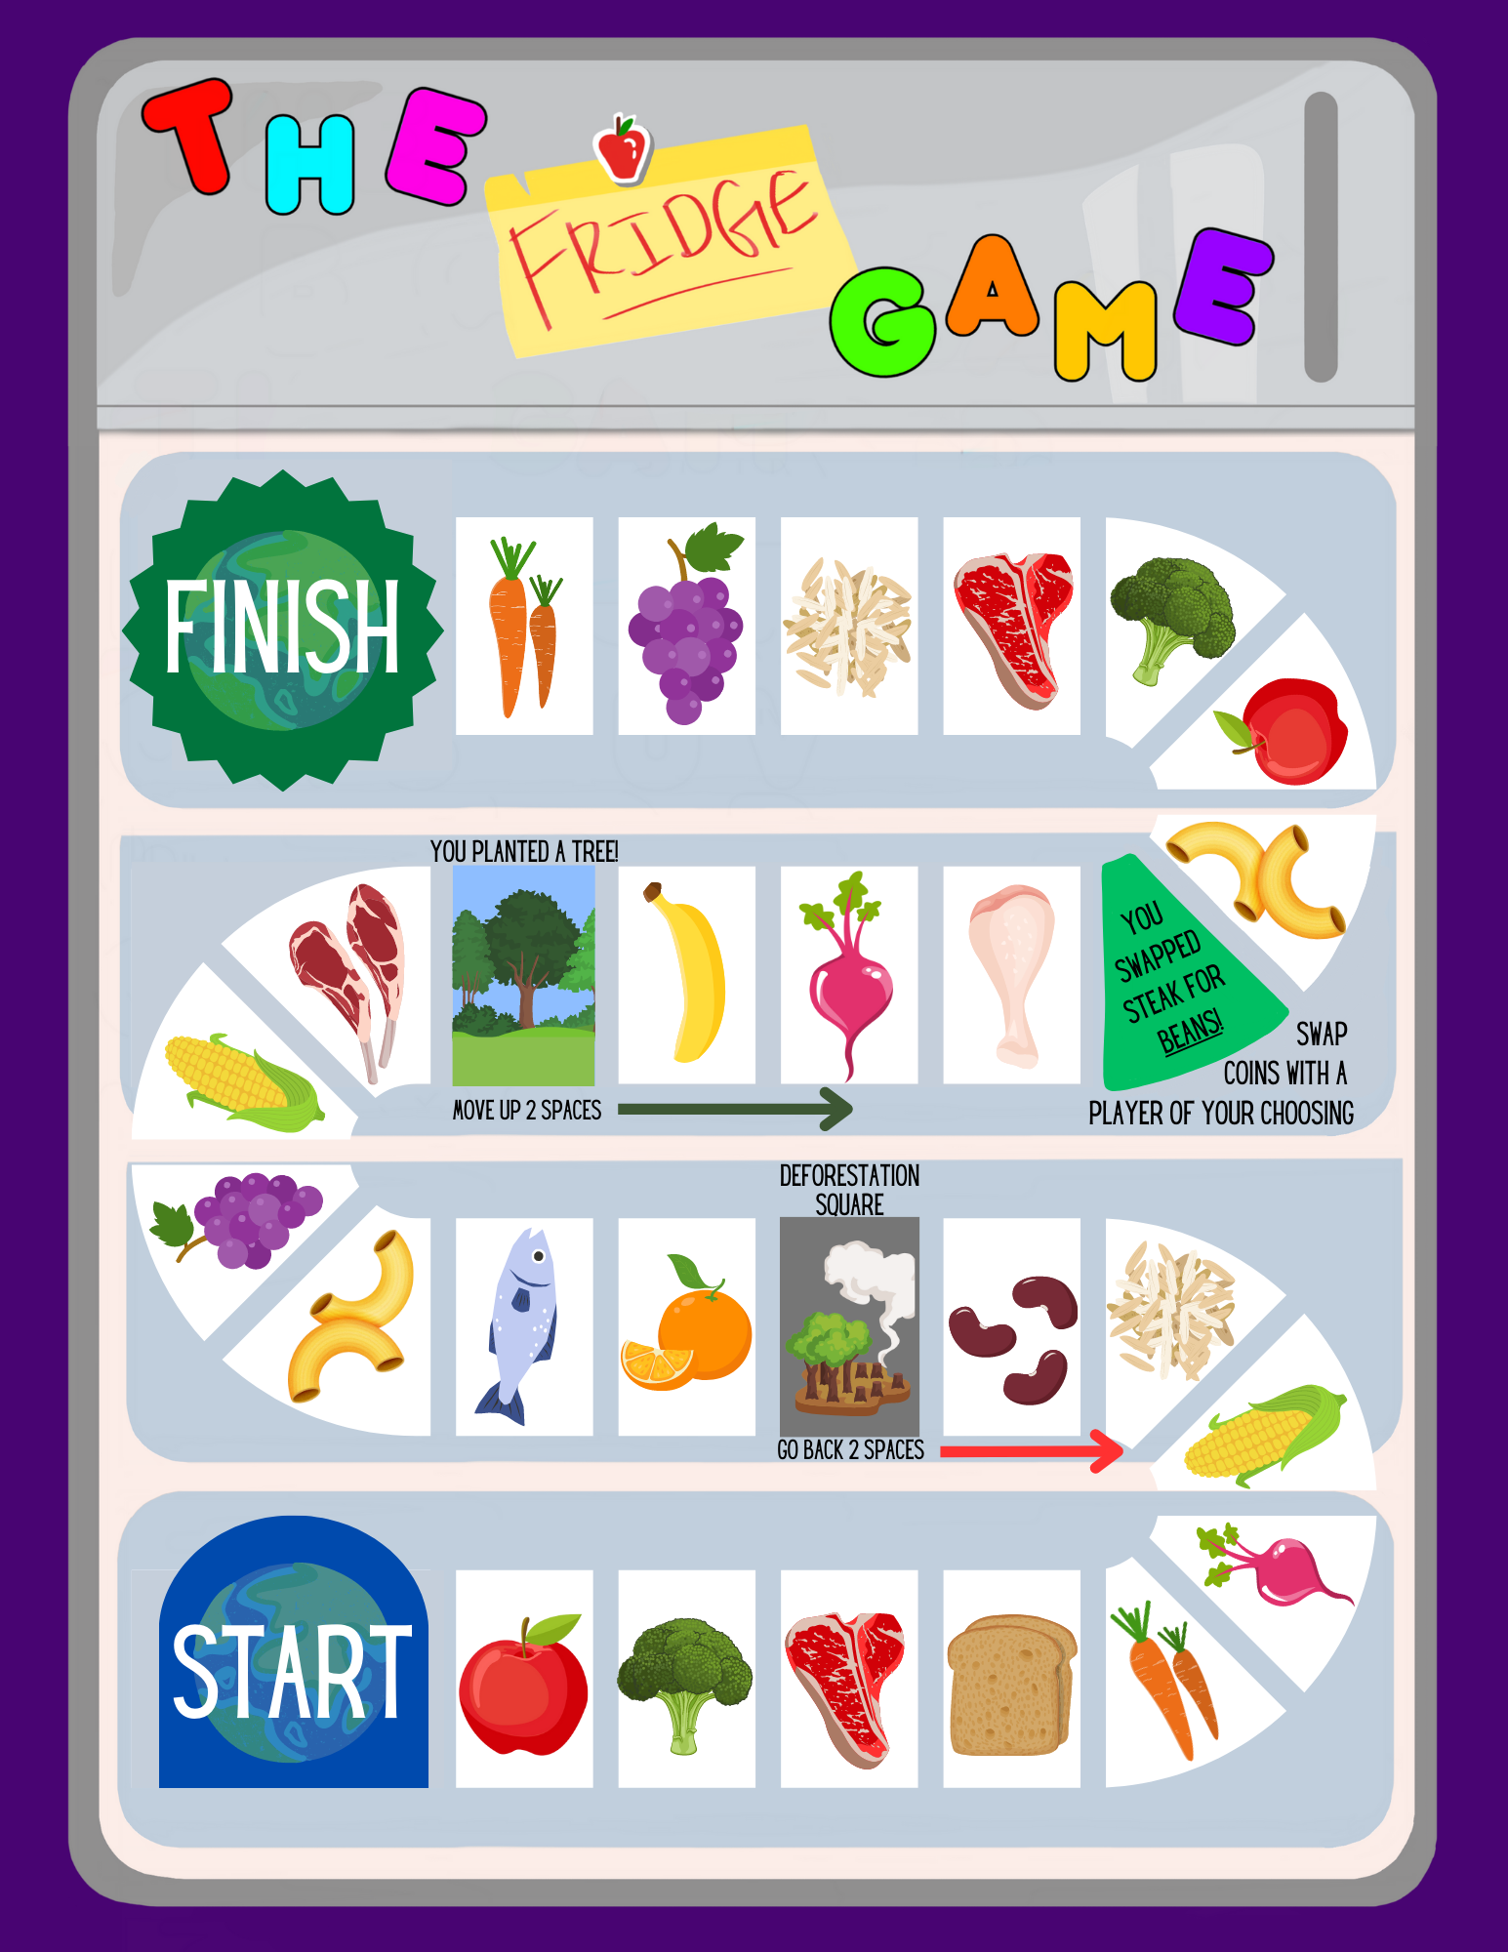

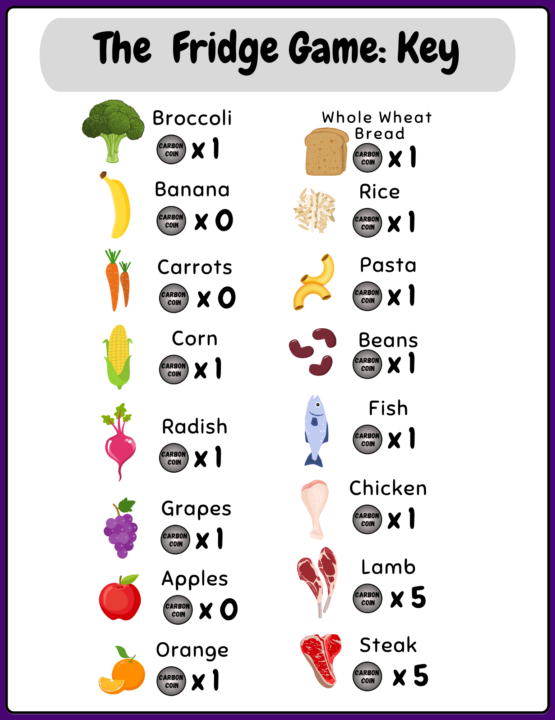





Let’s Play a Board Game!

Slide 12
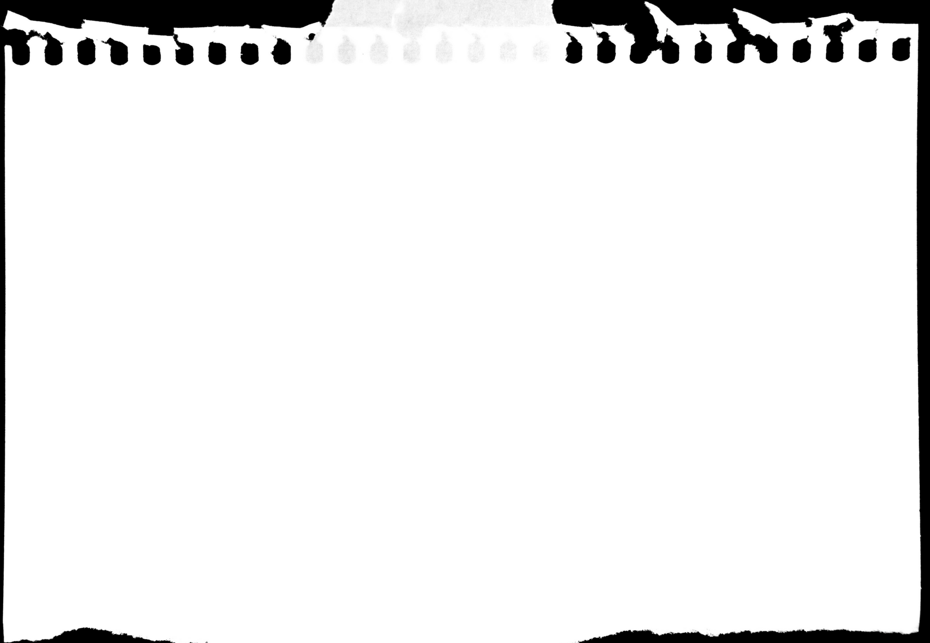
Summary
Different eating patterns use different amounts of resources or inputs like land and water
Different eating patterns also produce different amounts of outputs, specifically greenhouse gases
Eating patterns that include red meat, use up more land and water and produce more greenhouse gases
How can you reduce greenhouse gas emissions and land and water use through their food choices?

Slide 13
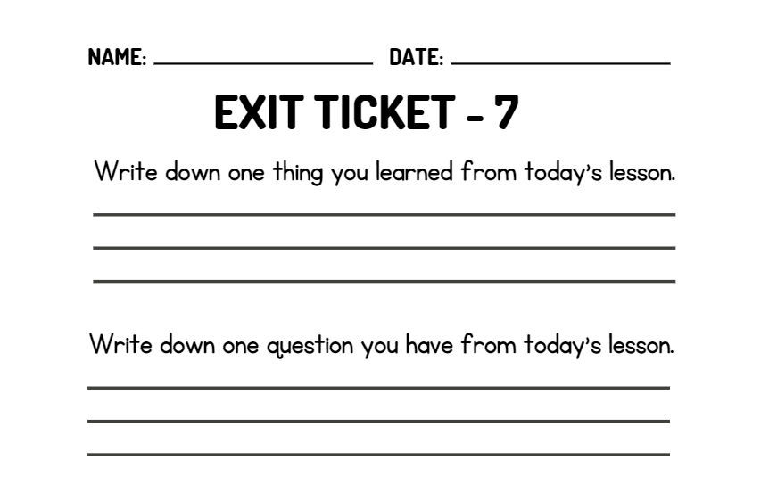
WRAP UP
On your EXIT TICKET write...
Notes:
Once the students have completed the exit ticket, collect them and make minor adjustments to the next lesson based on the data received

