Slide 1




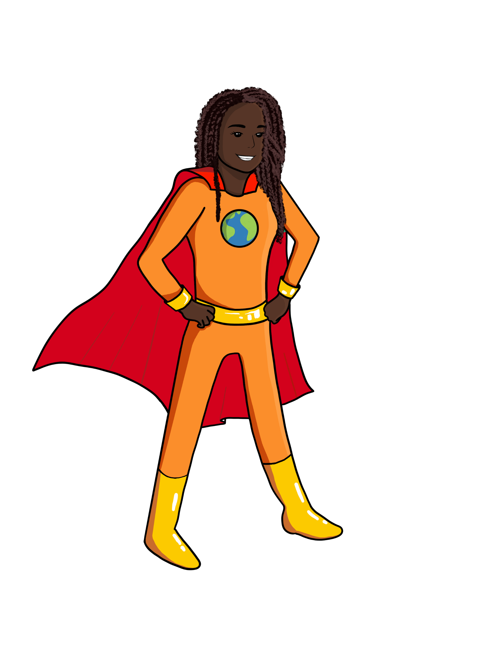




LESSON 6
Types of Eating Patterns
{
{
{

Slide 2



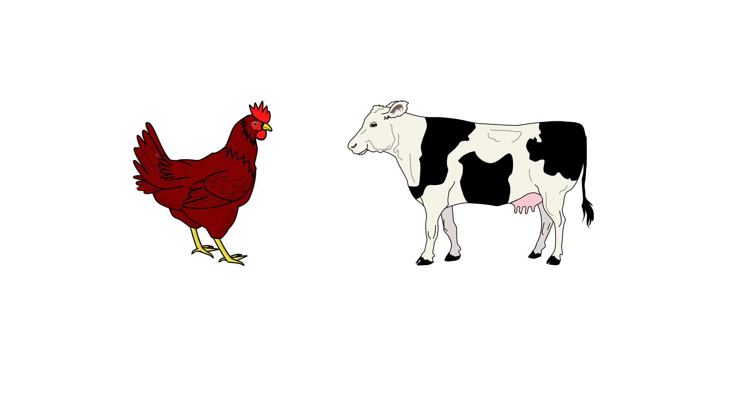

Today we will learn about…
What types of foods use more resources or inputs?
What are some types of eating patterns?
Big Ideas
&
Questions of the Day

Slide 3

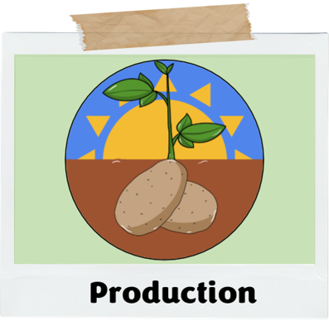
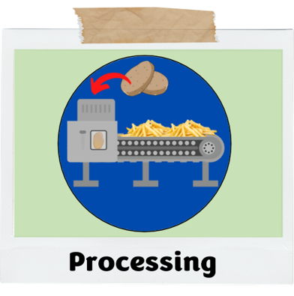
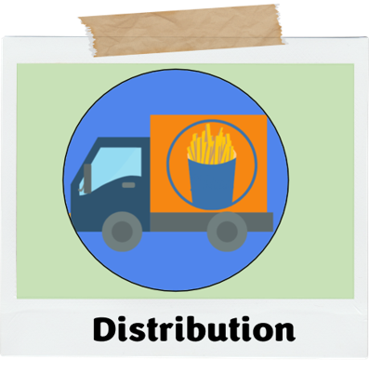
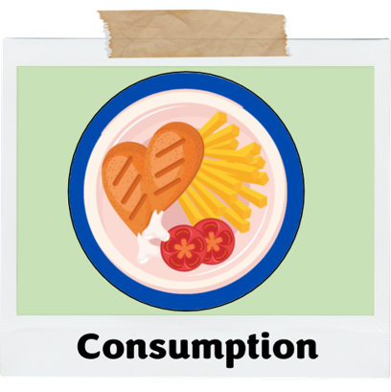
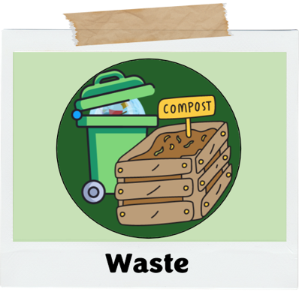
What did we learn about last class?
Food systems and how food moves through different stages to get to us
Today we will be talking about…
Different types of eating patterns
How different foods need more or less resources/inputs throughout their own food system
Recap!

Slide 4
RESOURCES / INPUTS
For Types of Foods
LET’S DISCUSS
Do you think an apple and a cow need the same resources or inputs?

Slide 5

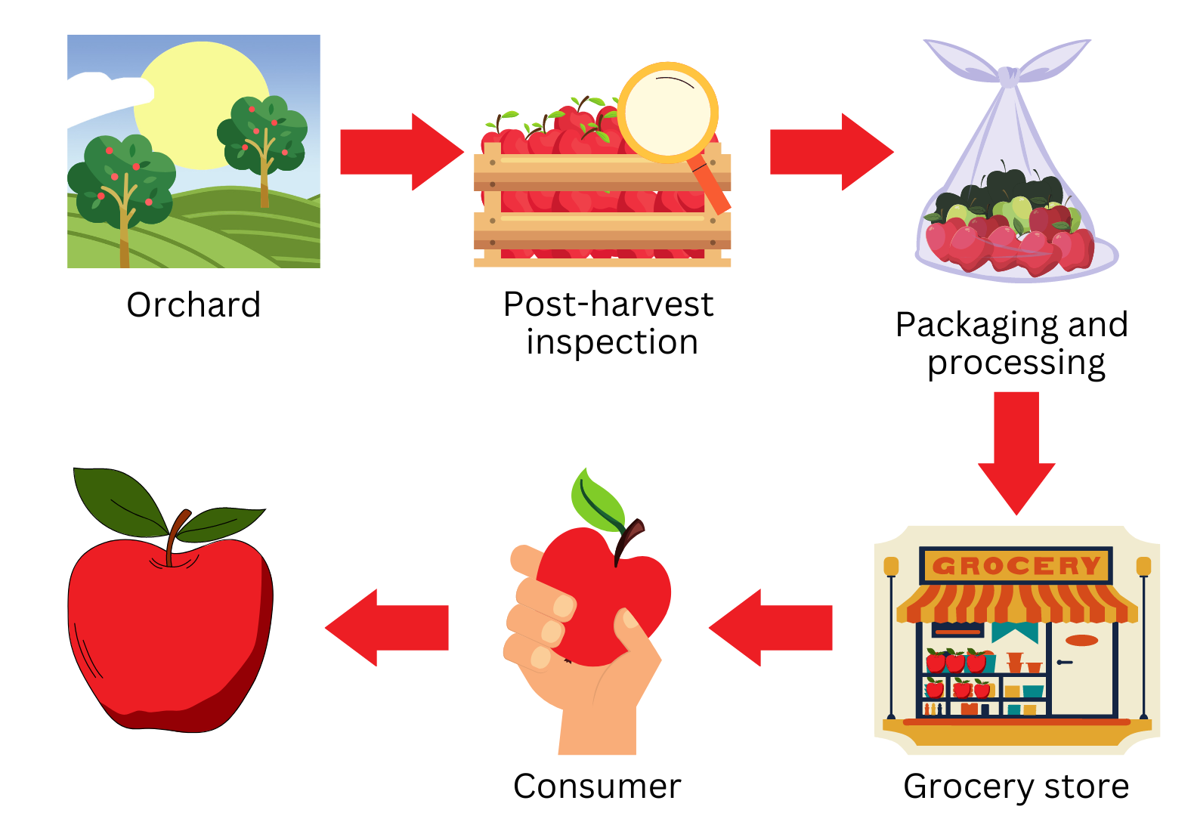
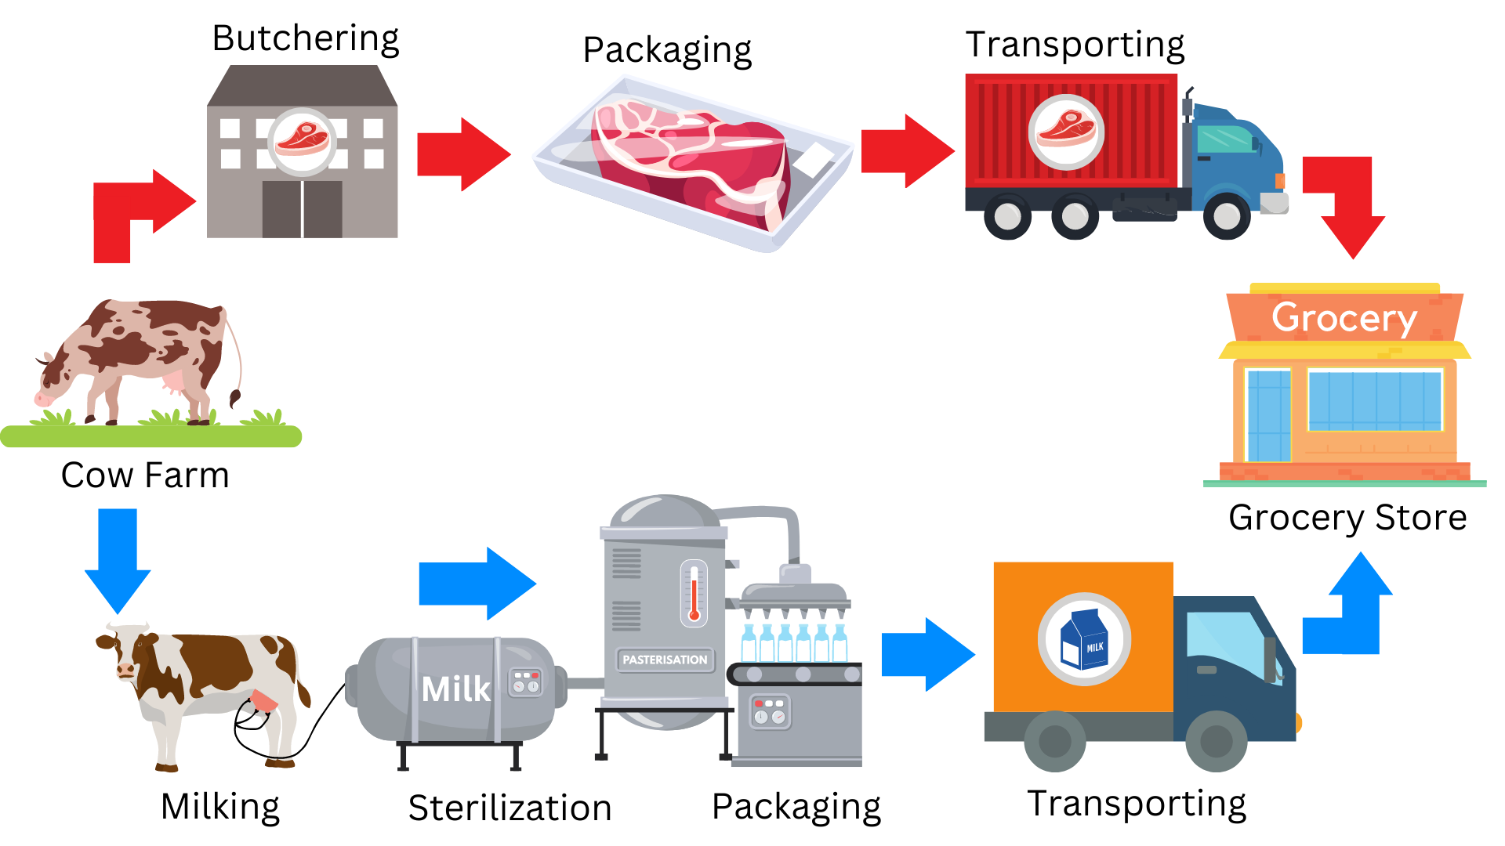
RESOURCES / INPUTS
For Types of Foods
Apple Food System
Meat/Dairy Food System

Slide 6

NOW LET’S TALK ABOUT
Eating Patterns
Notes:
Refer to handout

Slide 7
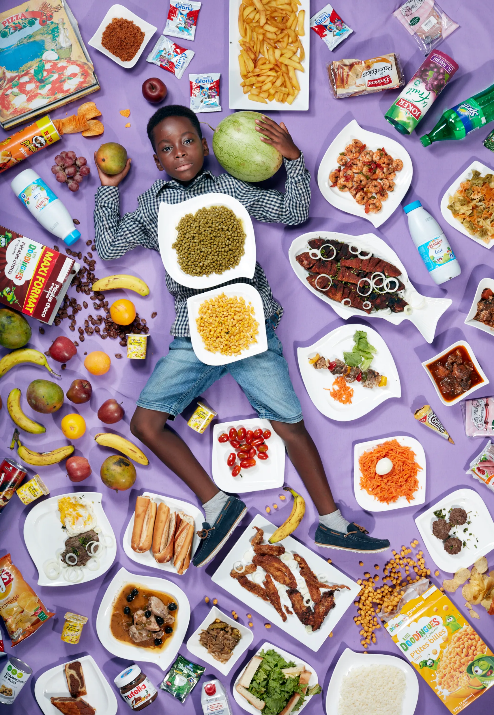
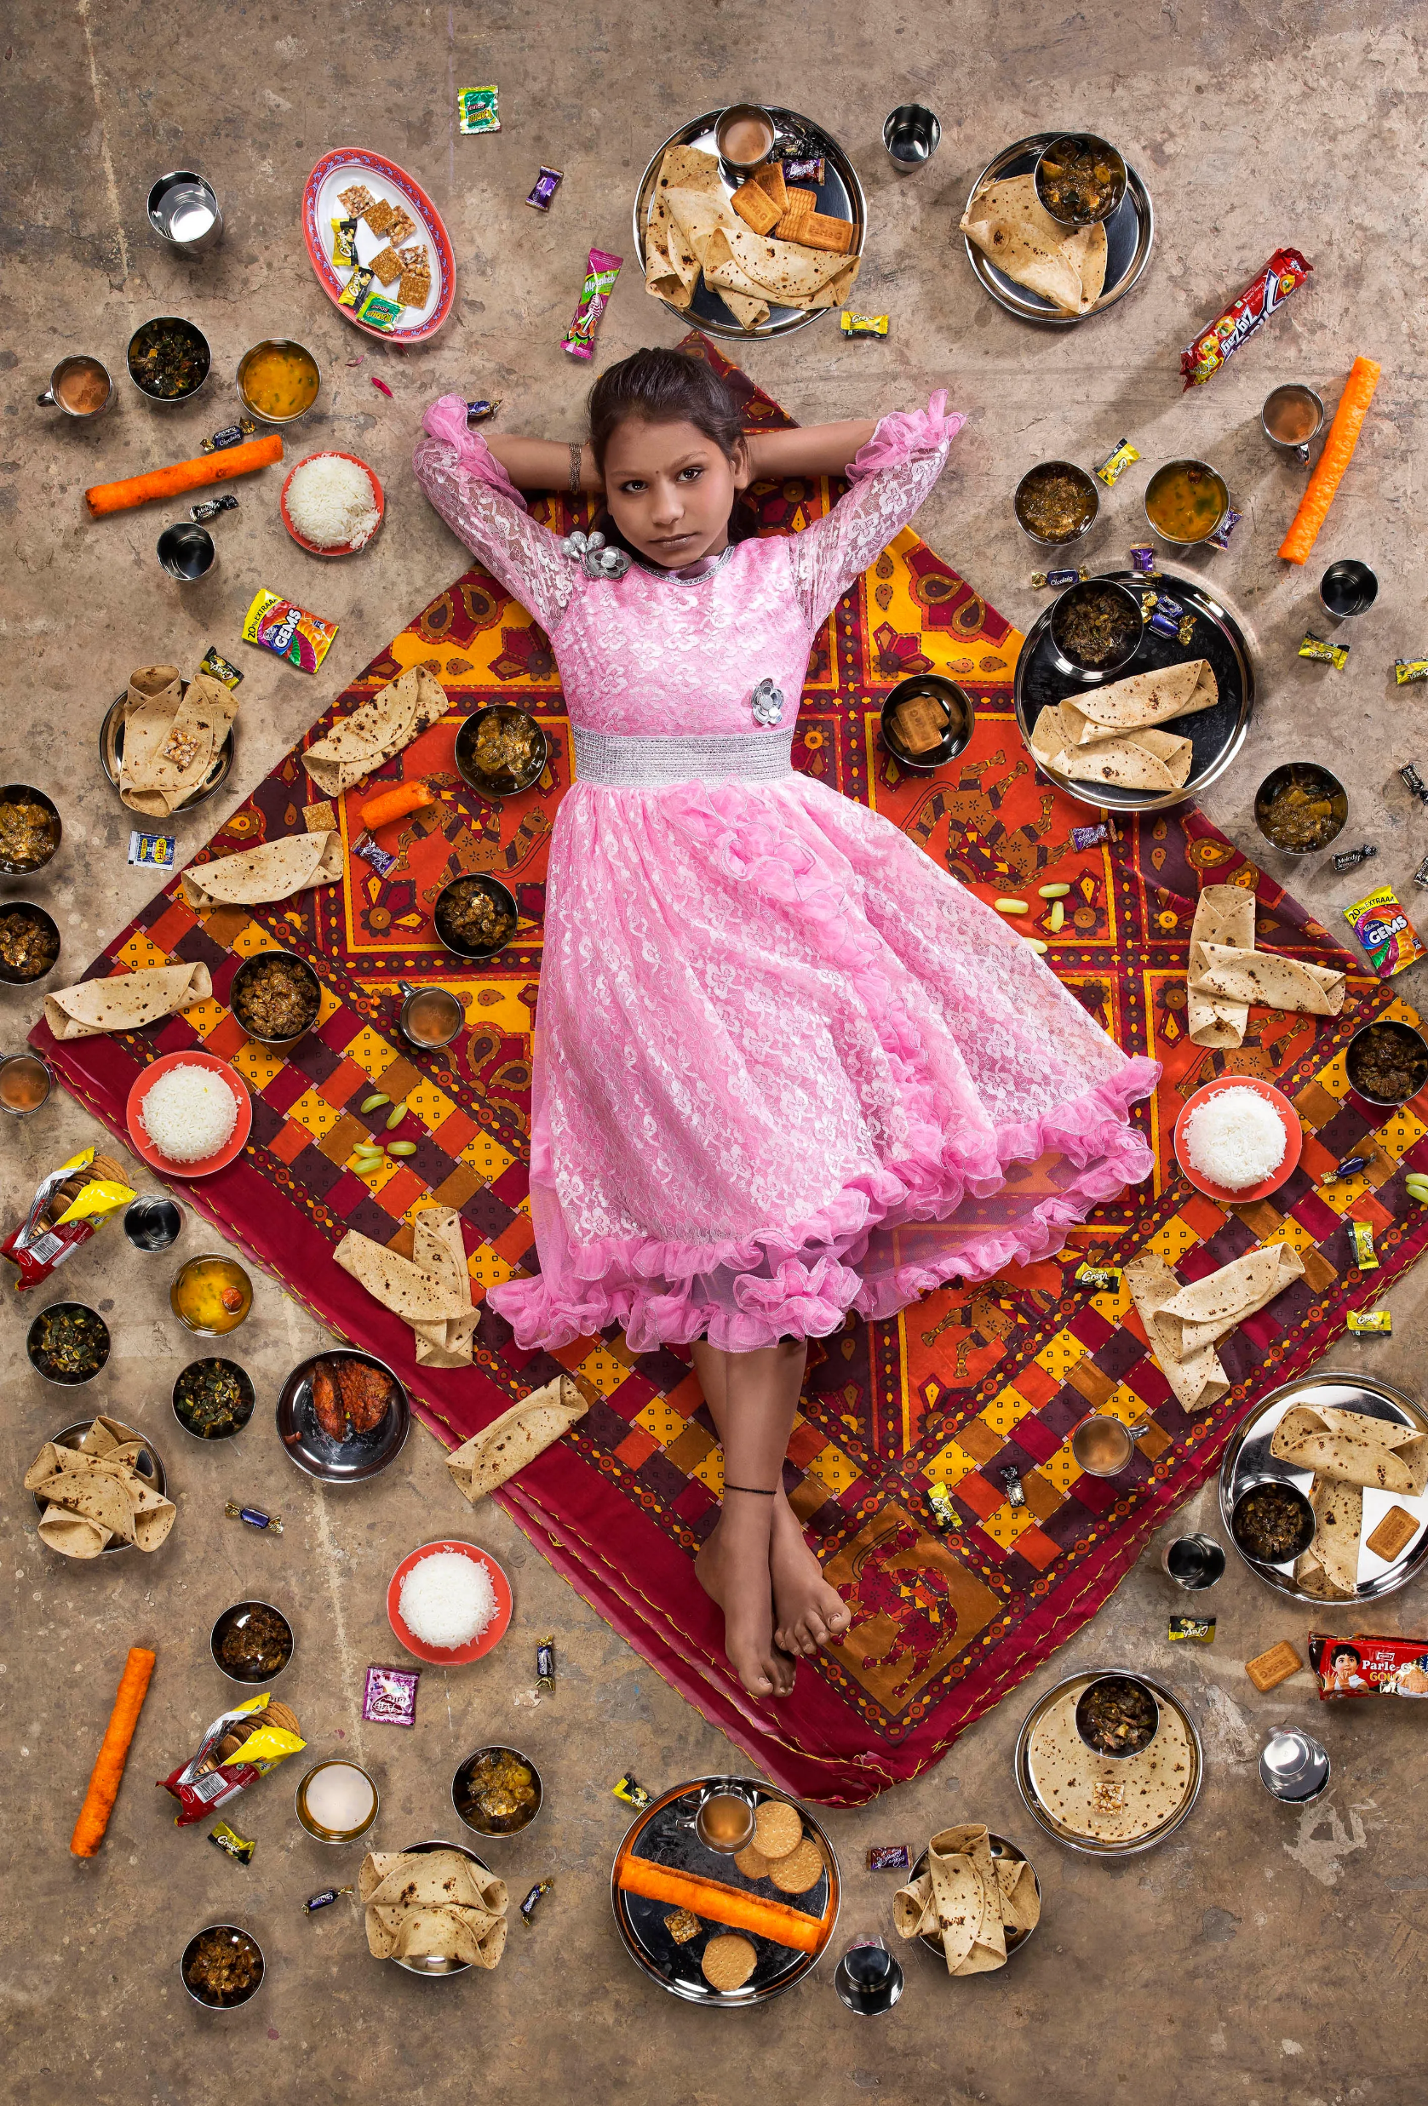
LESSON 6
PHENOMENON
What Kids Eat Around the World
NOTICE & WONDER
India
West Africa
Notes:
Left – Mumbai, India
Right – Senegal, West Africa

Slide 8
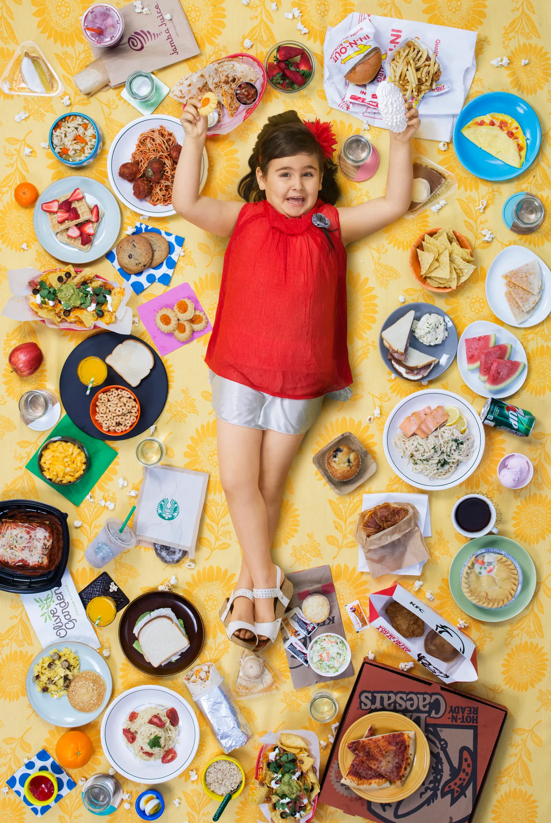
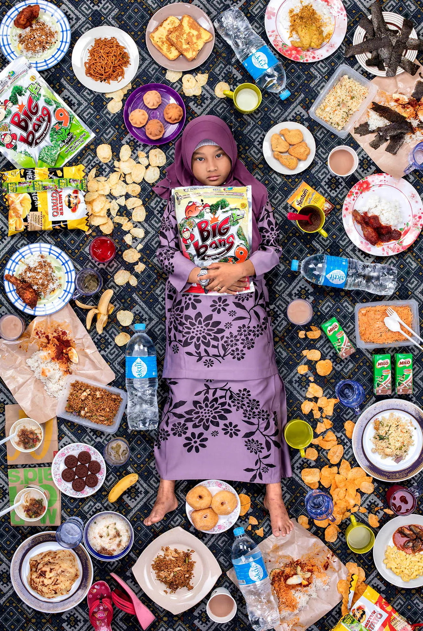
LESSON 6
PHENOMENON
What Kids Eat Around the World
NOTICE & WONDER
United States
Malaysia
Notes:
Left – California, US
Right - Kuala Lumpur, Malaysia

Slide 9
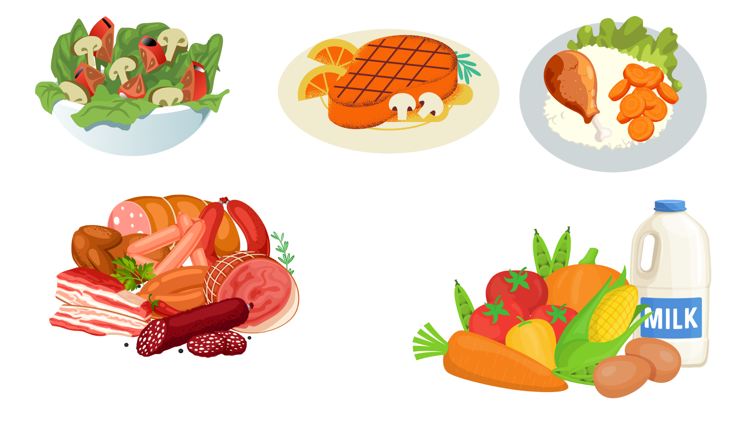
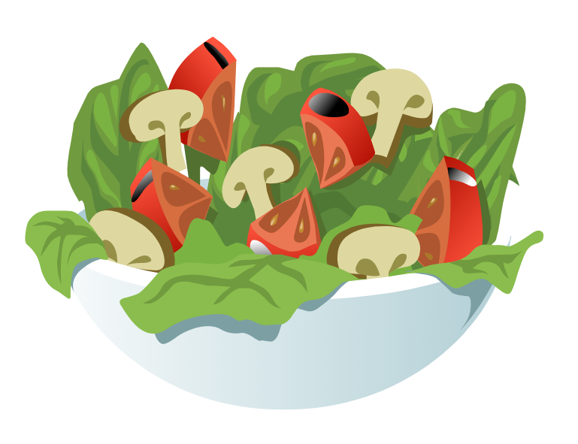
NOW LET’S TALK ABOUT
Eating Patterns
Animal-based
Plant Forward
Plant-based

Slide 10
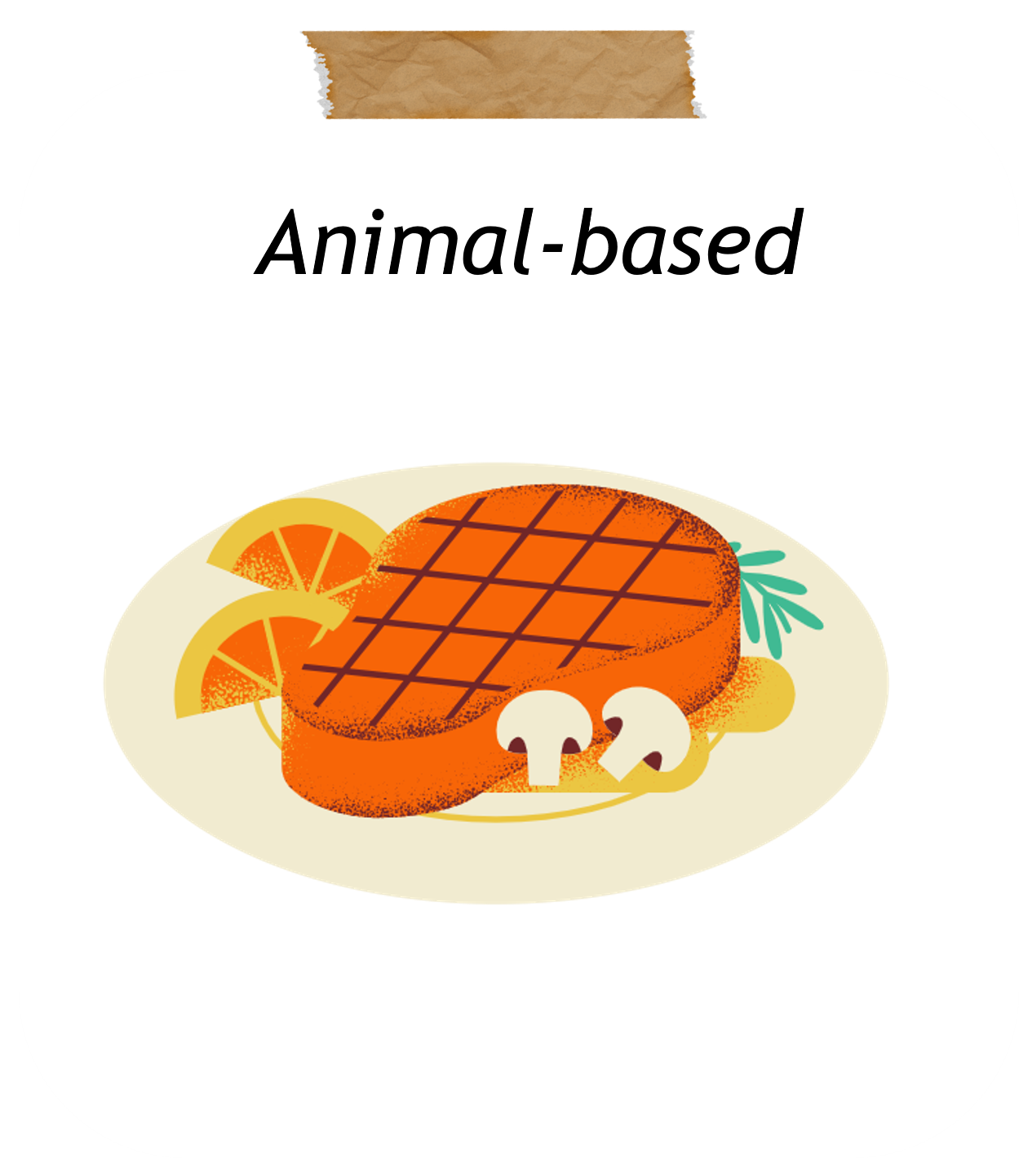
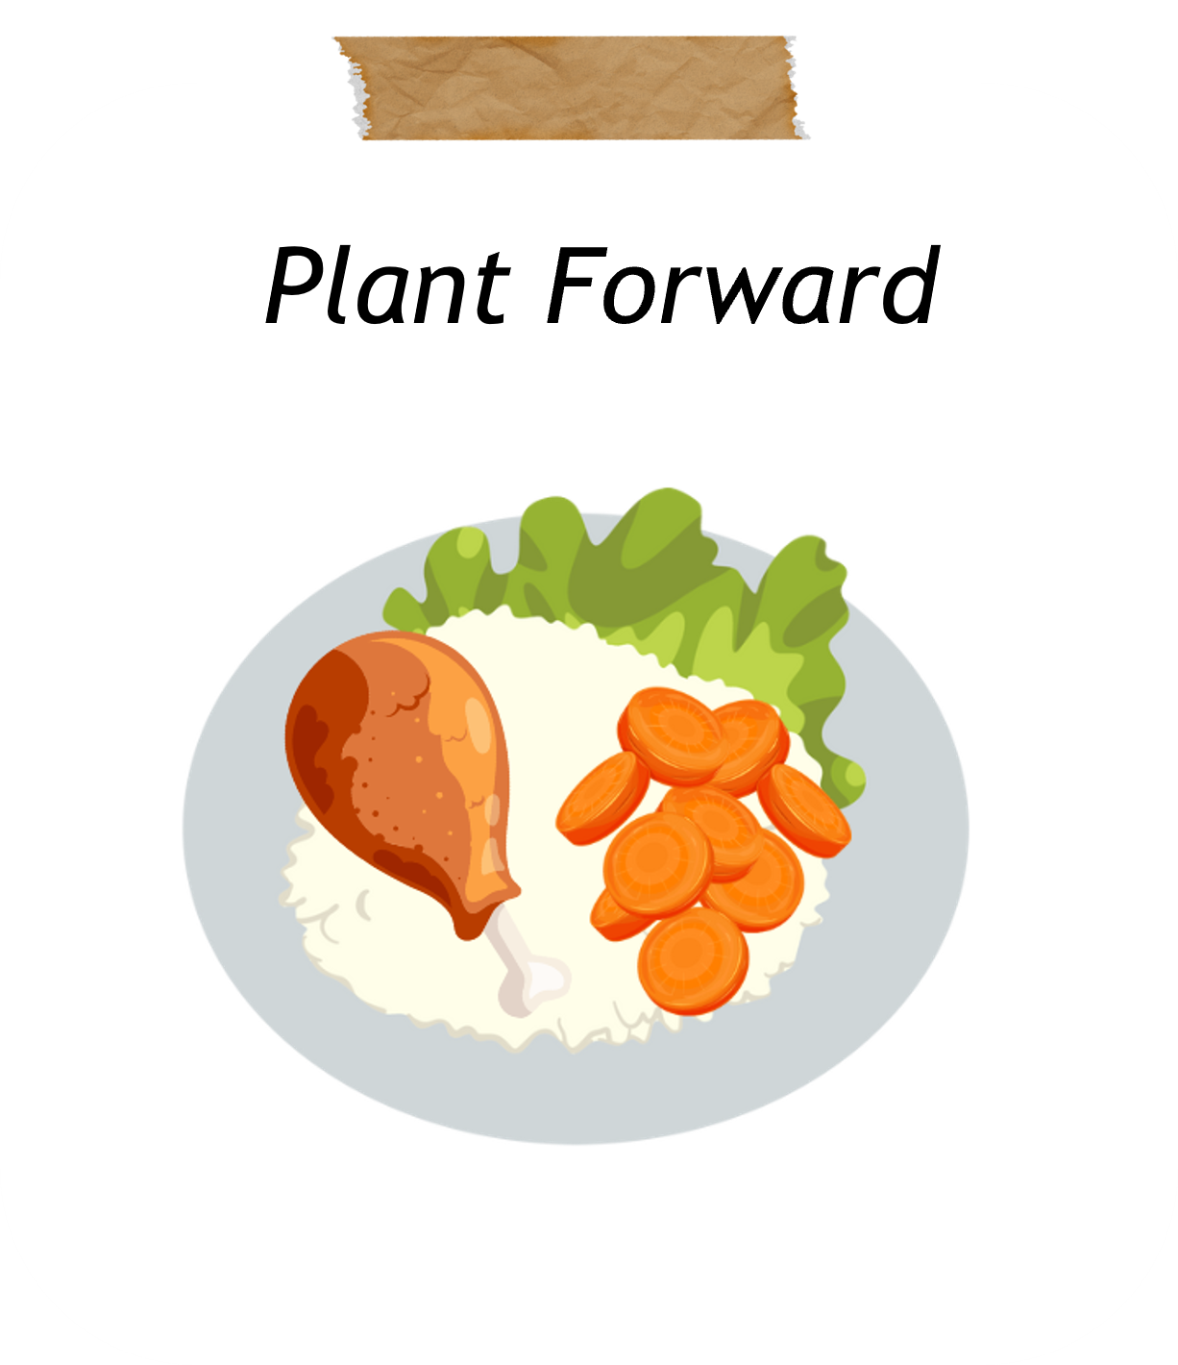
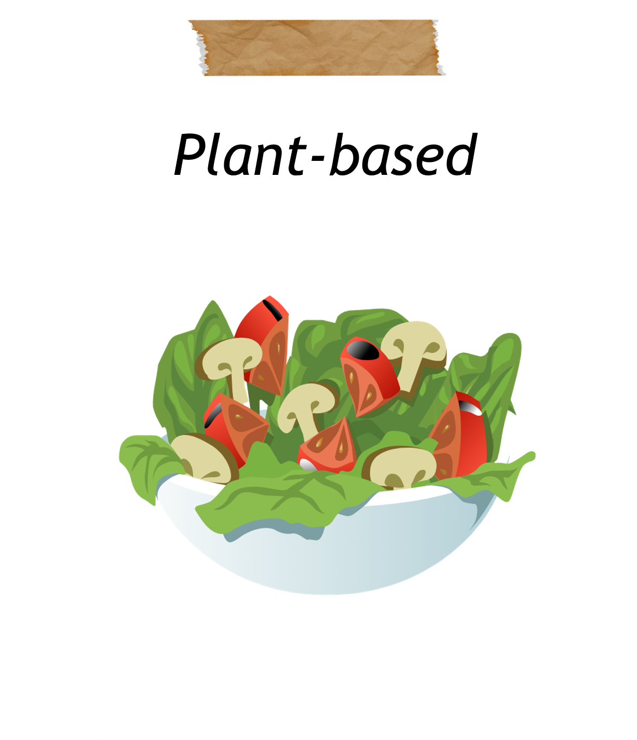
LET’S TALK ABOUT
What foods go in each?
What are some examples of animal-based foods?
What about plant-based foods?
Would lasagna be a plant-based food or an animal-based food?
What is an example of plant forward meal?

Slide 11
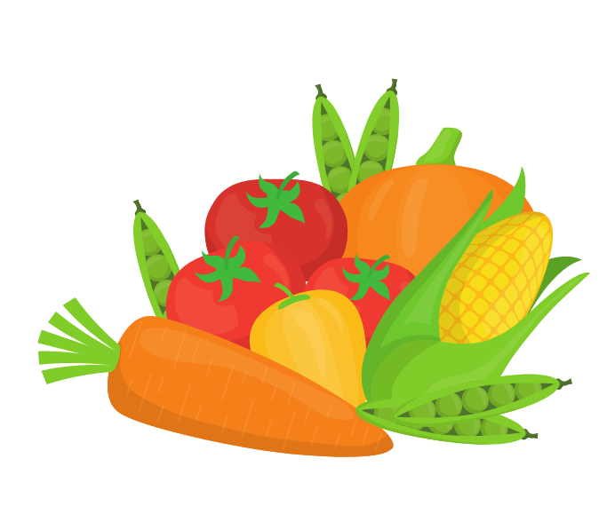
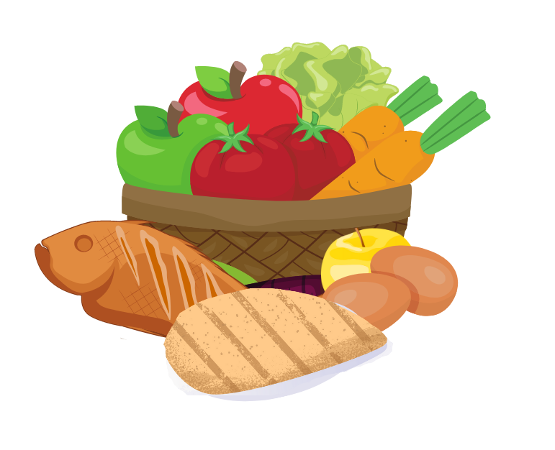
LET’S COMPARE:
Types of foods
Animal-based Foods
Plant Forward
Plant-based Foods
Includes small quantities of animal foods with
no red meat.
**Can include small amounts of fish, chicken, and eggs in every meal.
Can include red meat in every meal.
**Red meat includes cows, sheep, goats, deer, and buffalo.
Does not include animal products. More whole foods that are not processed as much.

Slide 12
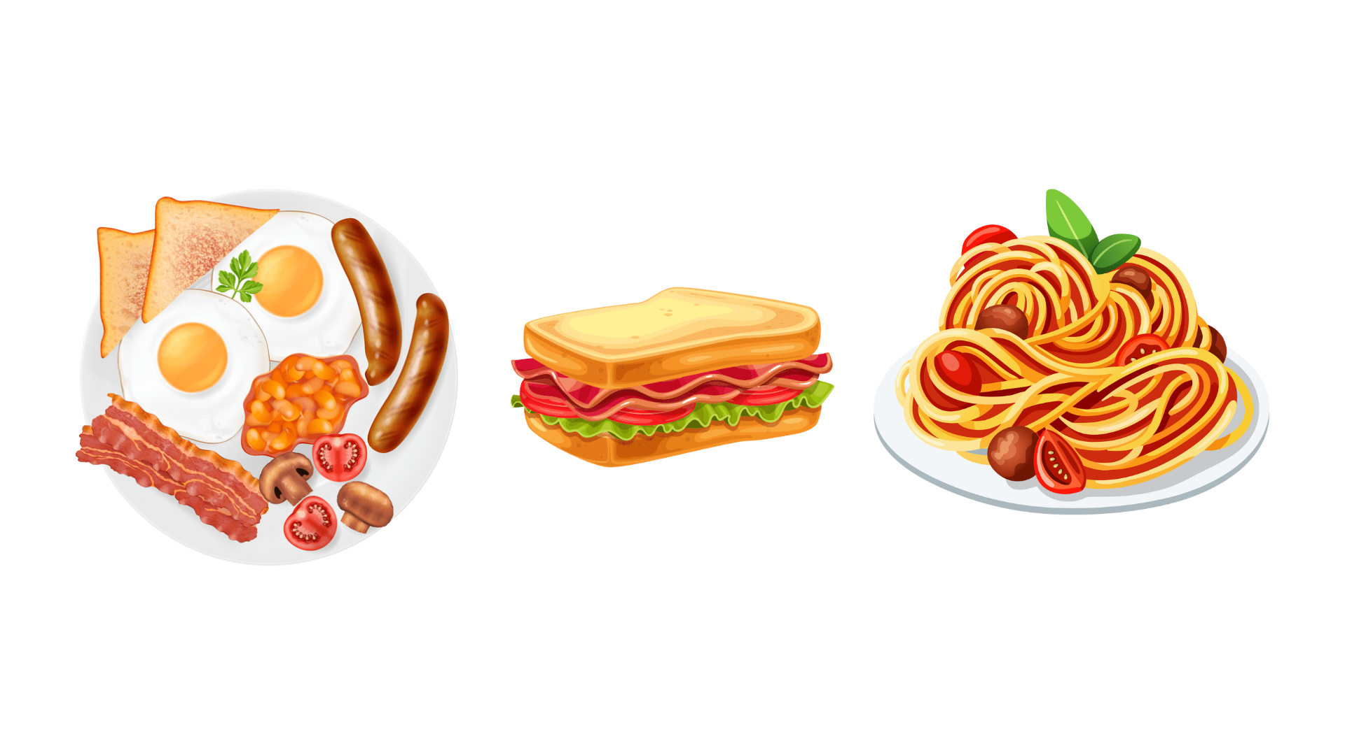
LET’S COMPARE
Eating Patterns
Let’s make an Animal-Based
Breakfast Lunch and Dinner
Animal-based
Can include red meat in every meal.
**Red meat includes cows, sheep, goats, deer, and buffalo.

Slide 13
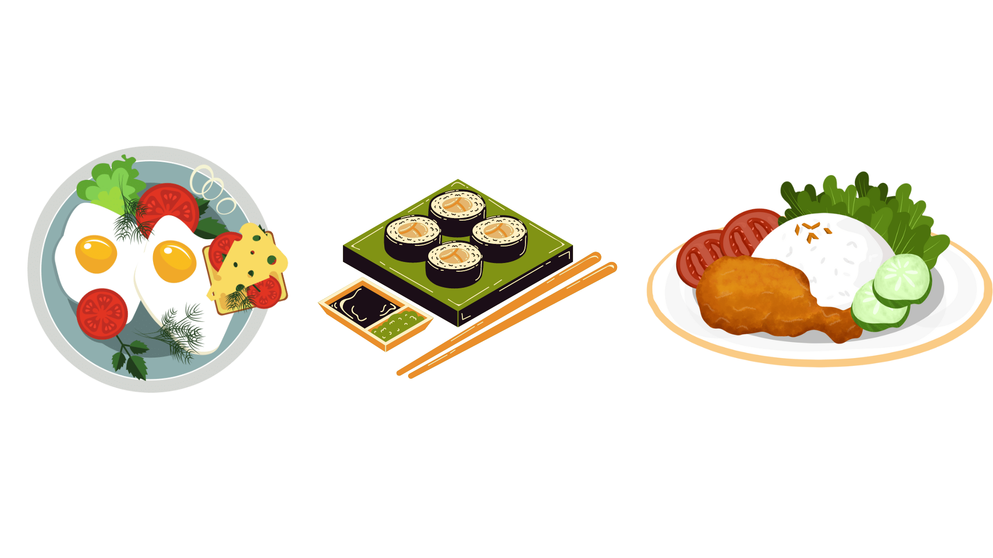
LET’S COMPARE
Eating Patterns
Let’s make a Plant Forward
Breakfast Lunch and Dinner
Plant Forward
Includes small quantities of animal foods with no red meat.
**Can include small amounts of fish, chicken, and eggs in every meal.

Slide 14
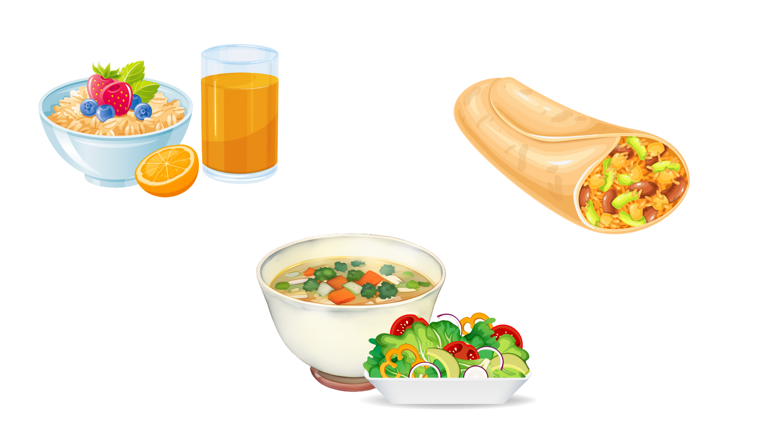
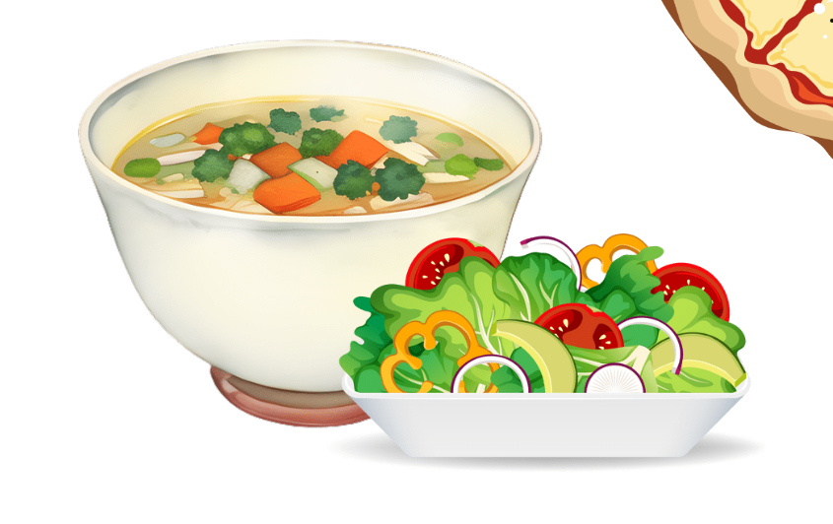
LET’S COMPARE
Eating Patterns
Let’s make a Plant-Based
Breakfast Lunch and Dinner
Plant-based
Does not include animal products. More whole foods that are not processed as much.

Slide 15
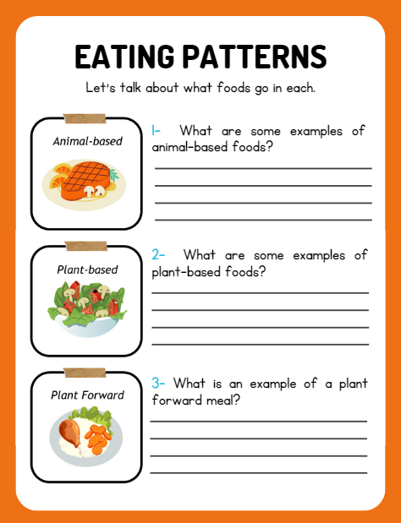

LET’S TALK ABOUT
What foods go in each?
Share your thoughts!

Slide 16

LET’S PLAY A GAME!
Pin the Meal on the Plate
Notes:
In small groups, student play the card came from Lesson Two again, this time using the brown cards "Food Waste Cards" also.
Instructions on next slide.

Slide 17
Let’s Summarize
Some foods use more resources or inputs for their food system compared to others (ex. Cow vs apple)
Three examples of eating patterns are:
Animal-Based
Plant Forward
Plant-Based
Next time we will learn about…
how these eating patterns relate to the environment

Slide 18
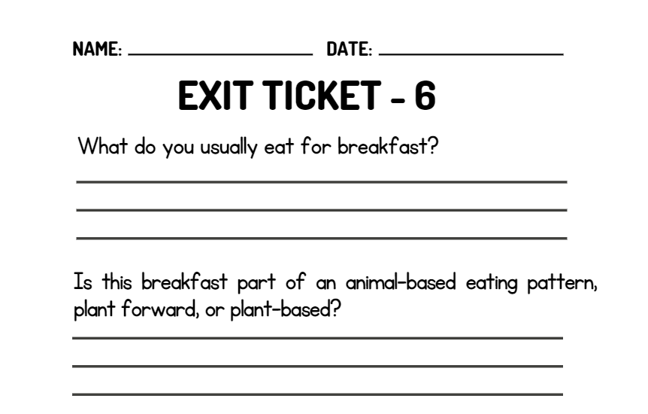
WRAP UP
On your EXIT TICKET write...
Notes:
Once the students have completed the exit ticket, collect them and make minor adjustments to the next lesson based on the data received

