Slide 1




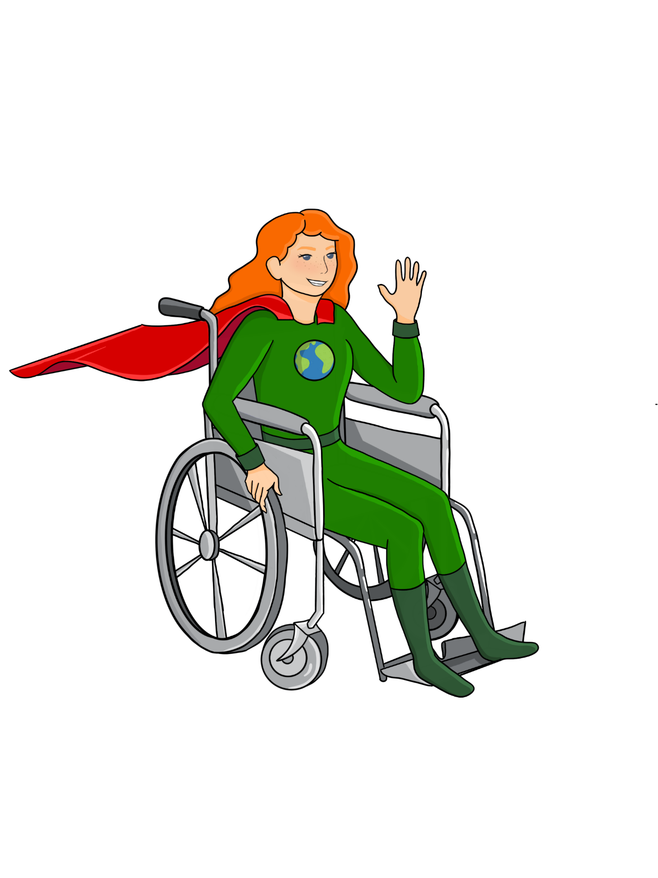




LESSON 5
Food Systems, Resources, and Outputs
{
{
{

Slide 2


Food systems are all the processes that are involved in bringing food to our plates.
Harmful outputs like pollution, and greenhouse gases can be reduced when we make better choices. We’ll learn more about this next time.
People can reduce the use of energy and resources in food systems through their food choices.
Big Ideas
&
Questions of the Day

Slide 3

Phenomenon
Let's Discuss
What are resources/inputs? What resources/inputs are provided by Nature/the Earth's Natural Systems?
Create a definition of what resources means
Think about the last food item you had today... What resources/inputs were used to make that food and get it to you?

Slide 4
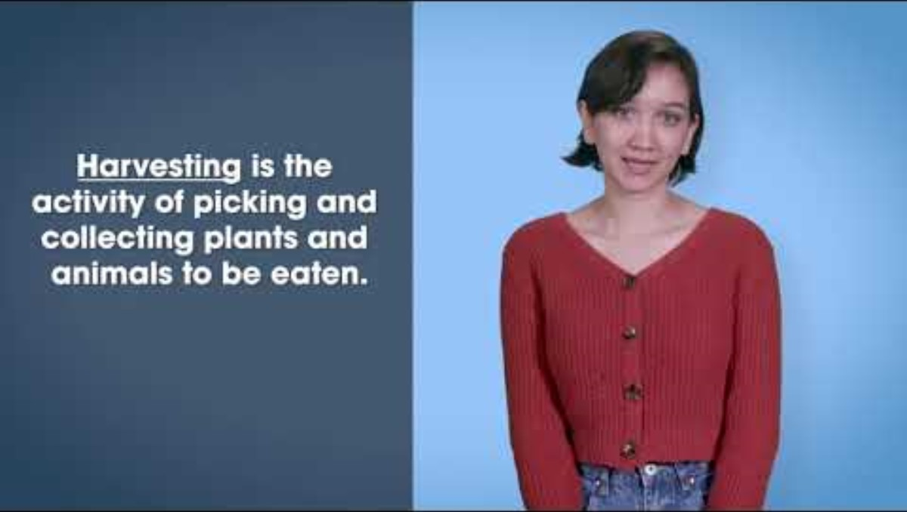
Video Lesson Getting to Know the Food System
https://www.youtube.com/watch?v=HIYTPPsjdA4&list=PLKx8NLAujm_nCPmzHM3eUKiaqMvaH55Zw&index=2

Slide 5
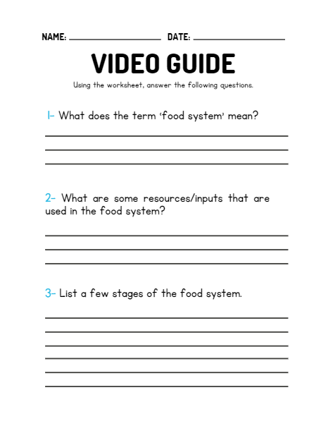

Video Recap

Slide 6
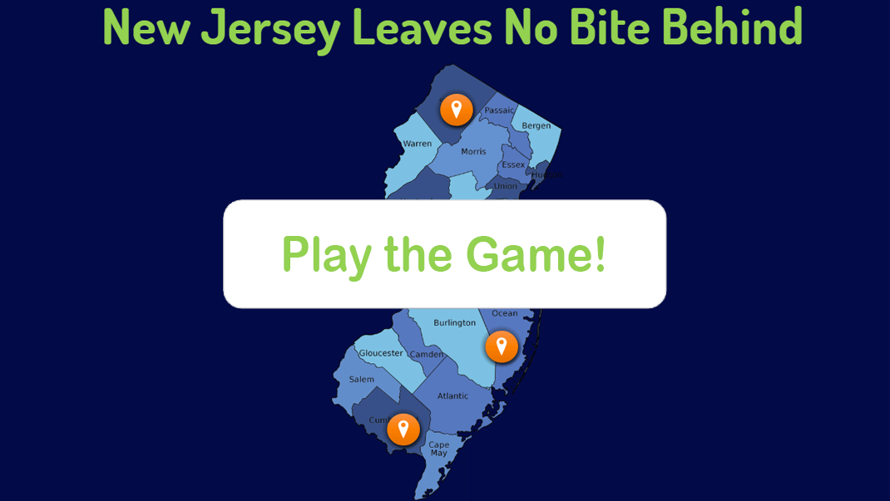
Let's Play E-Learning Game: The Food System

Slide 7
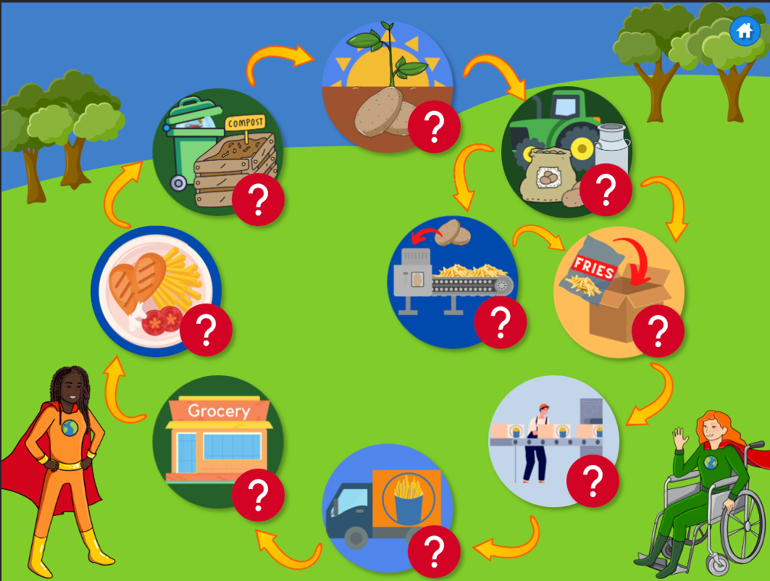
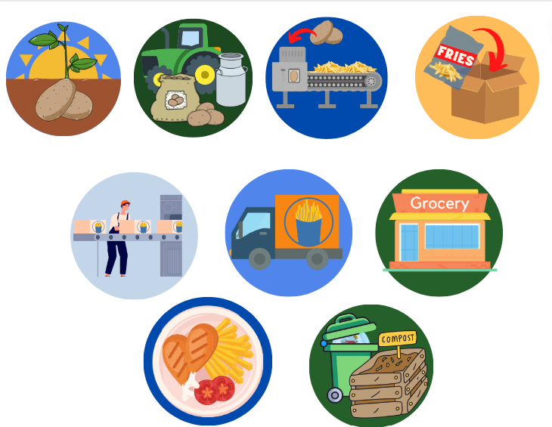
Review of E-Learning Game
PRODUCTION
HARVESTING
FOOD PROCESSING
PACKAGING
LABELING
TRANSPORTING
RETAIL

Slide 8
Group Activity
COMPLETE YOUR WORKSHEET
Choose a note taker for each stage
Fill out two inputs and outputs for each stage.
Make sure that one output is related to pollution or greenhouse gas.
*Brainstorm and discuss with your group!
Brainstorm Inputs and Outputs for each stage to produce your food item
INPUTS are specific resources or energy needed at each stage
OUTPUTS are what the end products of each stage can be.
Outputs can include greenhouse gasses and other kinds of pollution.
Work with your group

Slide 9
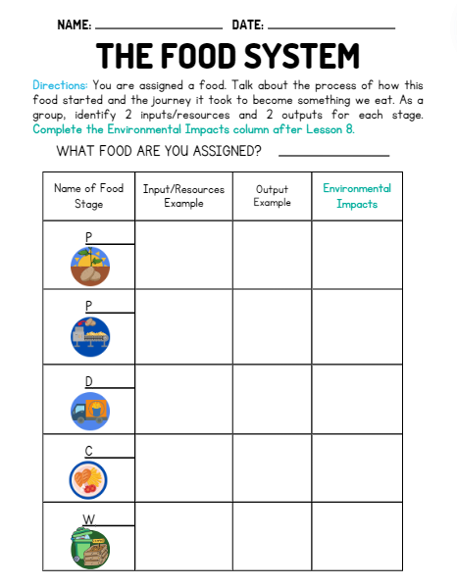
Each group will be assigned a food:
Oatmeal
Milk Carton
Frozen Chicken Strips
Fruit Salad
Cooked Hamburger

Slide 10




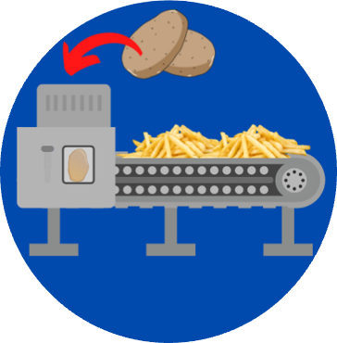
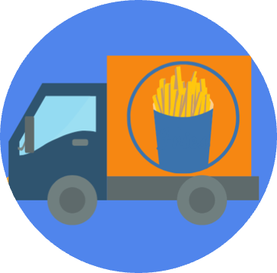

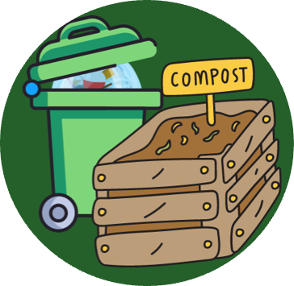
Let’s Discuss
Production
Processing
Distribution
The Five Main Stages of The Food System
Consumption
Waste

Slide 11
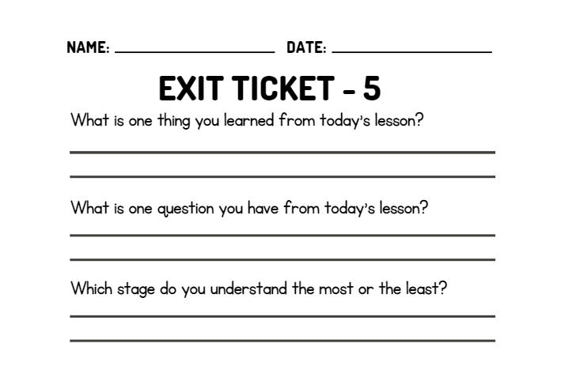
WRAP UP
On your EXIT TICKET write...

