Slide 1




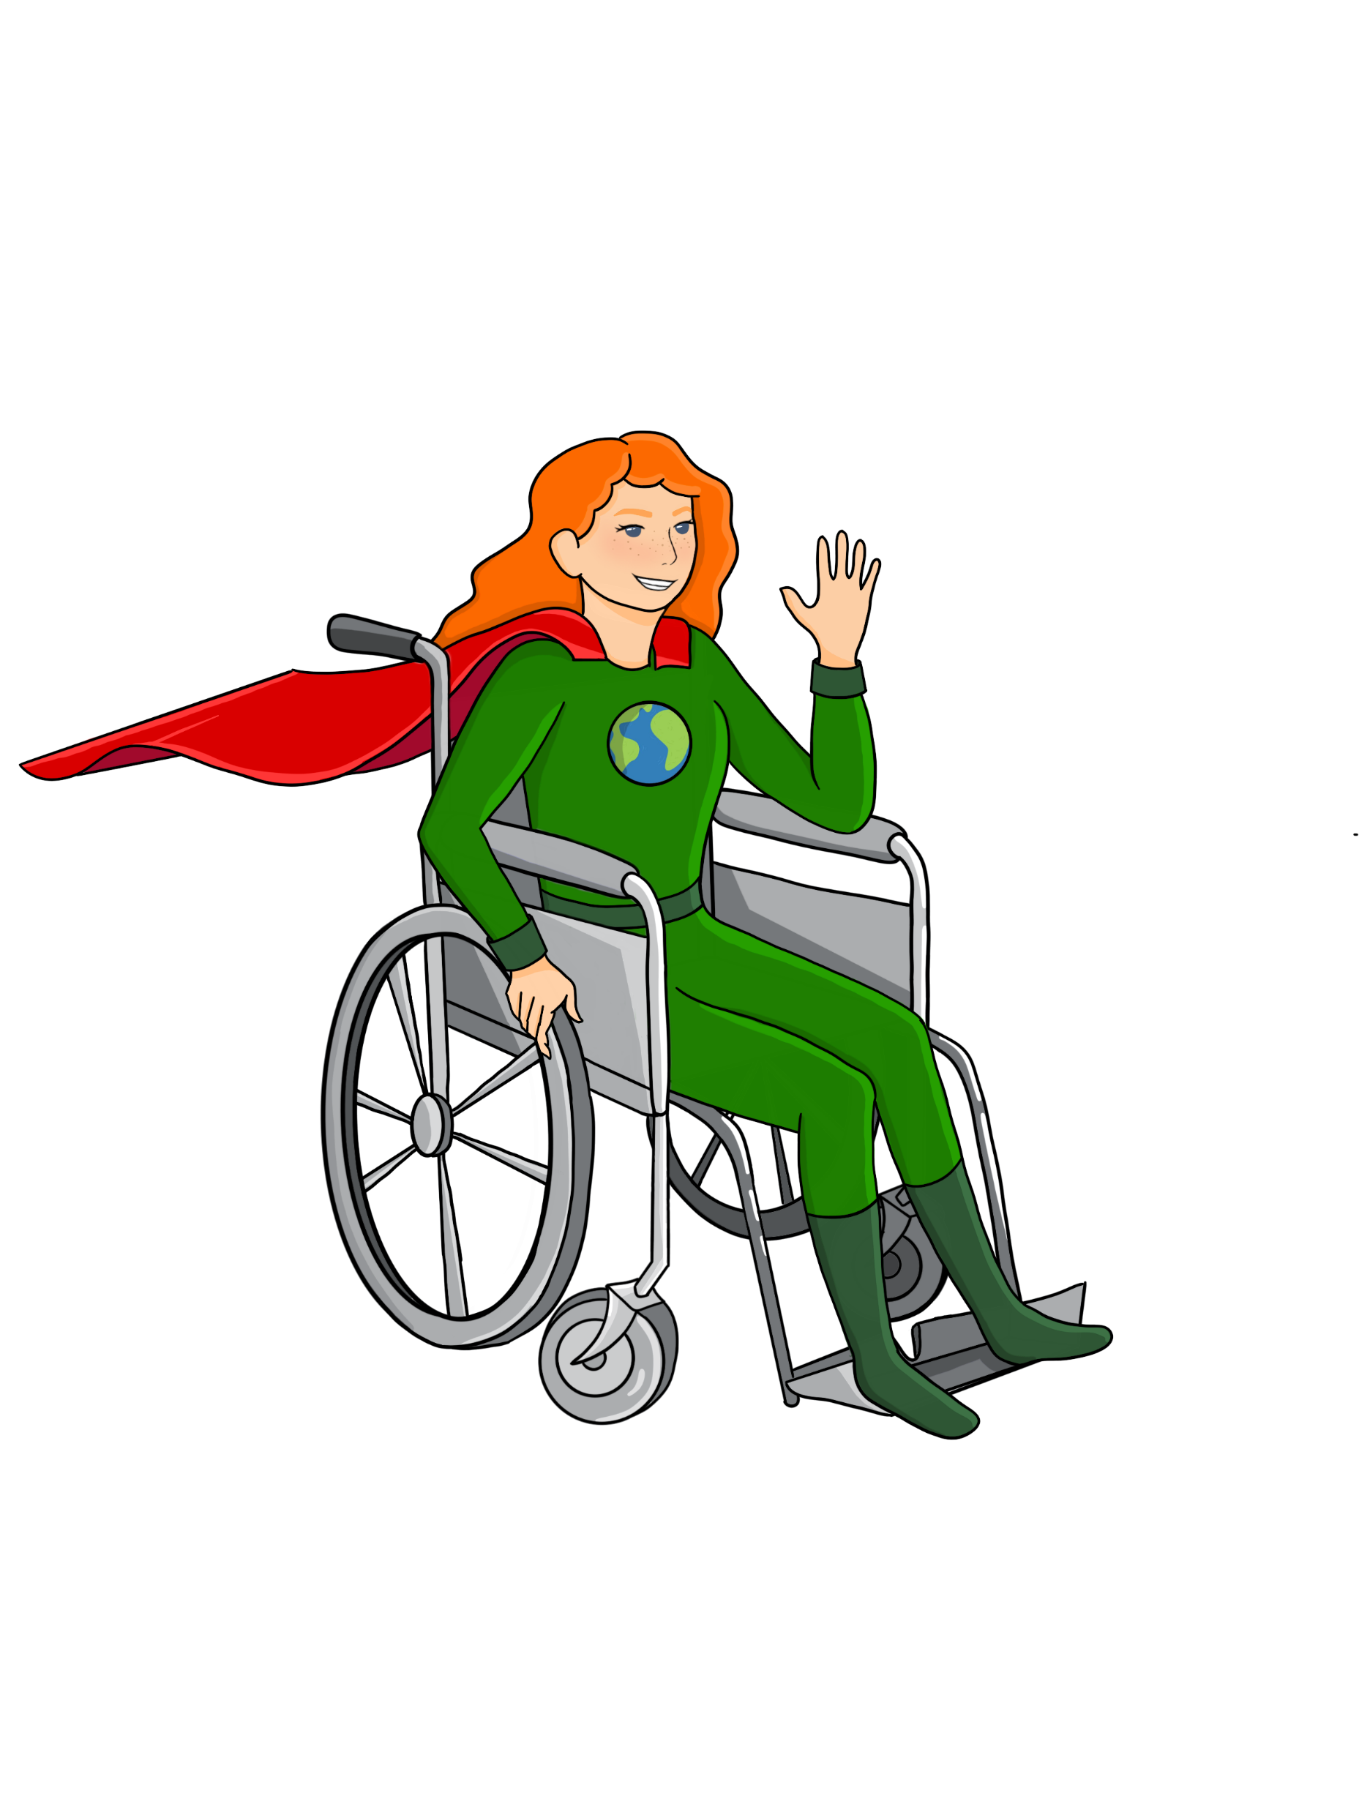




LESSON Four
Getting to know the
Food System
{
{
{

Slide 2
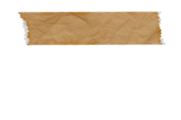

What steps and resources/inputs are involved in getting our food to us to eat?
What connects the different parts of the food system?
How does food get from the farm to plate?
Big Ideas
&
Questions of the Day
Notes:
Introduce main questions or big ideas for this lesson.
Before moving on, spend a few minutes walking through Lesson One eLearning activity (accessible from the Rutgers Food Waste Lessons website: https://foodwastelessons.rutgers.edu/)

Slide 3
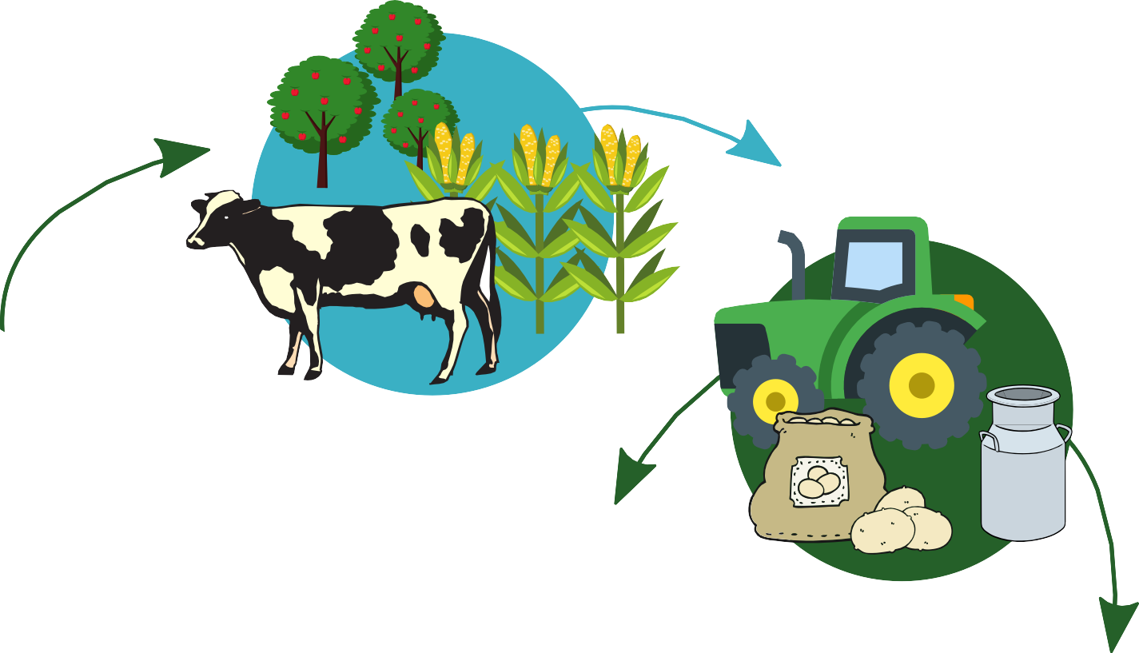
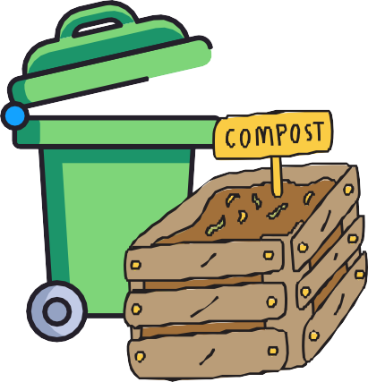
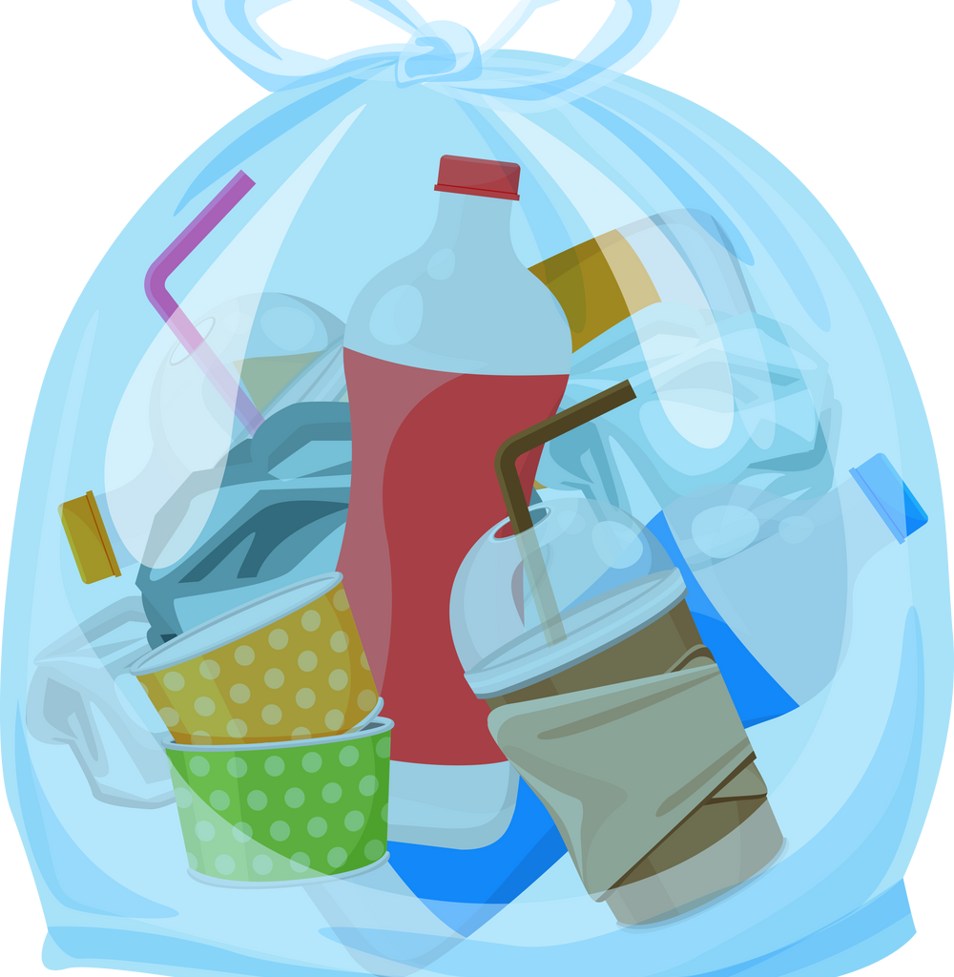
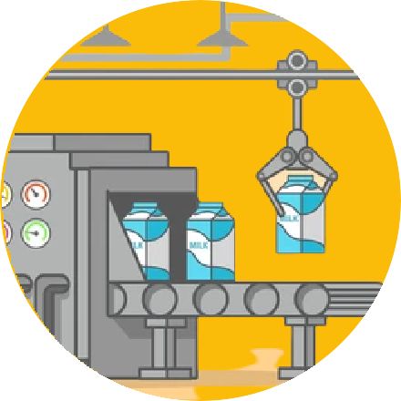
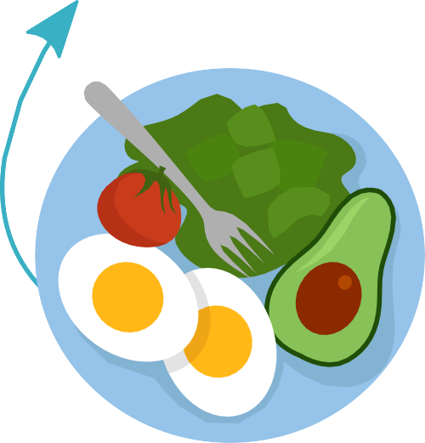
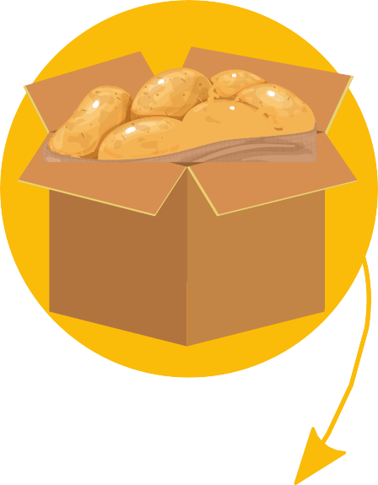






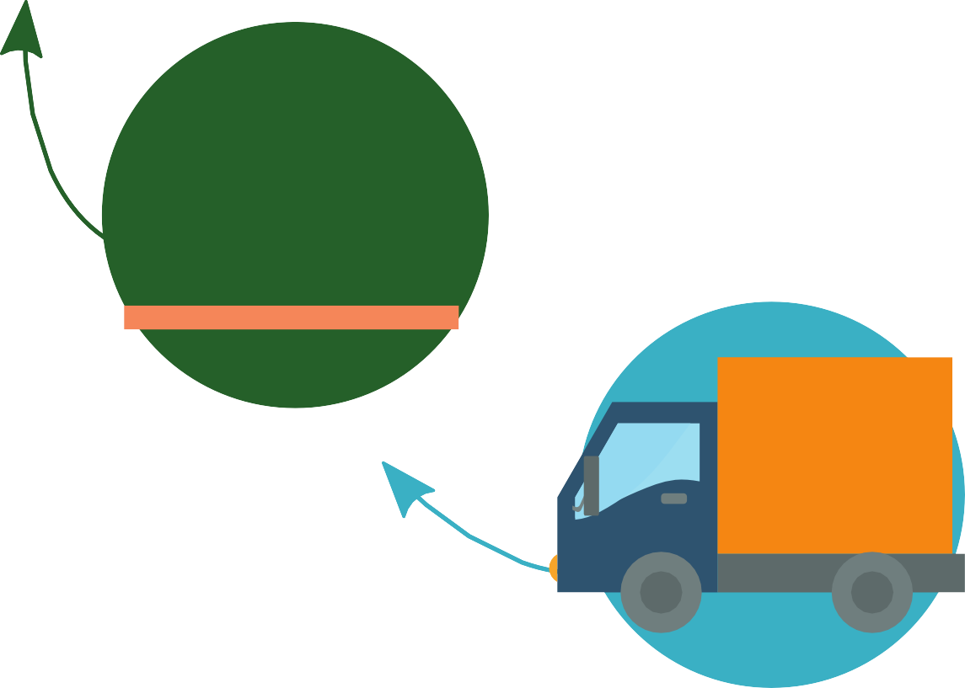



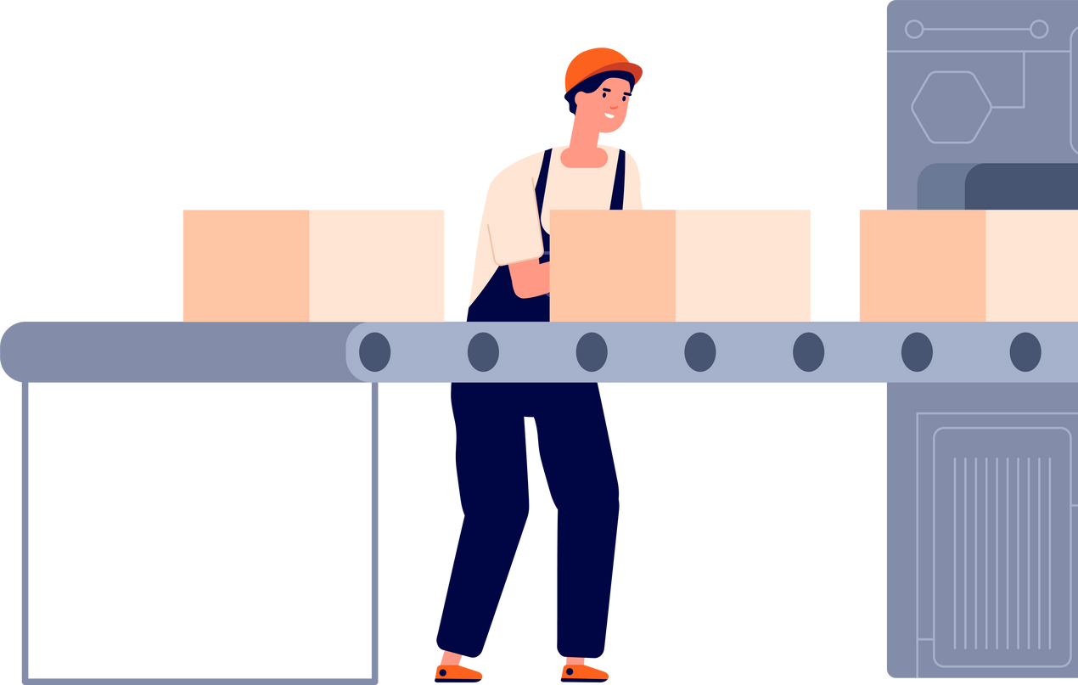
D IS P O S IN G
H A R V E S T IN G
P R O D U C IN G
F O O D P R O C E S S IN G
C O N S U MIN G
P A C K A G IN G
FOOD SYSTEM DIAGRAM
R E T A IL S T A G E
L A B E L L IN G
T R A N S P O R T IN G
Live Well San Diego, 2021
Notes:
The Observed Phenomenon for this lesson is the Food System Diagram.
Students use the diagram of the Food System in their workbooks or handout and given a few minutes to look it over.
Prompt the class to identify the different stages starting with “Producing” and an example of something that happens at each stage, using the table provided on the next slide.

Slide 4
D IS P O S IN G
Discuss with a classmate nearby:
H A R V E S T IN G
P R O D U C IN G
F O O D P R O C E S S IN G
C O N S U MIN G
P A C K A G IN G
What do you notice?
What do you wonder?
How is this a system?
How does this system impact greenhouse gases?
R E T A IL S T A G E
L A B E L L IN G
T R A N S P O R T IN G
Live Well San Diego, 2021
Notes:
The Observed Phenomenon for this lesson is the Food System Diagram.
Students use the diagram of the Food System in their workbooks or handout and given a few minutes to look it over.
Prompt the class to identify the different stages starting with “Producing” and an example of something that happens at each stage, using the table provided on the next slide.

Slide 5

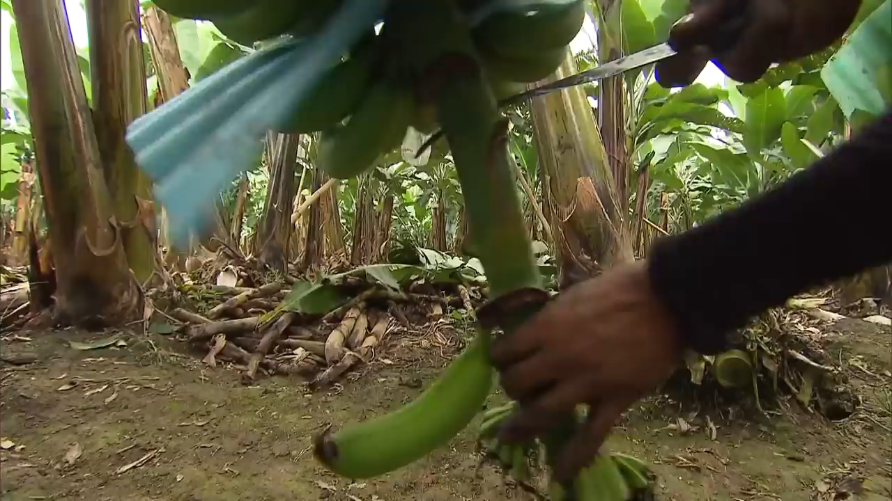
LESSON FOUR
Getting to Know the Food System
https://www.youtube.com/watch?v=SgFKfVfghpg
Notes:
Play this short video (stop video at 2 min. 47 seconds) of one food’s journey from farm to store. How Do Bananas Grow and End Up in the Store? on YouTube (Hint: ask students to pay attention for the number of miles the bananas travel).
Ask students to reference back to the diagram handout as they watch or listen to the video to identify each stage the bananas go through in the system and write down the different resources (like workers, or energy) that are used at different stages.

Slide 6

LESSON FOUR
FOOD SYSTEM DIAGRAM
What resources/inputs were used to move the bananas from where they were grown to where they are purchased and consumed?
1. examples: fuel, trucks, workers, etc.
2.
3.
4.
Can you think of any part of the banana supply chain that generated or created greenhouse gases to the atmosphere? Which parts?
1.
2.
3.
Notes:
After the video, ask if the bananas made it all the way through the system diagram stages and if not what was missed or what extra steps were there?
What resources did they notice being used? What parts of the process do they think create greenhouse gases that contribute to global warming? What other environmental impacts do they notice? What questions are generated from the diagram or video? Use this slide to record responses.

Slide 7
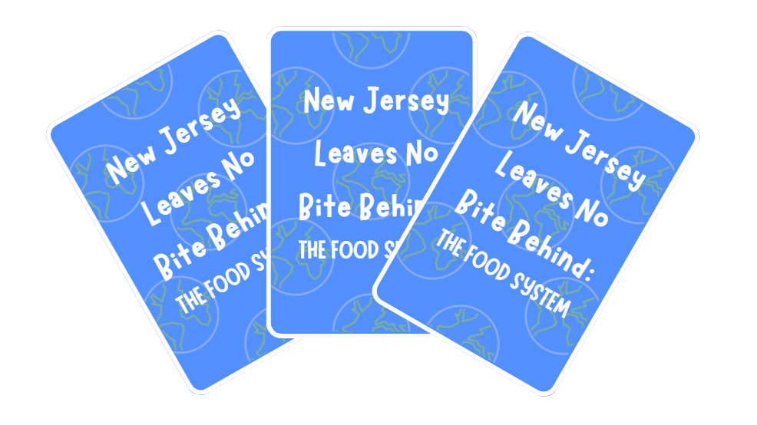
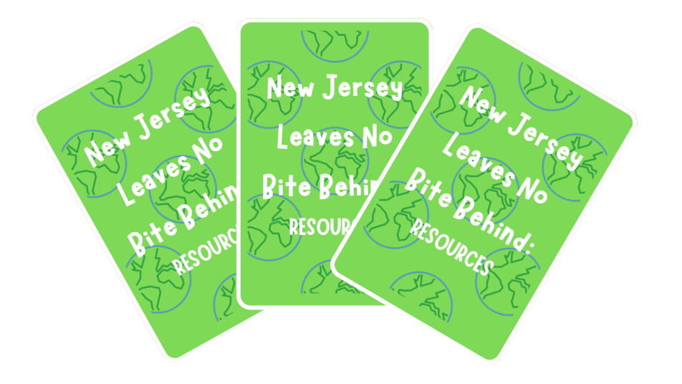
LET’S PLAY A CARD GAME!
Notes:
Students should remain in their groups of 3 or 4. Playing card decks should be already broken up with blue, green, brown and red cards in each deck. For this lesson, only the Food System Component cards (blue) and resource cards (green) are needed.
Students may use the Card Game Worksheets in their workbooks but it is not necessary. They can simply assemble the blue cards in the correct order to model a food system on their desks. They may refer to the diagram of the Food System in Lesson Two of the workbook if needed.
After assembling the model with the cards, they can add the resource cards to each stage of the system by placing them on top, below, or next to the card that indicates a stage or part of the food system. Encourage them to think about what kinds of resources are needed at each stage.

Slide 8
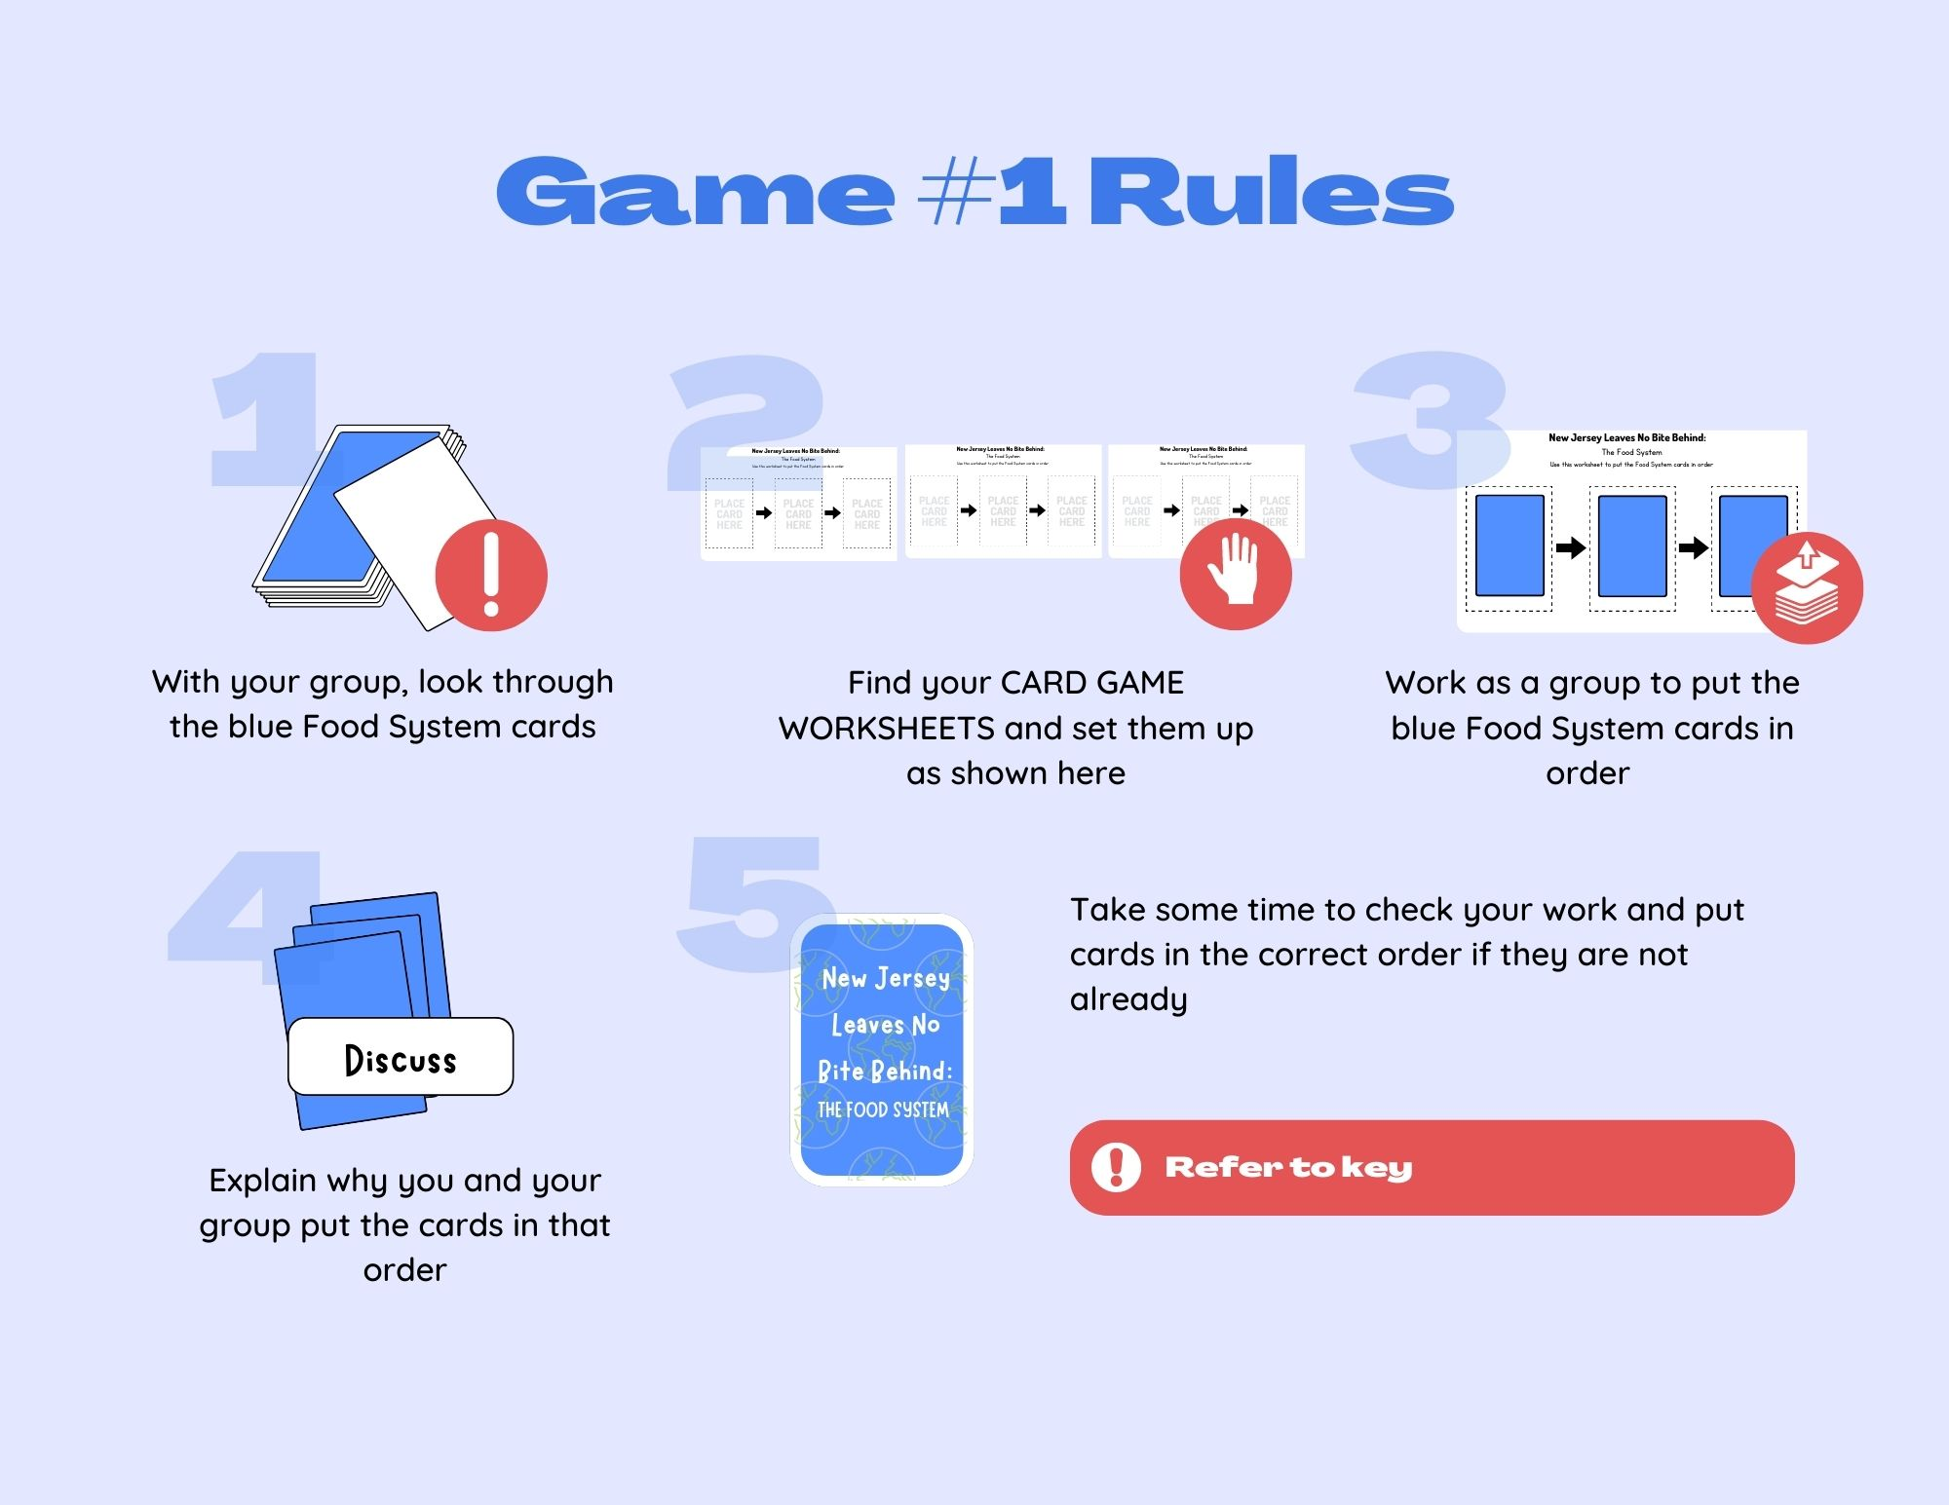
Notes:
Game rules are available if needed. There is a key in your Teacher's Guide as well.

Slide 9
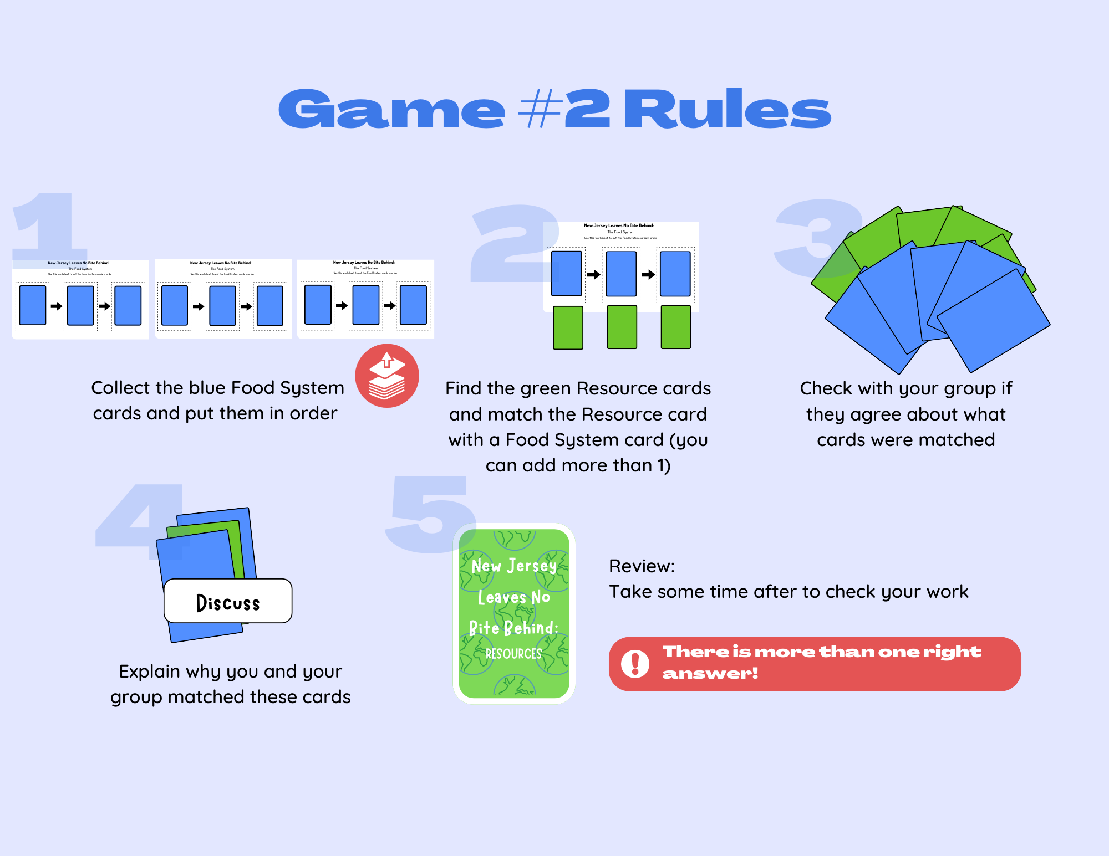

Slide 10




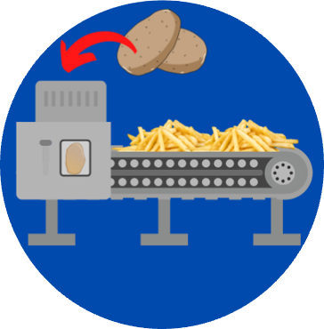
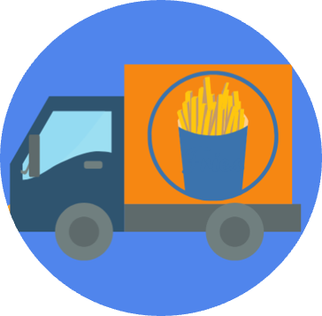

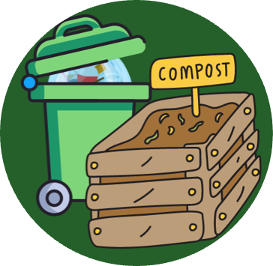
The Five Main Stages
Of The Food System: Potato Example
Production
Processing
Distribution
Consumption
Waste

Slide 11
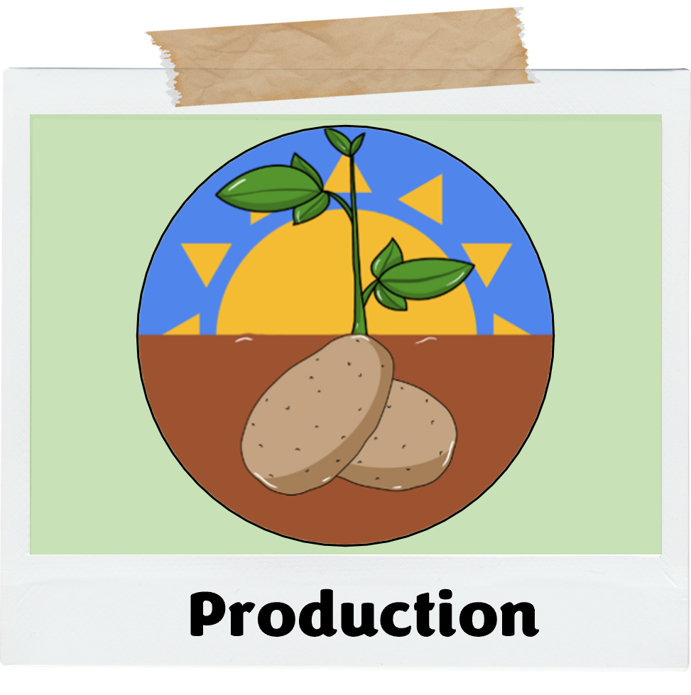

Slide 12
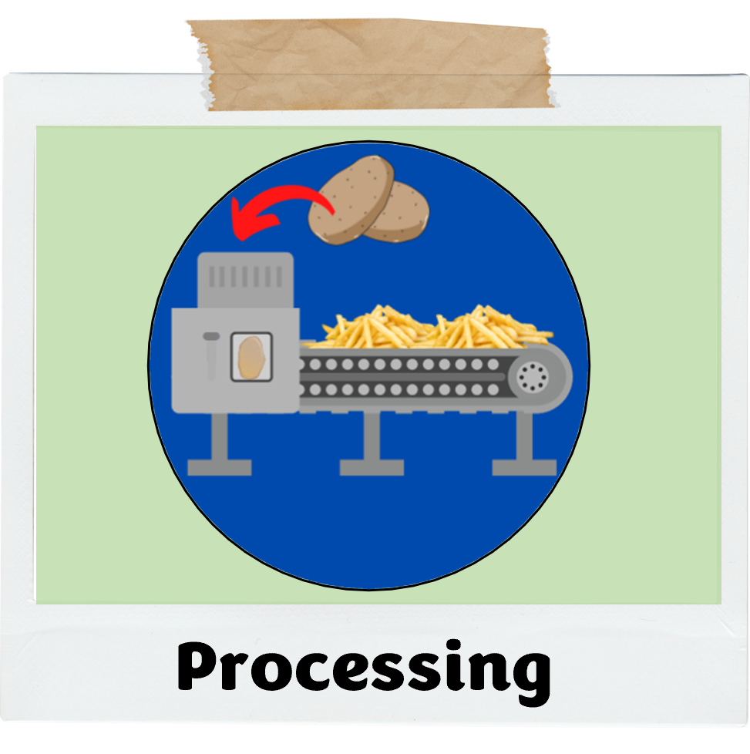

Slide 13
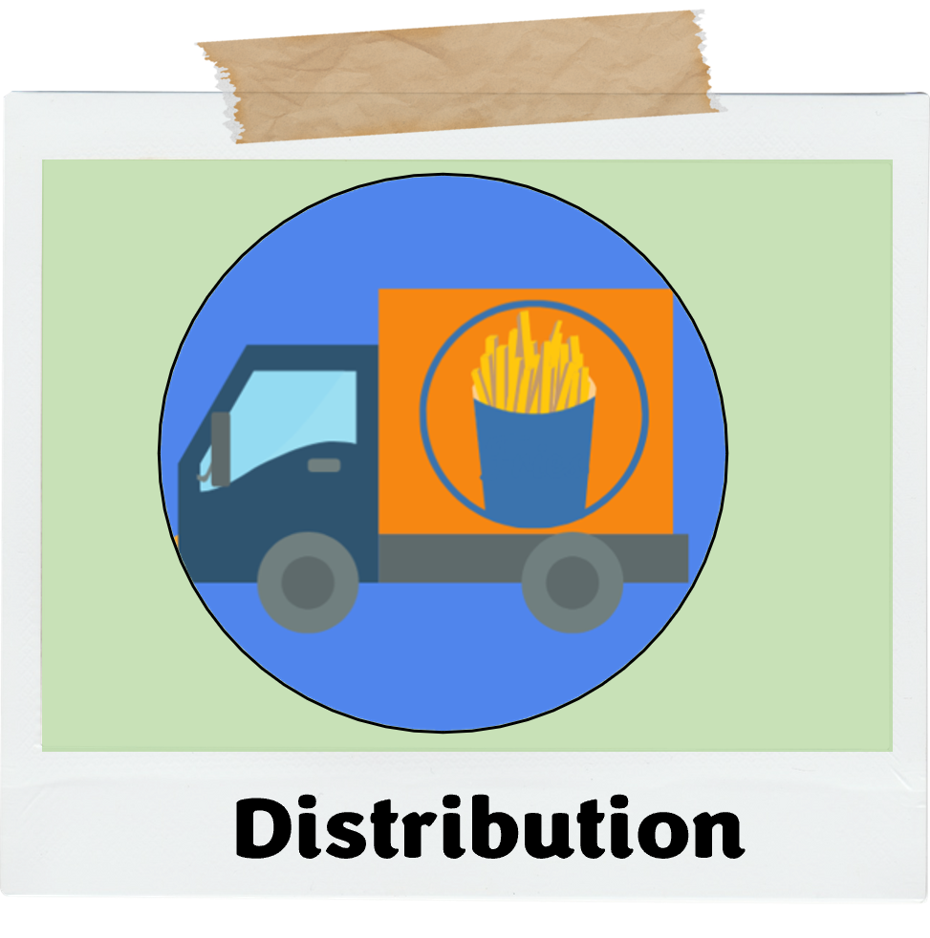

Slide 14
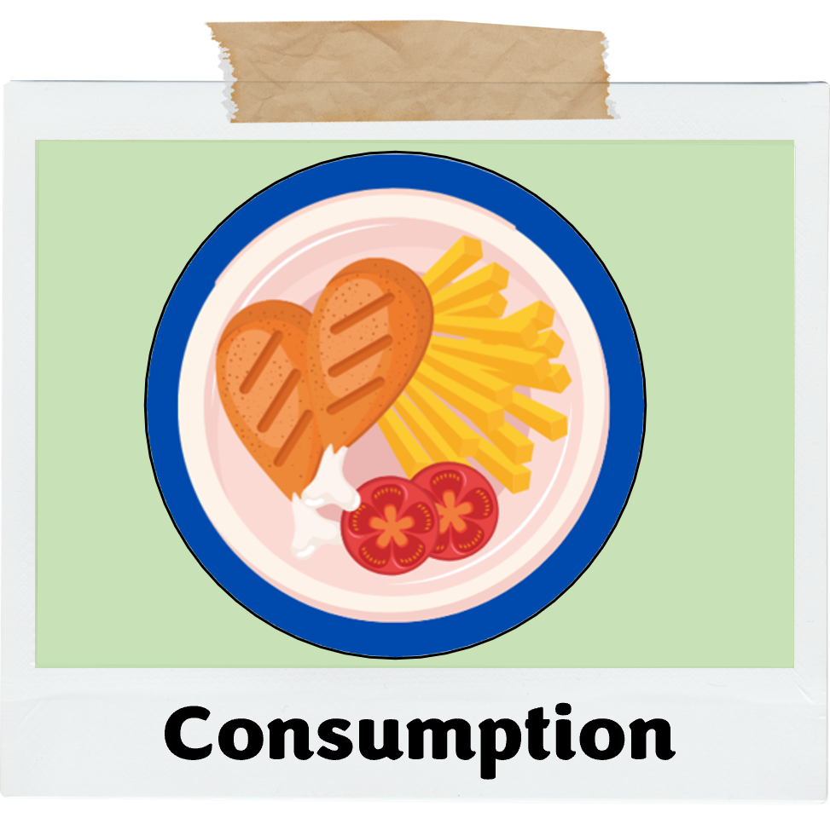

Slide 15
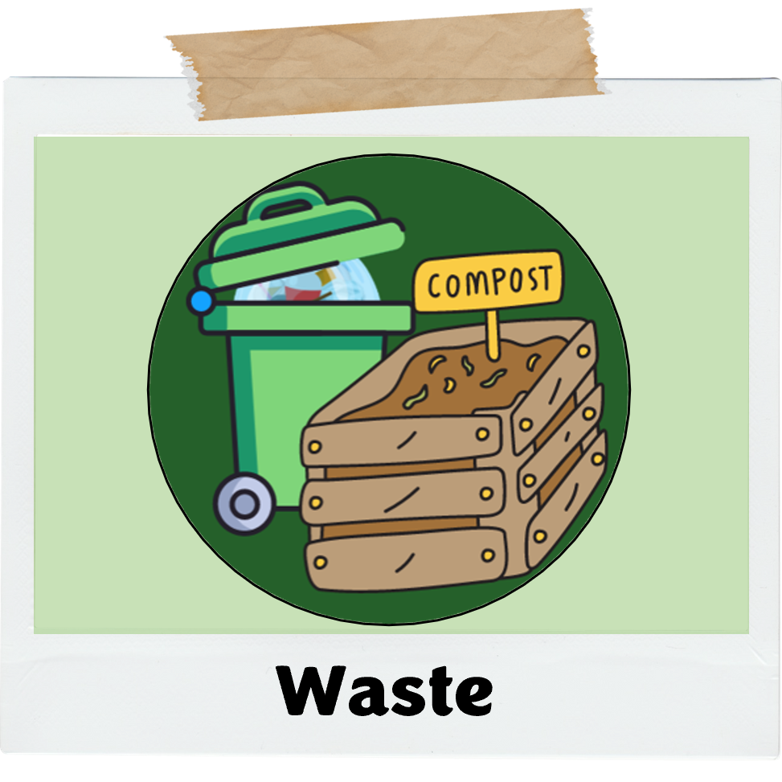

Slide 16
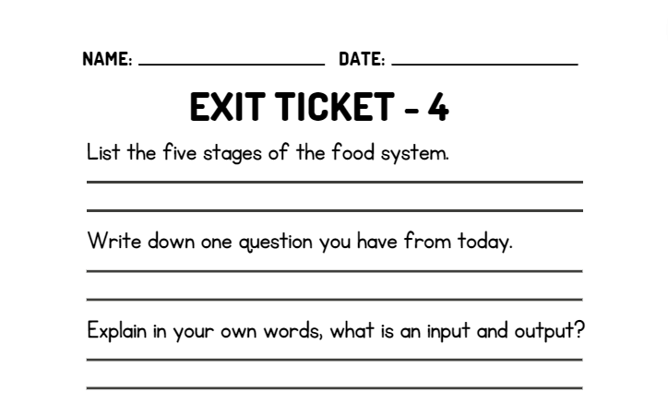
WRAP UP
On your EXIT TICKET write...

