Slide 1







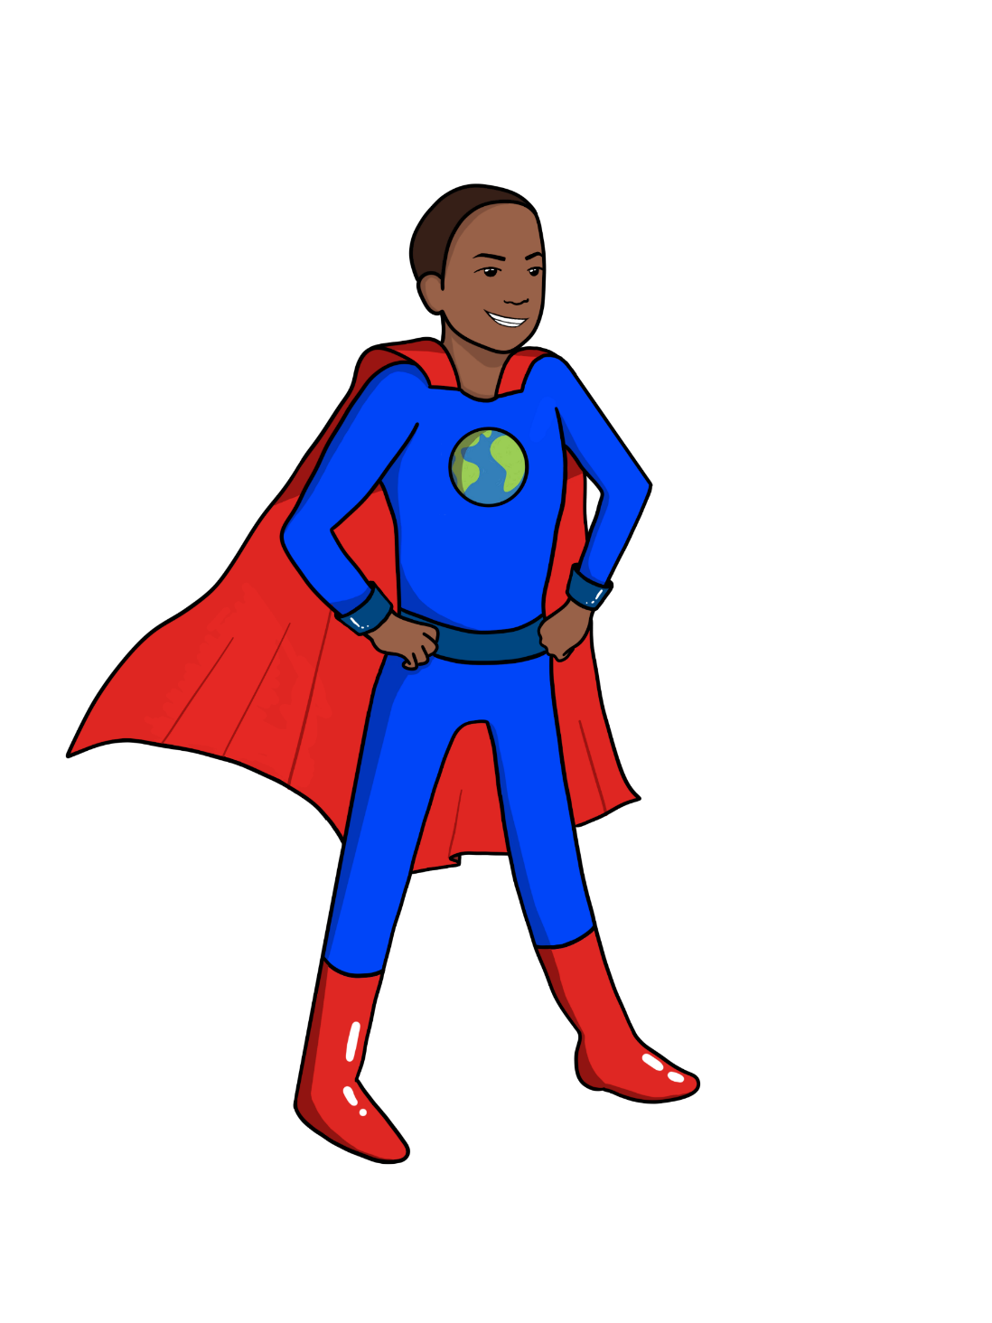

LESSON THREE
What Impacts our Climate System?
{
{
{
Notes:
Introduce yourself [guest instructors] and Name of Lesson

Slide 2
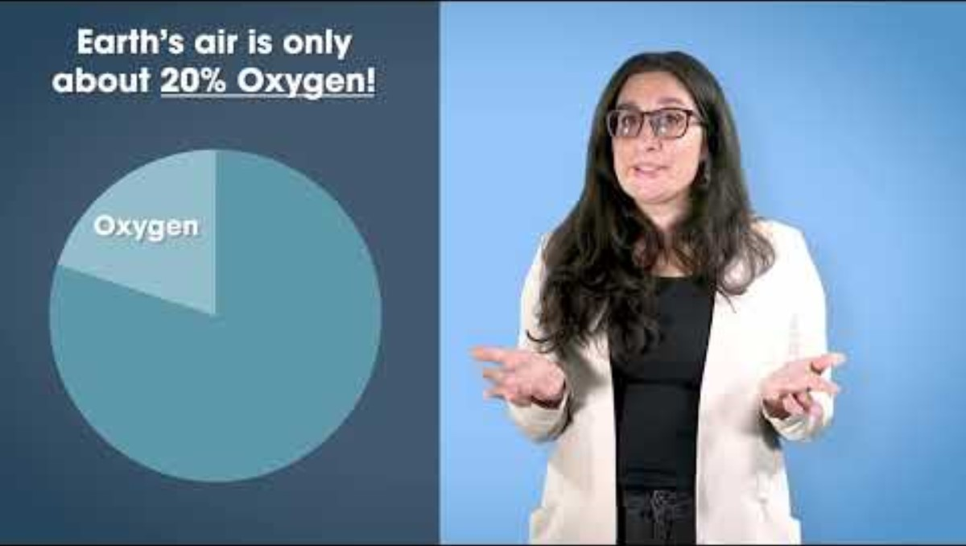
Let's Recap With a Video!
https://www.youtube.com/watch?v=YLlEMQJ4W1o&list=PLKx8NLAujm_nCPmzHM3eUKiaqMvaH55Zw&index=1

Slide 3
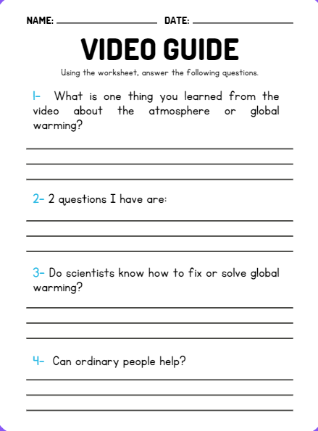

Video Recap

Slide 4


What impacts our climate system?
How can activities, such as farming and eating, change the Earth's climate?
Big Ideas
&
Questions of the Day
Notes:
“Our big ideas and questions for this lesson are: …"
"In this lesson, you'll learn about the earth's climate system and that a system is made up of components or parts that interact, meaning the parts influence each other."

Slide 5
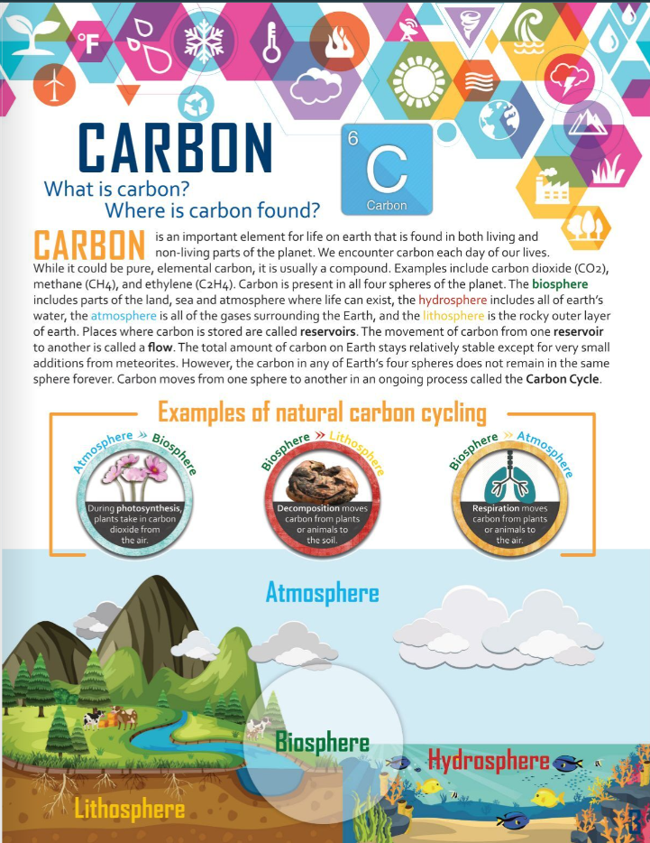
Lesson Three
Phenomenon
Carbon, What is Carbon? Where is Carbon Found?
In Climate Change Phenomena Magazine
Start by reading a science article!

Slide 6
Let's play eLearning Game!
Understanding the Carbon Cycle
INSERT NEW GAME

Slide 7
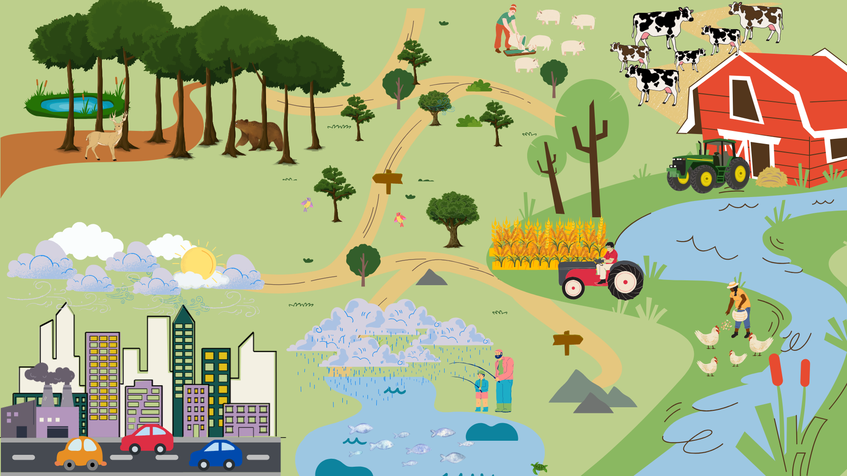
THE CLIMATE SYSTEM:
CAUSES OF CLIMATE CHANGE
CARBON CYCLE
FARMING CONTRIBUTIONS
ATMOSPHERE
WATER CYCLE
HUMAN CONTRIBUTIONS
Notes:
Show picture of the climate system and ask students to identify the different parts of the climate system. (Atmosphere, Water cycle, Carbon cycle and human contributions)
Highlight that the molecules in the atmosphere that can increase the greenhouse effect we discussed in the video.
Have students identify what happens in the water cycle,
Water from our rivers, lakes and oceans evaporates, forming clouds and then when it's cool enough it precipitates causing rain or snow.
Ask students how this cycle changes if the weather is too hot because of the greenhouse effect.
Ask the students to note the human activities such as cars, factories and cattle can increase change molecules in the air that can increase the greenhouse effect.

Slide 8


THE CLIMATE SYSTEM:
Questions
What systems are in this image?
What activities in this image are creating greenhouse gases? Explain.
What could you add to this image to show more activities that increase/decrease greenhouse gases?
Notes:
Show picture of the climate system and ask students to identify the different parts of the climate system. (Atmosphere, Water cycle, Carbon cycle and human contributions)
Highlight that the molecules in the atmosphere that can increase the greenhouse effect we discussed in the video.
Have students identify what happens in the water cycle,
Water from our rivers, lakes and oceans evaporates, forming clouds and then when it's cool enough it precipitates causing rain or snow.
Ask students how this cycle changes if the weather is too hot because of the greenhouse effect.
Ask the students to note the human activities such as cars, factories and cattle can increase change molecules in the air that can increase the greenhouse effect.

Slide 9

Time for an Activity!
Model of the Climate System

Slide 10
MODEL OF THE CLIMATE SYSTEM ACTIVITY
Divide into groups of 4
Each group use a large piece of blank paper and coloring tools
Create a model of 3 activities showing food or farming in an environment (for example growing, farming, or cooking)
Label where greenhouse gases are being released in your model
Label where these activities may impact one or more of the Earth systems (Geosphere, biosphere, hydrosphere, and atmosphere)
Write a Claim, Evidence, Reason (CER) on how these activities are either increasing or decreasing greenhouse gases in the atmosphere
Notes:
Show picture of the climate system and ask students to identify the different parts of the climate system. (Atmosphere, Water cycle, Carbon cycle and human contributions)
Highlight that the molecules in the atmosphere that can increase the greenhouse effect we discussed in the video.
Have students identify what happens in the water cycle,
Water from our rivers, lakes and oceans evaporates, forming clouds and then when it's cool enough it precipitates causing rain or snow.
Ask students how this cycle changes if the weather is too hot because of the greenhouse effect.
Ask the students to note the human activities such as cars, factories and cattle can increase change molecules in the air that can increase the greenhouse effect.

Slide 11
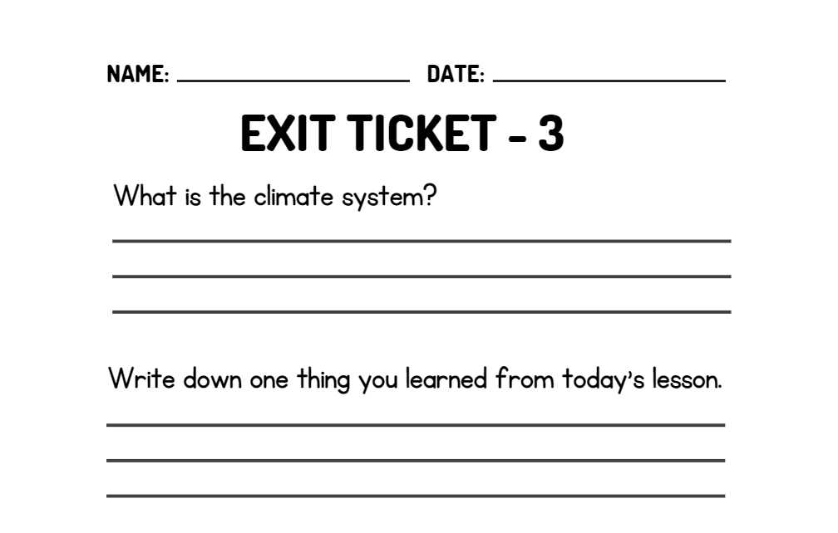
WRAP UP
On your EXIT TICKET write...
Notes:
Once the students have completed the index card, collect them and make minor adjustments to the next lesson based on the data received

Slide 12
Climate Change Hero Challenge
Additional Activity
{
{
{
Notes:
A big and exciting component of this unit is the Climate Change Hero Challenge! Or class can have a friendly and earth-friendly competition against the other classes in your grade to see who can get the most points for doing Climate Change Hero Activities. [Show students the handouts in their workbooks]

Slide 13
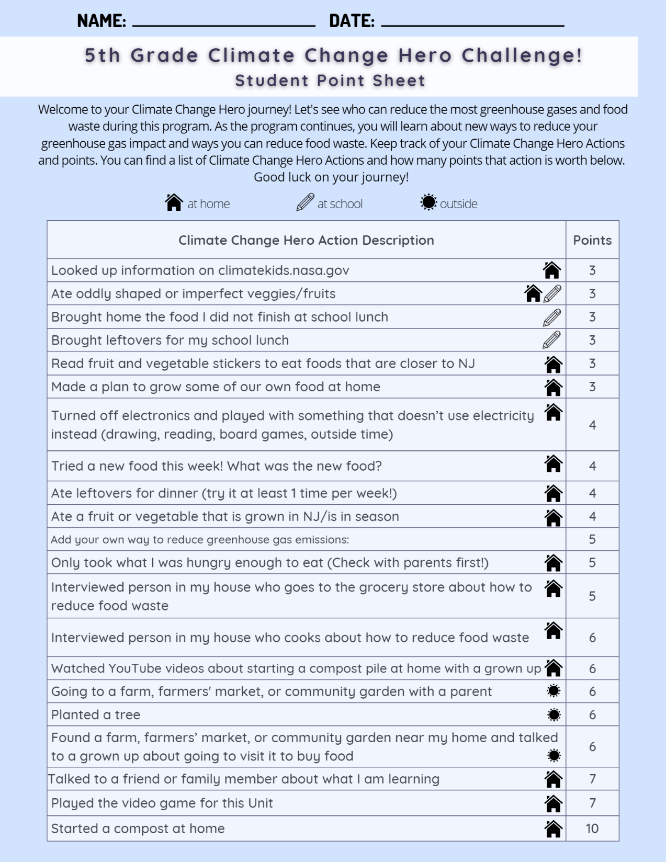
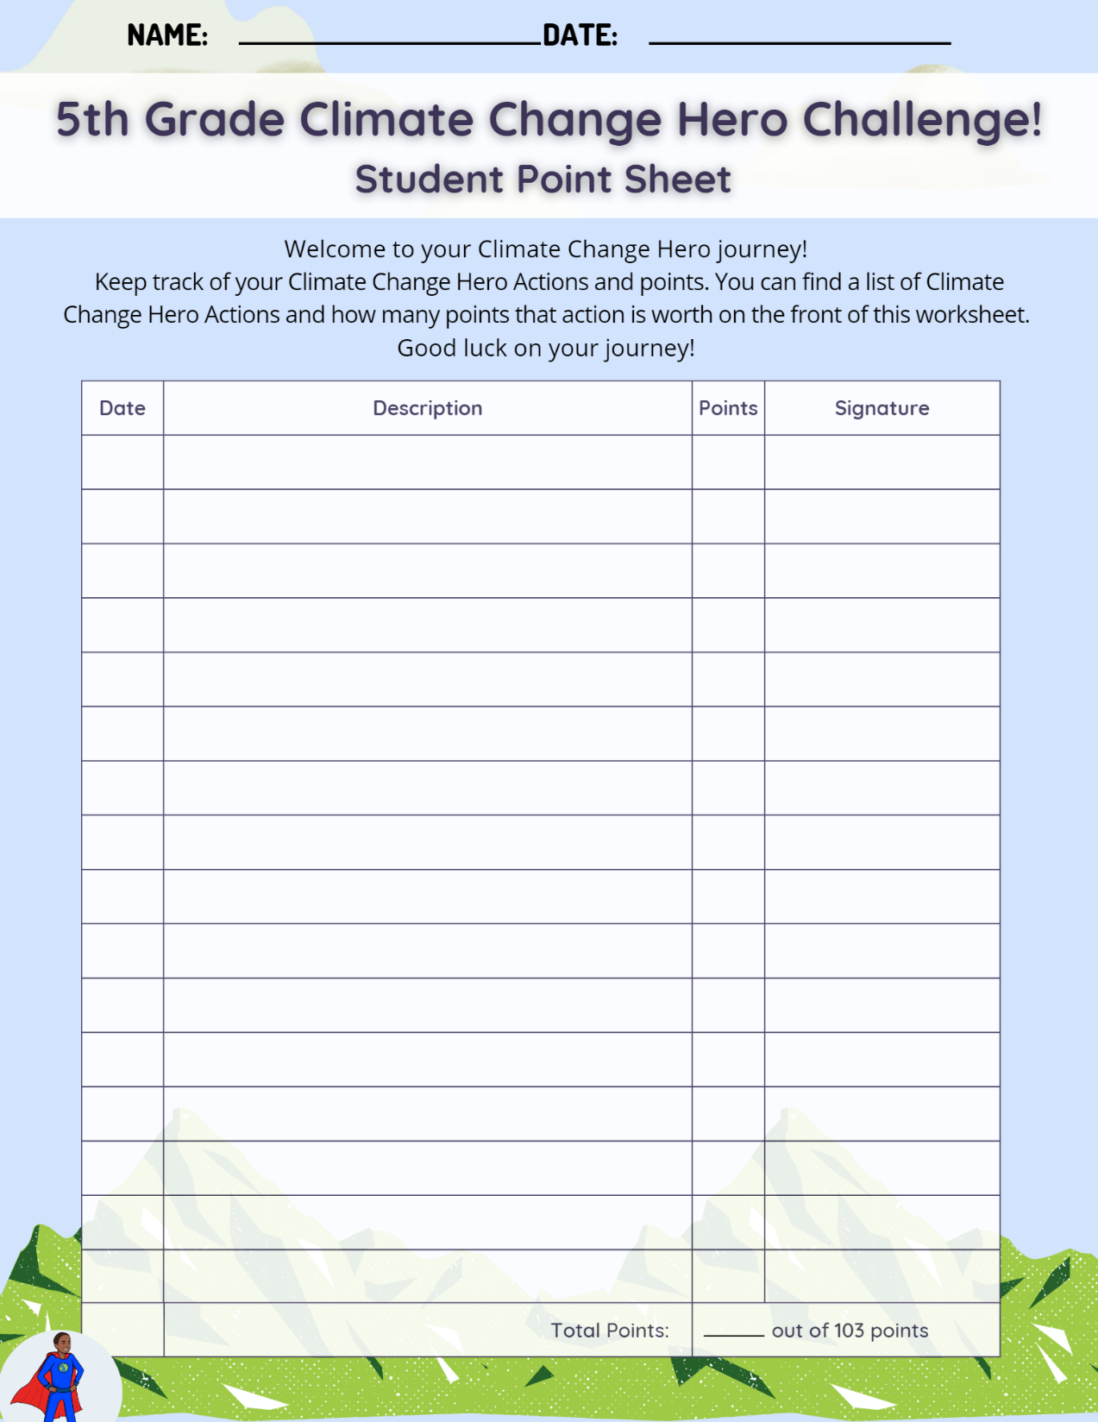
Notes:
Review the activities and review how to track points. This can be done in school and at home.

