Slide 1






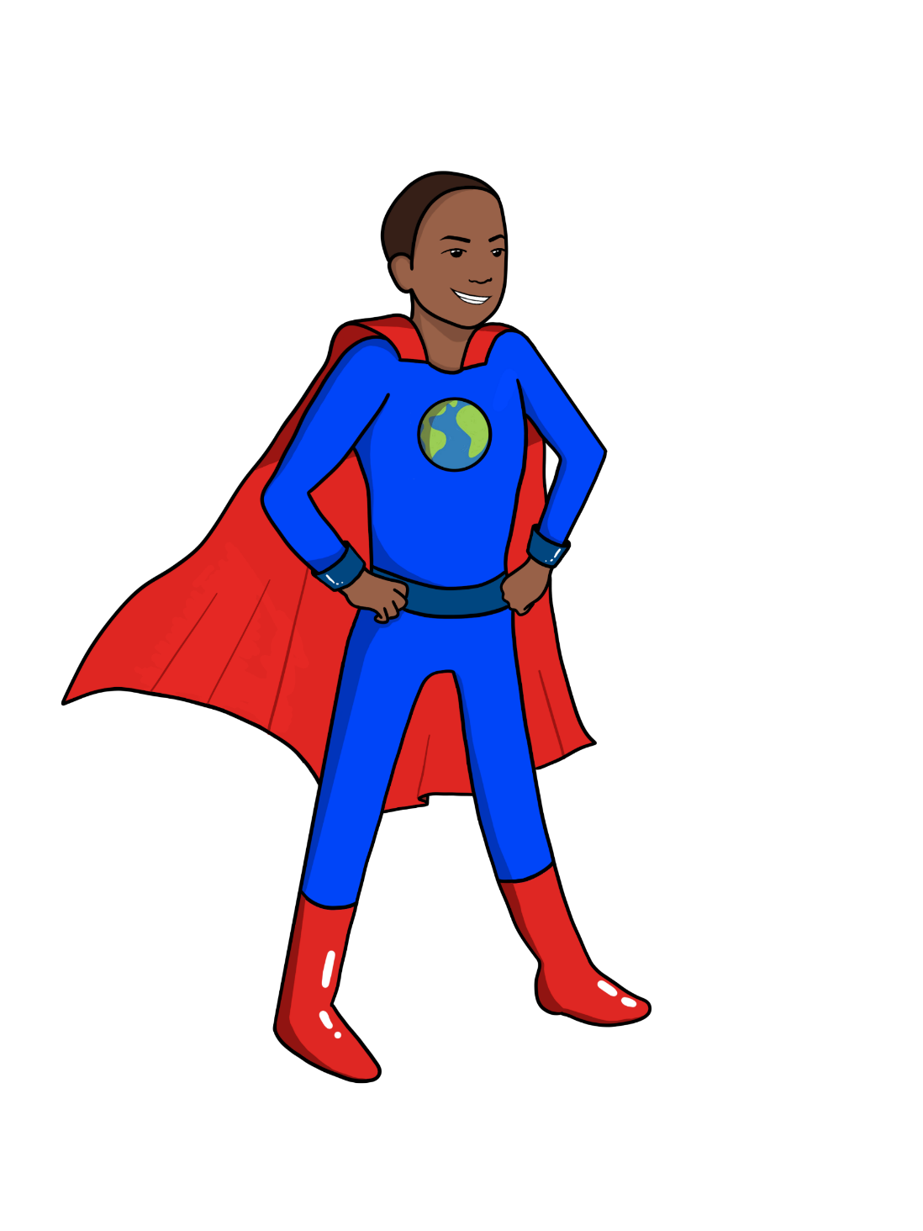


LESSON TWO:
The Greenhouse Effect
{
{
{
Notes:
Introduce yourself [guest instructors] and Name of Lesson

Slide 2


How do different gases in Earth's atmosphere affect the temperature of the planet?
Which human activities generate greenhouse gases & which activities can remove them?
Big Ideas
&
Questions of the Day

Slide 3
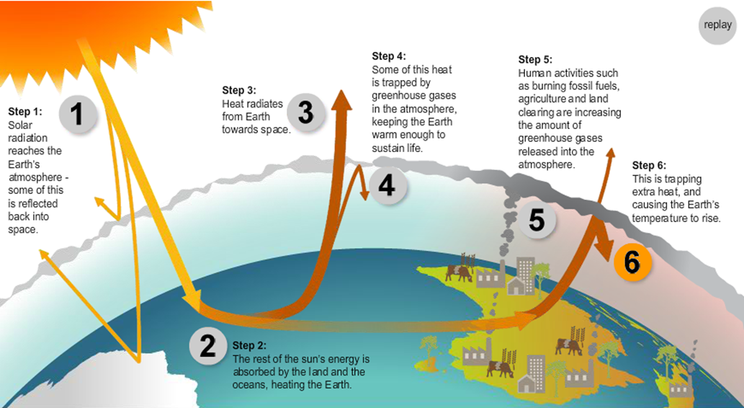
Let's Review!
NJCTL.org
Human Impacts on Earth Unit
PROGRESSIVE SCIENCE INITIATIVE® (PSI®)

Slide 4

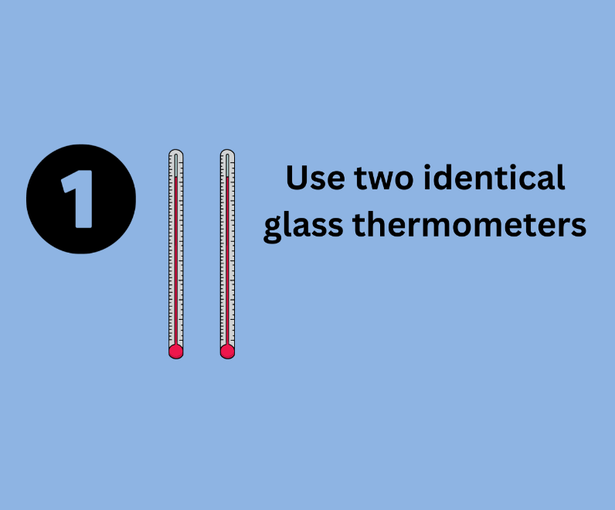
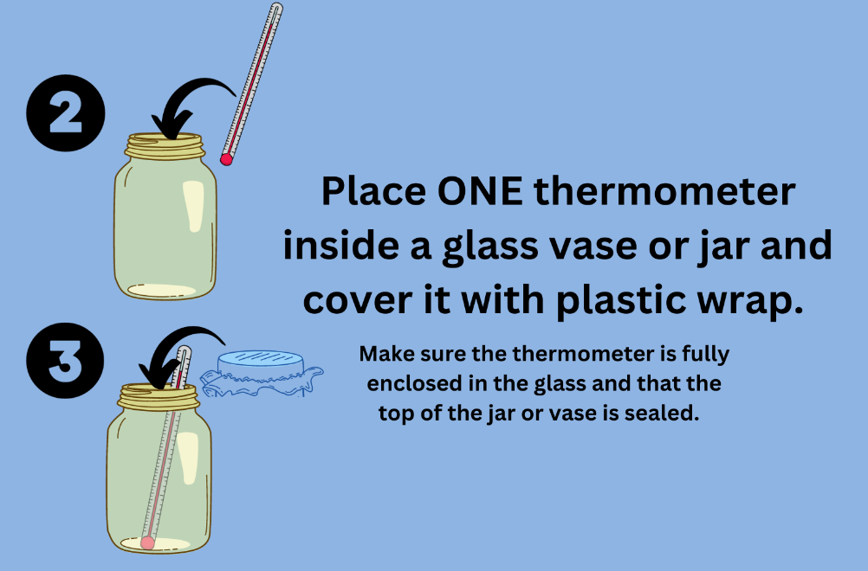
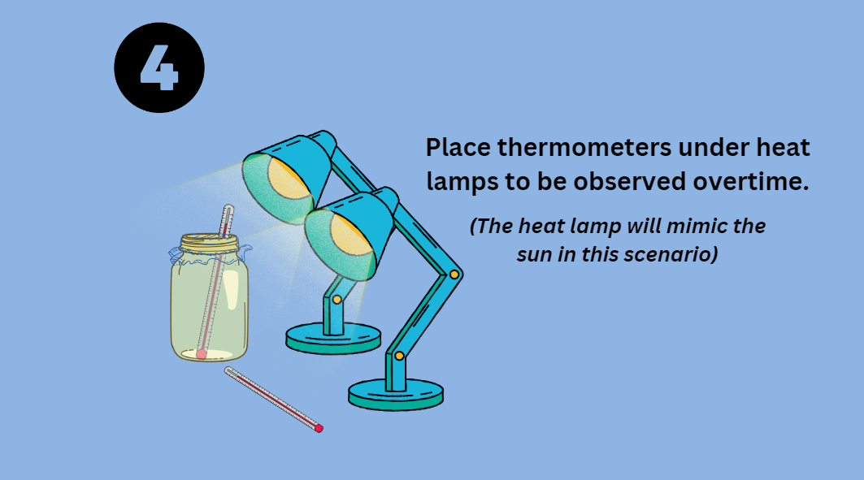
Observable Phenomenon
Notes:
TEACHER PREP SLIDES

Slide 5

Notes:
TEACHER PREP SLIDES

Slide 6

Notes:
TEACHER PREP SLIDES

Slide 7
Notes:
TEACHER PREP SLIDES

Slide 8
Lesson Two
Observable Phenomenon
NOTICE AND WONDER!
What do you think will happen to the temperatures of each thermometer?
I think...
I notice...
I wonder...
Notes:
"Now you are going to turn to the first page of your workbook to the first page where it says "NOTICE & WONDER" and as we are going to watch a very short video made by scientists who study climate change. It shows how earth is changing.
Pay close attention to what is happening. There is no talking or narration in the video, you must watch and try to observe or notice what you think this data is showing or telling us. You can write it down on the worksheet …"I notice" and "I wonder". Use the "I wonder" side of the worksheet to write down questions you have or things you are uncertain of.
Okay, ready? Let's go. I can play it twice."

Slide 9

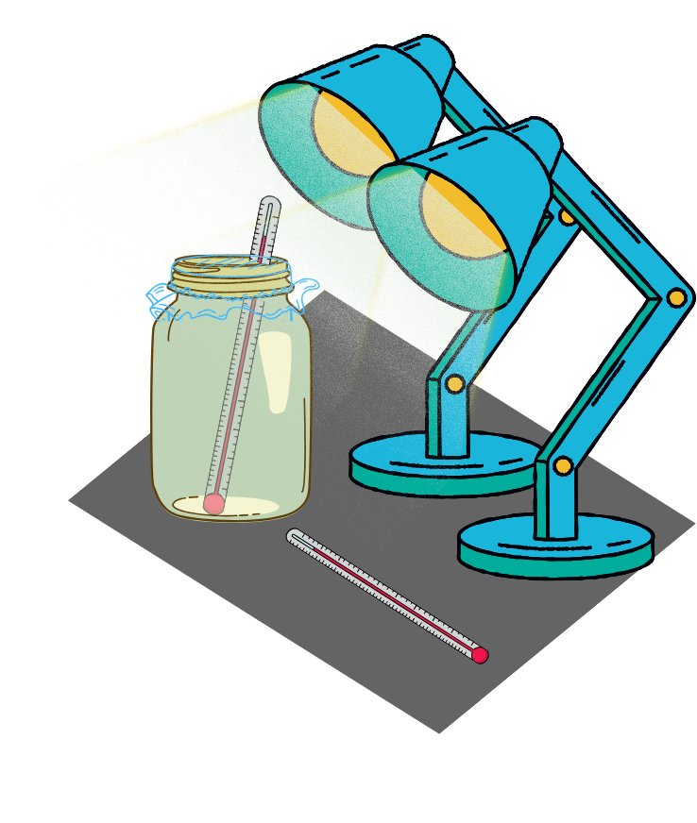
Class Activity
Check the temperature on the thermometers a few times throughout class
When checking temperatures, record the temperature readings and discuss your observations

Slide 10
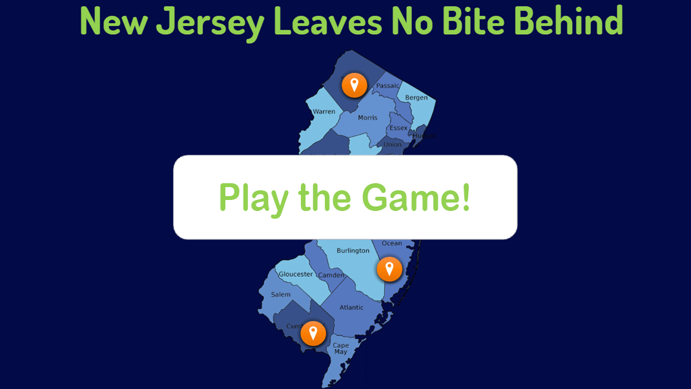
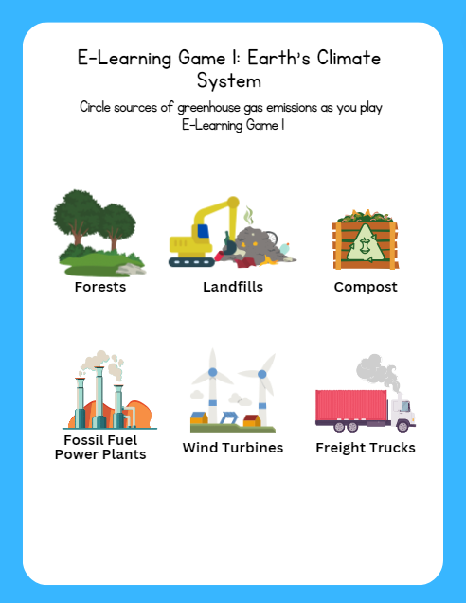
Let’s Play eLearning Game: Earth's Climate System

Slide 11
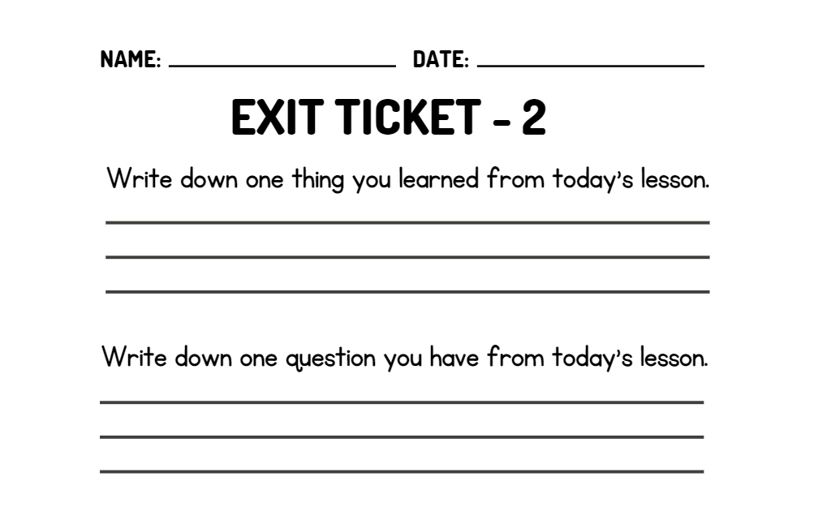
WRAP UP
On your EXIT TICKET write...
Notes:
Once the students have completed the index card, collect them and make minor adjustments to the next lesson based on the data received

