Slide 1




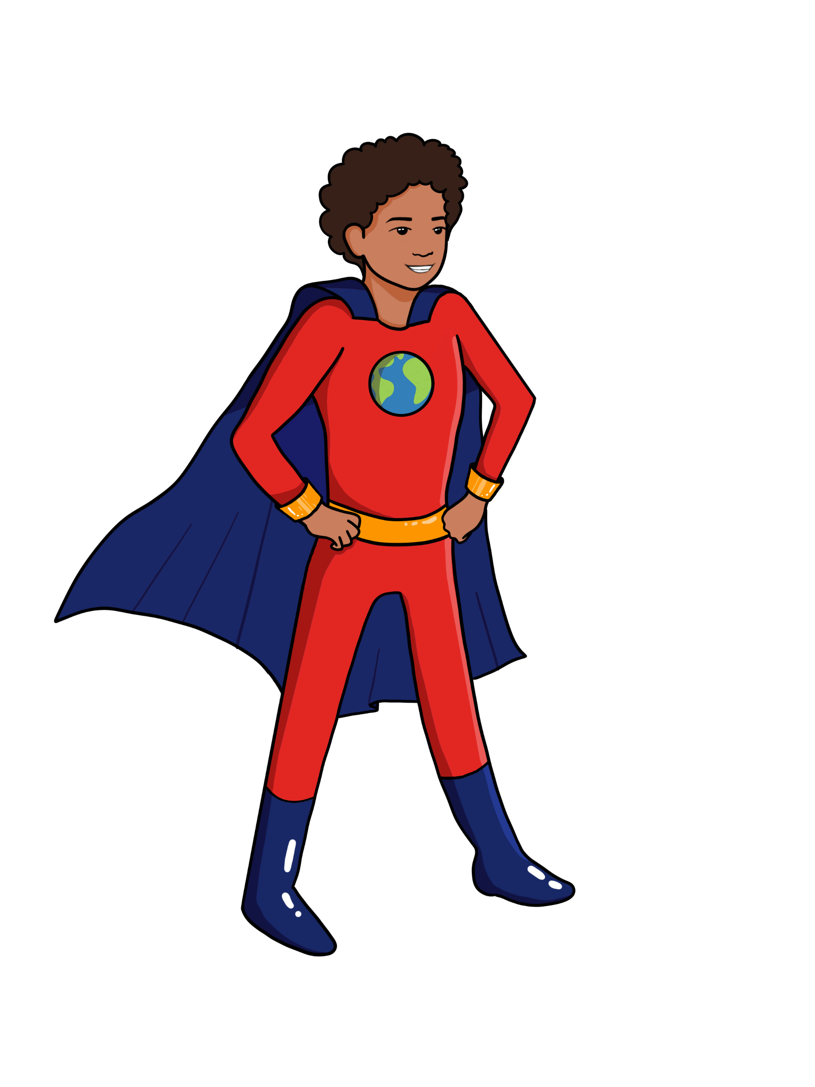




LESSON 10
Carbon Footprint
{
{
{

Slide 2


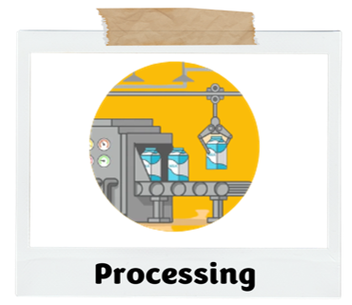
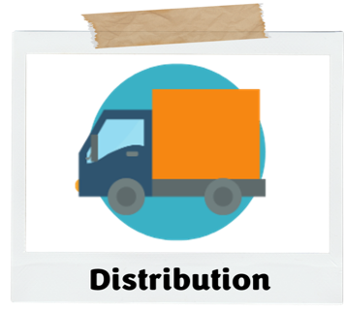
What did we learn about last class?
We learned how greenhouse gases are produced after the food leaves the farm due to processing and distribution
Today we will put all the things we learned together and talk about our Carbon footprint
Recap!

Slide 3

Big Ideas
&
Questions of the Day
What is a carbon footprint?
What eating patterns have higher carbon footprints?
How can I lower my carbon footprint?

Slide 4

WARM-UP
What is a footprint?​
Carbon Footprint

Slide 5
What is a footprint?
A footprint is...
Something that is left behind
Evidence that someone or something was there
A remainder or reminder of where someone has been
Something to follow to lead to something
​
WARM-UP

Slide 6

What do you think the ​term
“Carbon Footprint​” means?

Slide 7
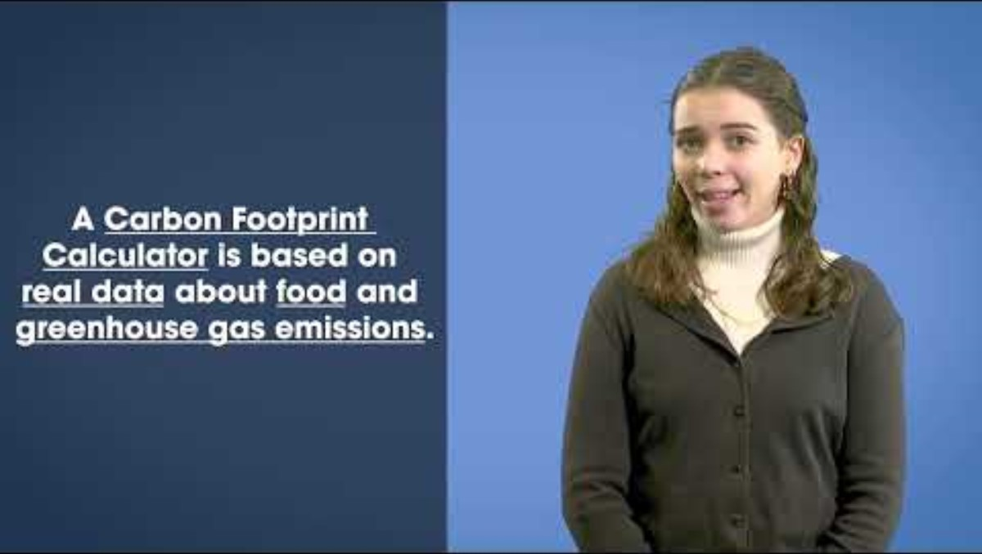
Video Lesson
https://www.youtube.com/watch?v=aGZpZfICzek&list=PLKx8NLAujm_nCPmzHM3eUKiaqMvaH55Zw&index=4
Notes:
Today is the last lesson of our climate series! We have learned about many ideas that related to growing, producing and eating food. Today we are going to learn about a very special kind of footprint, the carbon footprint.

Slide 8


Carbon Footprint:
Total amount of greenhouse gas emissions that result from your actions

Slide 9

Time for an Activity!

Slide 10
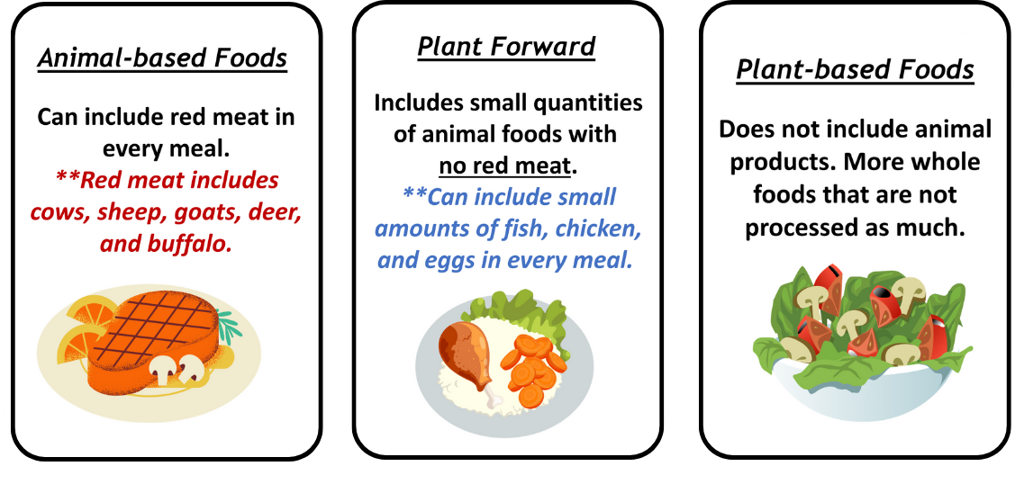
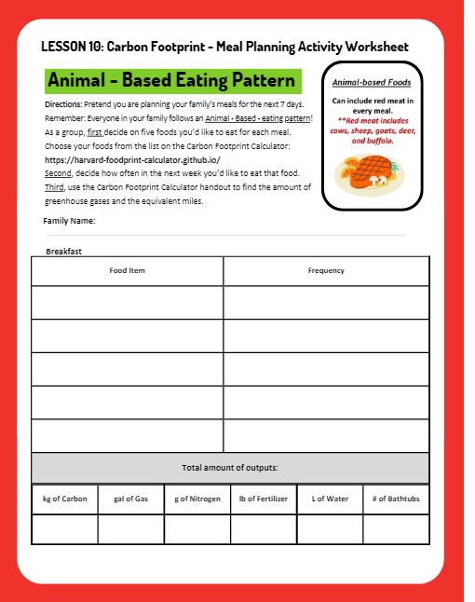
GROUP
ACTIVITY!
Pretend you are a family unit and come up with a family name. You have one minute to decide on a family name and write it on the top of your worksheet.
Your group is going to plan animal-based meals for the next 5 days.
Notes:
Teacher passes out the Carbon Footprint Calculator reference sheet and worksheets for each group.
The teacher explains the activity, “Your group is going to plan the group meals for the next 5 days. Pretend you are a family unit and come up with a family name. You have one minute to come up with a family name and write it on the top of your worksheet.”
The teacher reads the directions on the worksheet aloud. The teacher should be ready to break down the task one at a time before letting each group work independently.
Ask one student to name the first task their group should complete: Decide on 5 foods they’d like to eat for breakfast, lunch and dinner).
Ask a second student to explain the second task: Decide on frequency. Teachers may need to give an example. For example: “our group wants to eat oatmeal 1-2 times a week and apples 3-5 times a week.”
Ask a student to explain the third task: Use the chart to find the greenhouse gas emissions and equivalent miles. The teacher may need to remind or explain that “equivalent” means an equal value or amount.
Each group will be planning a meal for an Animal-Based eating pattern with Red Meat. This means that nothing is limited on the Carbon Footprint Calculator resource. All groups should have at least one food item in each meal, that is an animal product.
When groups have finished filling out their chart, each group will add the total number of greenhouse gas emissions and equivalent miles.
Review **?

Slide 11







ACTIVITY : STEPS
Step 1: Decide on 5 foods they’d like to
eat for breakfast, lunch and dinner.

Slide 12

ACTIVITY : STEPS
Step 2: Decide on frequency.
For example:
“our group wants to eat rice 1-2
times a week and yogurt 3-5 times a
week.”
X 2

Slide 13
ACTIVITY : STEPS
Step 3: Use the online Carbon Footprint Calculator to calculate your groups environmental impact
____ kg Carbon = ____ gallons of gasoline
____ g Nitrogen = ____ pounds of fertilizer
____ L Water = ____ bathtubs of water

Slide 14

LET’S DISCUSS
​
  What is one thing you notice about your group’s greenhouse gas emissions? Explain why it is interesting.
  Which food items do you think increased your carbon footprint the most?
  What is something you wonder about as you look at your filled out handout?

Slide 15
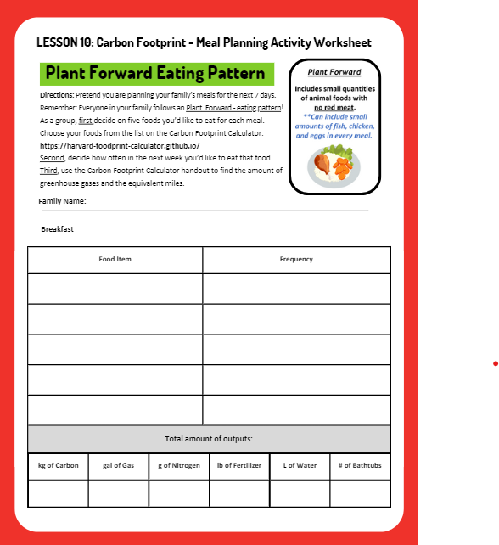
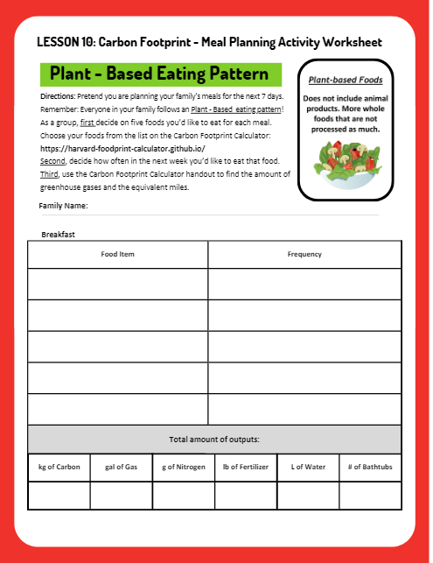
GROUP
ACTIVITY!
Each group will now develop meals that follow a plant-based and plant forward eating pattern.
Remember in a plant-based eating pattern you can include some meat but not too much. Your group will make another group family meal plan for the week, but it must fit the eating pattern you choose.

Slide 16
ACTIVITY : STEPS
Step 1: Decide on 5 foods they’d like to
eat for breakfast, lunch and dinner.

Slide 17
ACTIVITY : STEPS
Step 2: Decide on frequency.
For example:
“our group wants to eat rice 1-2
times a week and yogurt 3-5 times a
week.”
X 2

Slide 18
ACTIVITY : STEPS
Step 3: Use the online Carbon Footprint Calculator to calculate your groups environmental impact
____ kg Carbon = ____ gallons of gasoline
____ g Nitrogen = ____ pounds of fertilizer
____ L Water = ____ bathtubs of water

Slide 19


Activity Review:
Let’s review your group’s environmental impact
Notes:
Each group fills out the chart in the same manner as they did in Lesson 6-a. Teacher repeats the directions and breaks down each of the three tasks students will do.
As groups finish, they calculate the grand total of their greenhouse gas emissions and write it on the board under the column for their group.
The teacher will need to calculate the average number for the plant-based and for plant-forward eating patterns.

Slide 20
LET’S DISCUSS
What observations can you make?
What eating pattern was best for the environment? How do you know?​
What eating pattern would be easiest to adopt?​
Which eating pattern could most people adopt with some effort? Why?​
Which eating pattern would be really hard for people to adopt? Why?​
How can we change our own behaviors to move closer to low-carbon eating patterns?​

Slide 21
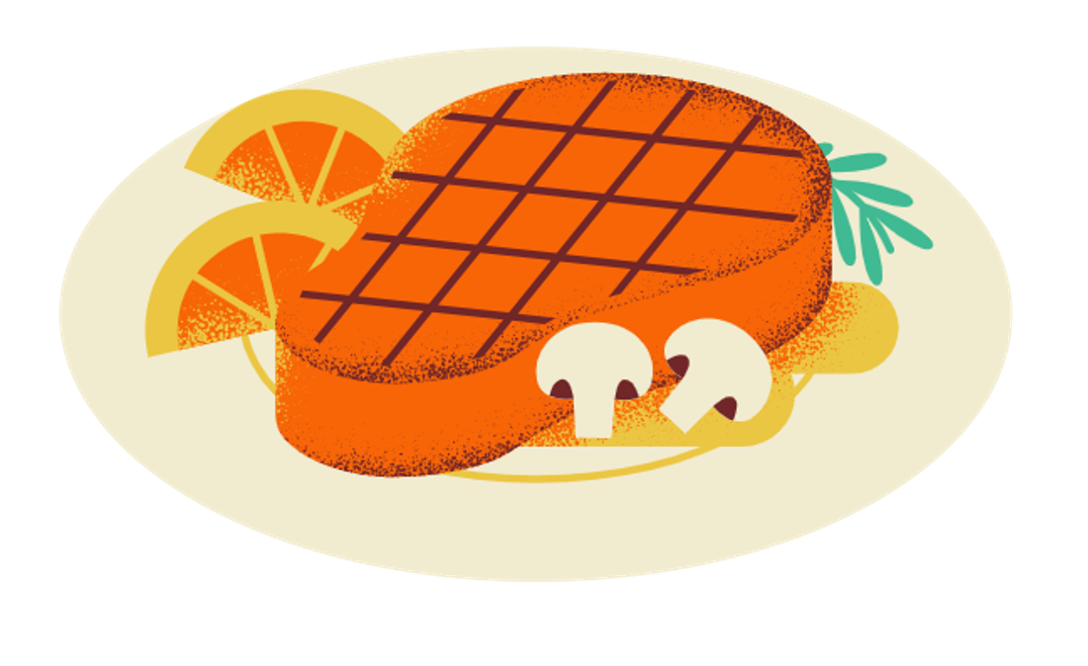
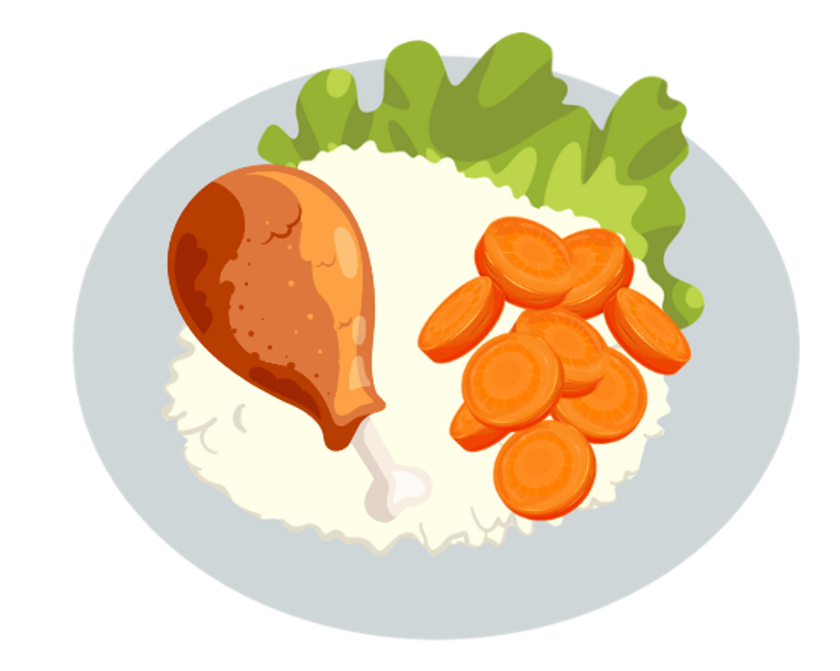
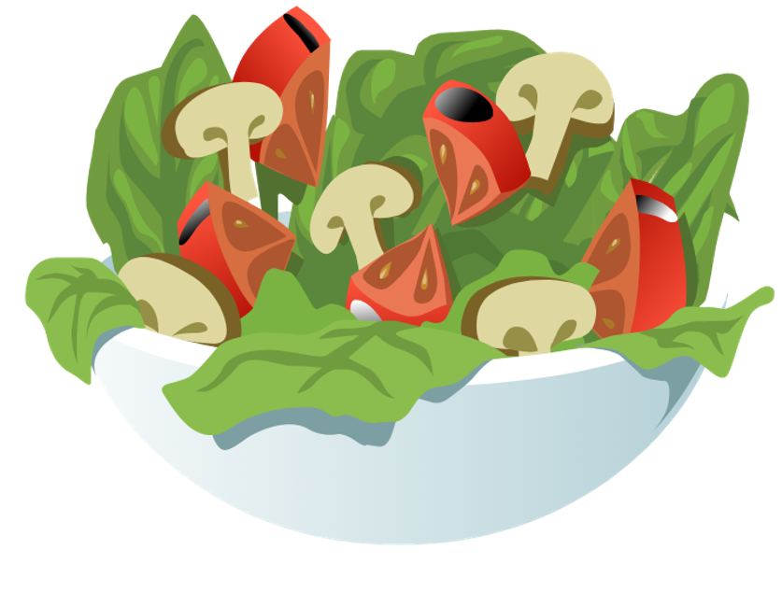
What did we learn?
Your carbon footprint is the total amount of greenhouse gas emissions from your actions
The types of foods you eat will have different impacts on your carbon footprint
Eating less animal-based foods can help lower your carbon footprint
Summary

Slide 22
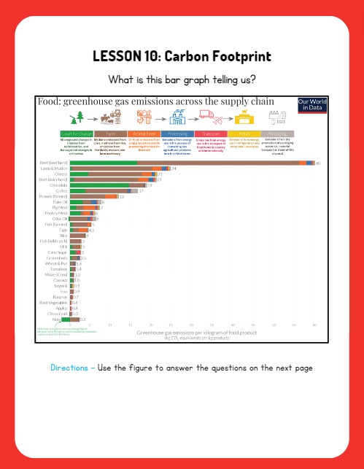
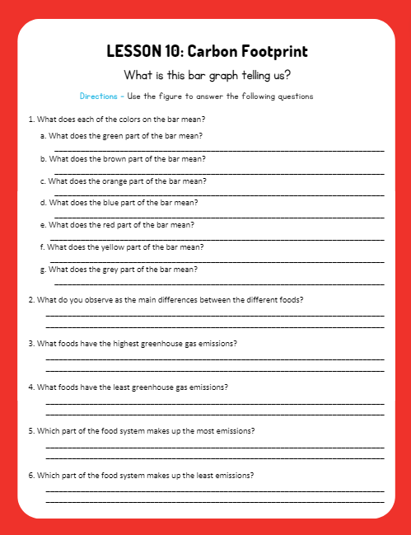
Now let’s put it all together….
Time for an Activity!

Slide 23

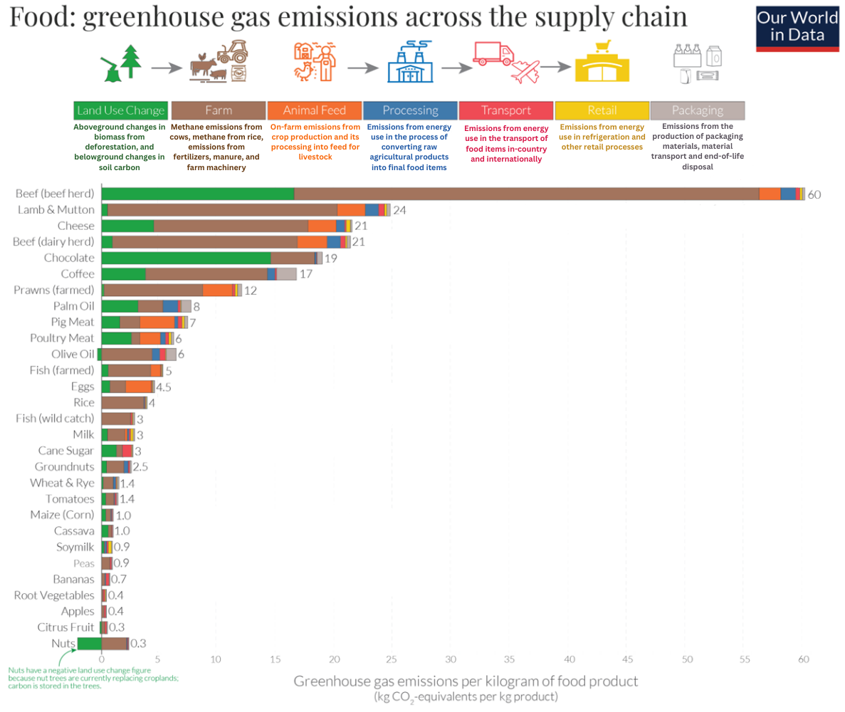
Lesson 10
Figure
What is this bar graph telling us?

Slide 24
Lesson 10
Figure
Reference the five stages of the food system mentioned in the previous video.
How do emissions differ for each food?
Discuss the pre vs post farmgate emissions of each of the foods
  Compare the size of the green, brown and orange part of the bar with the blue, red, yellow and grey part of each food’s bar.
Notes:
Source: https://ourworldindata.org/food-choice-vs-eating-local

Slide 25
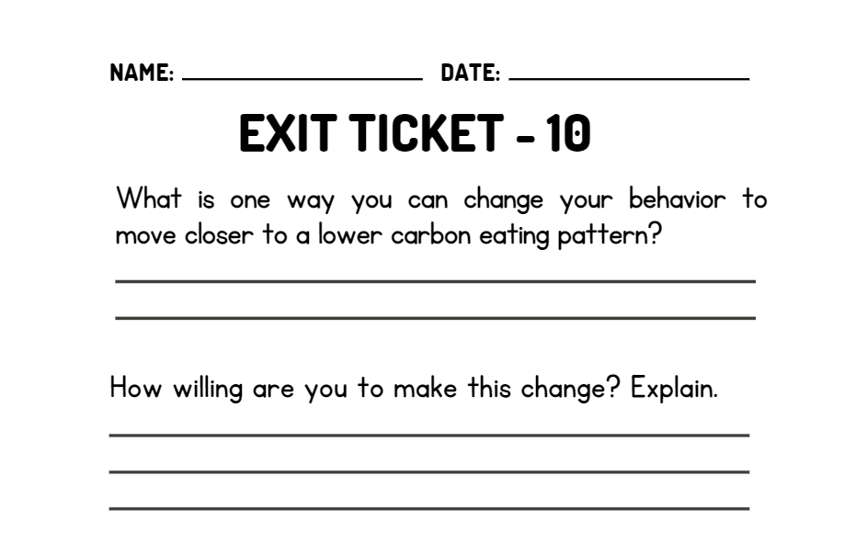
WRAP UP
On your EXIT TICKET write...
Notes:
Once the students have completed the exit ticket, collect them and make minor adjustments to the next lesson based on the data received

