Slide 1






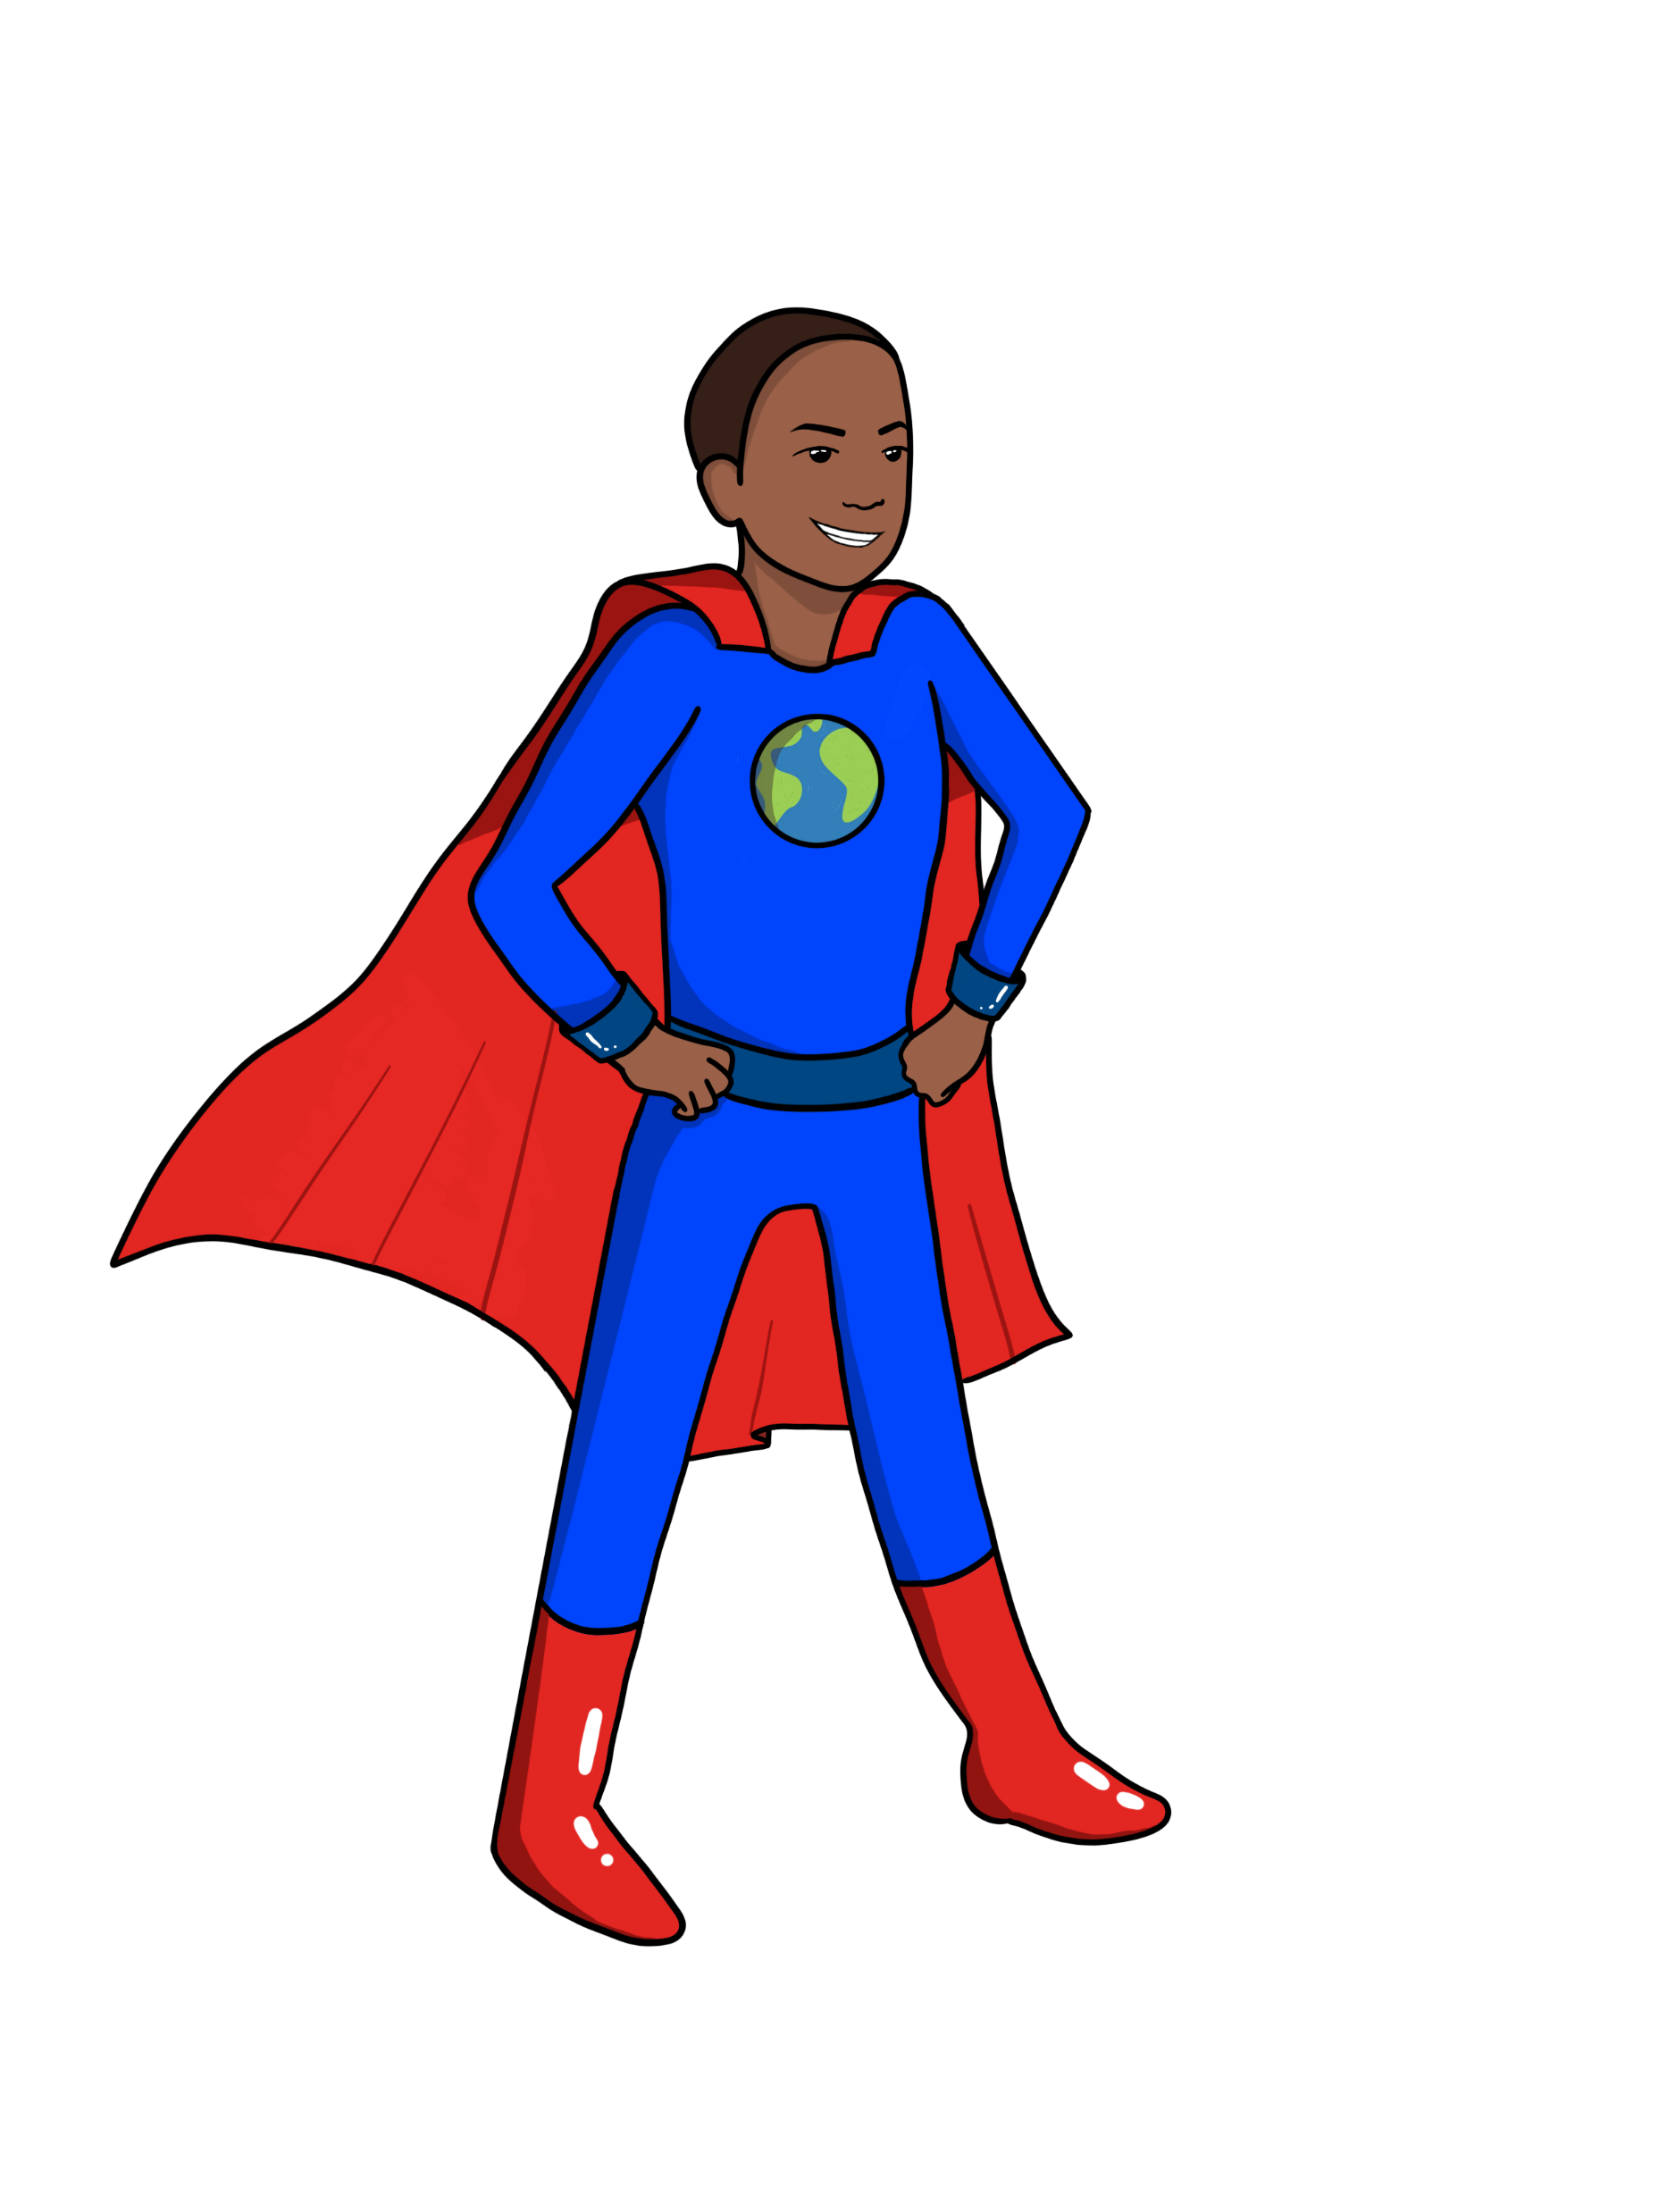


LESSON ONE
What's Happening to Earth's Climate?
{
{
{
Notes:
Introduce yourself [guest instructors] and Name of Lesson

Slide 2


What is causing the earth's global temperature to rise or increase?
What data are scientists collecting to learn and know about this?
What are communities and individual people doing to help with this problem?
Big Ideas & Questions of the Day
Notes:
"Our big ideas and questions for this lesson are: …"
"In this lesson, you'll learn about the earth's climate system and that a system is made up of components or parts that interact, meaning the parts influence each other."

Slide 3

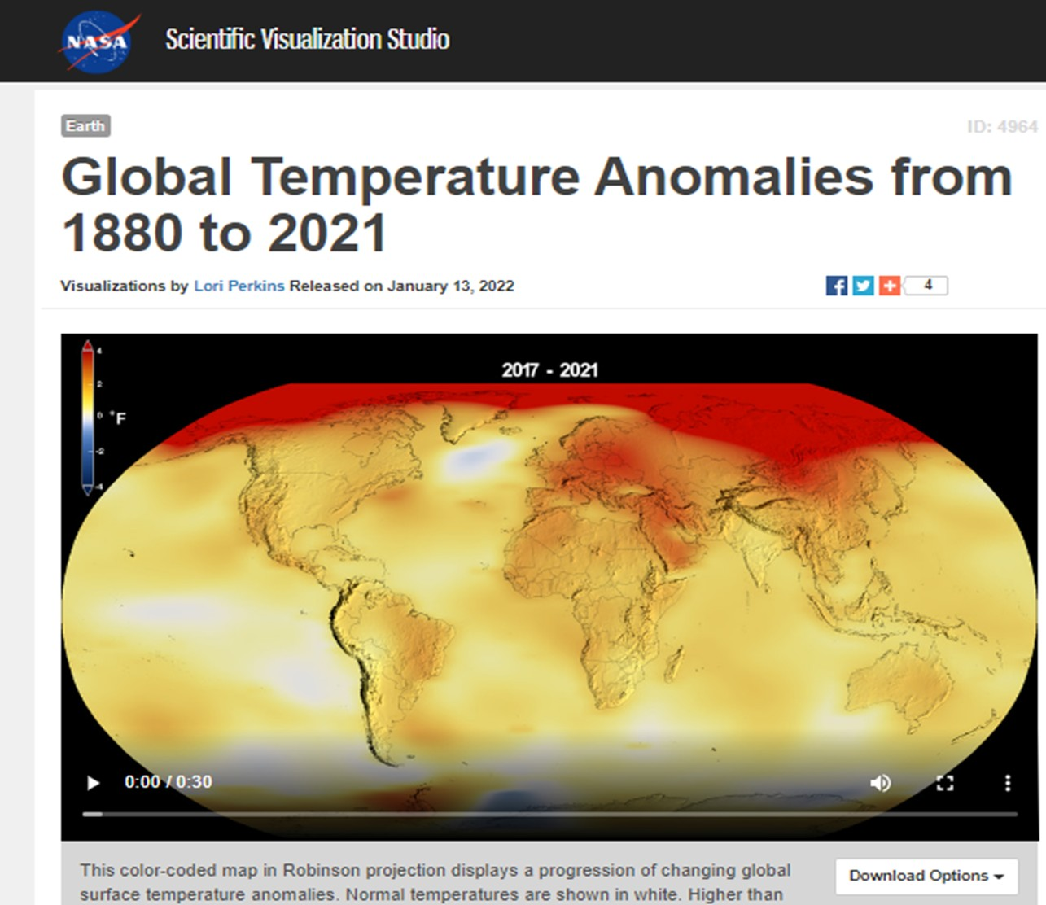
Lesson One Phenomenon
NOTICE AND WONDER!
Link to NASA website:
https://svs.gsfc.nasa.gov/cgi-bin/details.cgi?aid=4964
Notes:
"Now you are going to turn to the first page of your workbook to the first page where it says "NOTICE & WONDER" and as we are going to watch a very short video made by scientists who study climate change. It shows how earth is changing.
Pay close attention to what is happening. There is no talking or narration in the video, you must watch and try to observe or notice what you think this data is showing or telling us. You can write it down on the worksheet …"I notice" and "I wonder". Use the "I wonder" side of the worksheet to write down questions you have or things you are uncertain of.
Okay, ready? Let's go. I can play it twice."

Slide 4
Lesson One Phenomenon
I notice….
I wonder…

Slide 5
Lesson One Phenomenon
What questions do we have?
Driving questions for this study…
Notes:
Encourage students to record at least one I Notice and one or two I wonders on the worksheet. Ask for a couple of students to share one of each...be quick and mindful of the time!

Slide 6





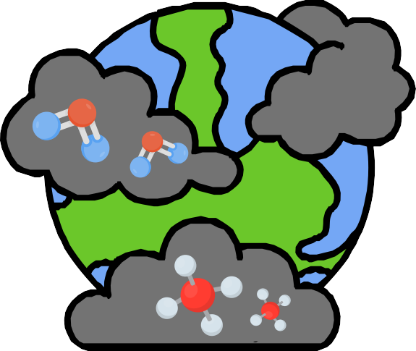





EXAMPLES OF
SYSTEMS AND CYCLES
Systems and
Cycles in Nature
School
City
Water Cycle
Climate System
Systems in your body
What else?
Carbon Cycle

Slide 7
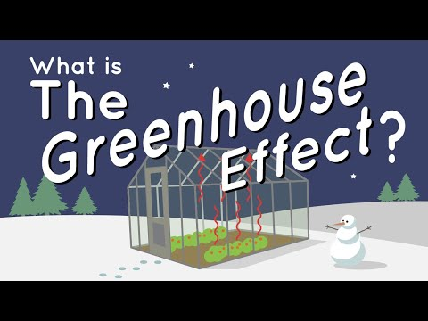
Notes:
https://www.youtube.com/watch?v=SN5-DnOHQmE

Slide 8
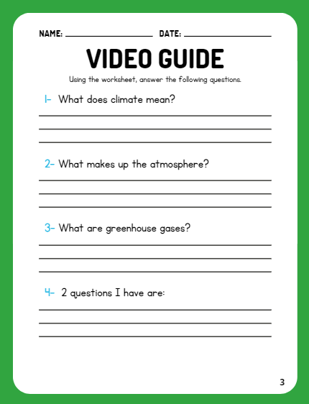

Video Recap

Slide 9
Vocab: Climate, atmosphere, Greenhouse Gases
Climate means weather on Earth over a long period of time.
Earth is surrounded by a layer of transparent gases called the atmosphere. The atmosphere helps to warm and cool the Earth.
Greenhouse gases in the atmosphere help to trap this heat.
Video Recap

Slide 10

Time for an Activity!

Slide 11
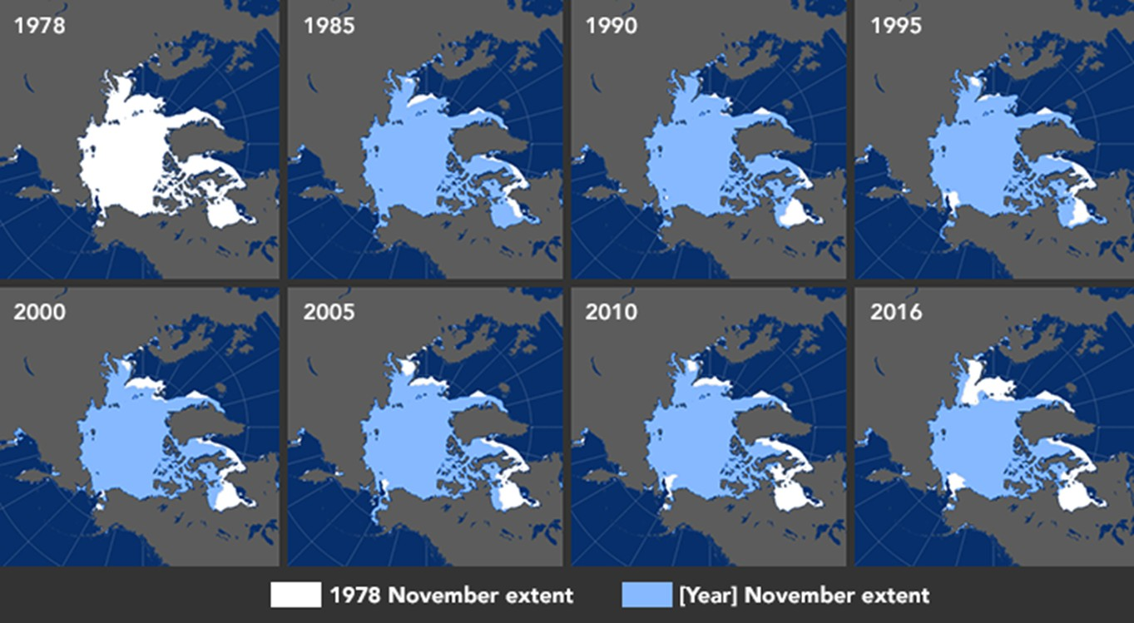
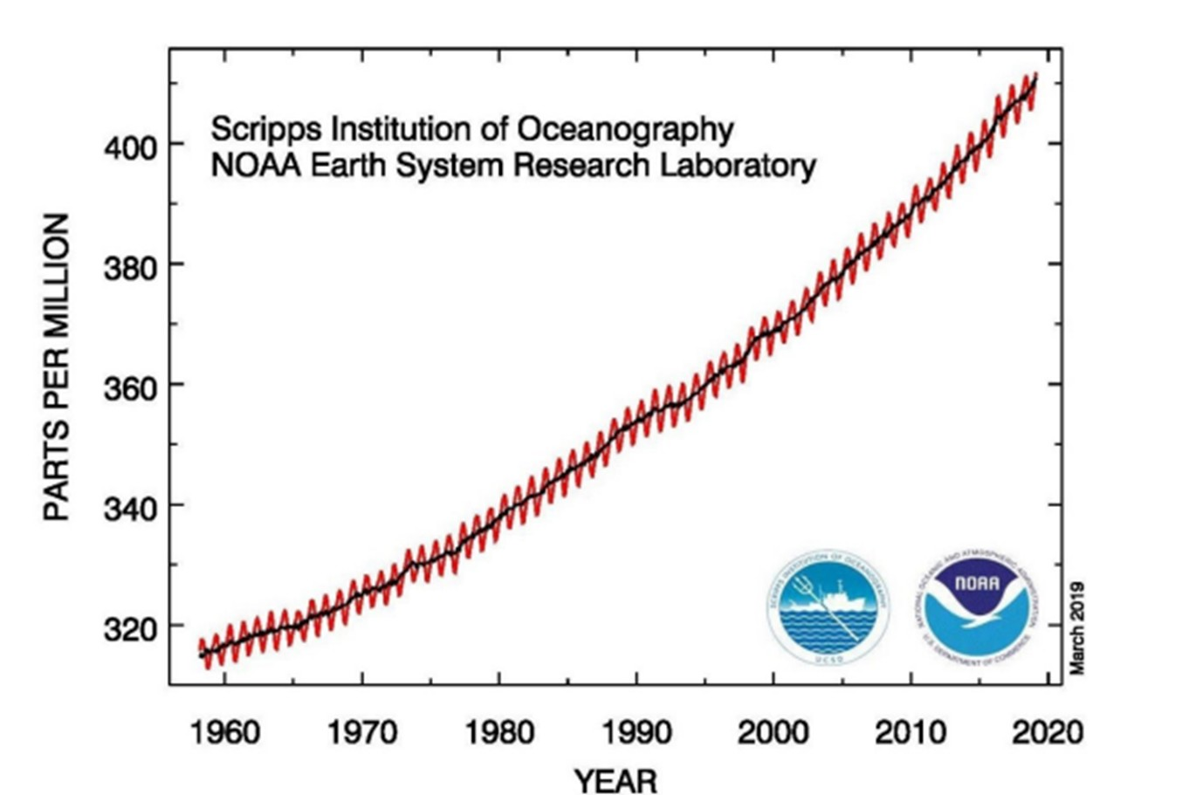
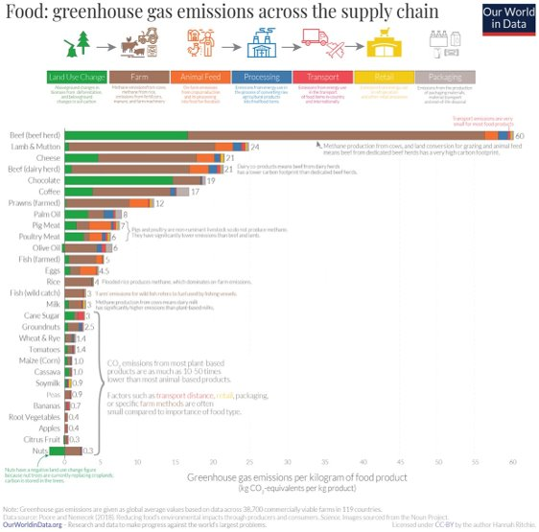
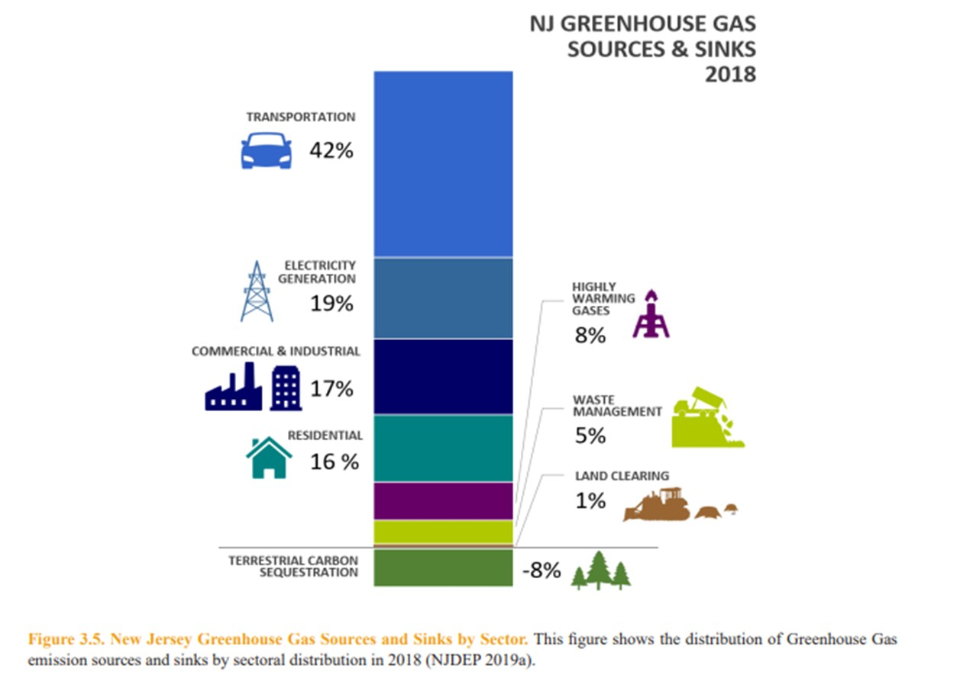
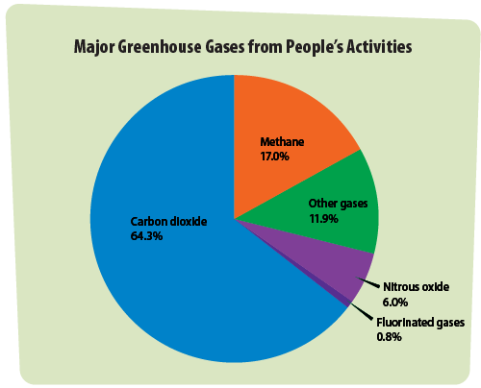
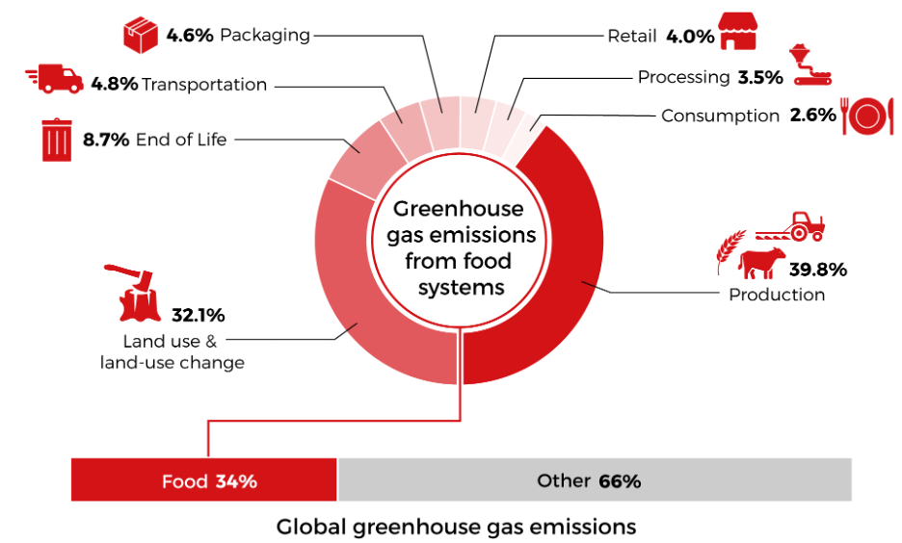
Time for Expert Groups!
AMOUNT OF CARBON DIOXIDE IN EARTH’S ATMOSPHERE
Notes:
Say something like, "Great Job on the Notice and Wonder activity".
"Next you are going to break up into expert groups and each expert group will look at a different example of Scientific Data that tells us something about Global Climate Change"
Depending on which Figure your group is looking at, turn to that page in your workbook. As a group you will use the questions about the figure in your workbook to discuss with your group, what is this figure telling us? What can we learn from this?
Teacher should review the Teacher's Guide and Guide to Lesson One provided or refer to it during the activity as needed. Give students about 15 minutes in Expert Group, then another 10 minutes in Home Groups if possible. This can be stretched out over multiple class periods if possible until the worksheet is completed.
Students are given one of three possible handouts with figures: 1: Figures showing changes to sea ice extent in the Arctic over time; 2: a graph of the amount of carbon dioxide in earth’s atmosphere over time, and 3: a chart of activities that generate different greenhouse gases in N.J.
Students start in their Expert Groups, discussing their figure with others. Then students move back to their Home Groups and take turns sharing what each figure tells us. If there’s time, one or two groups can share out with the class.

Slide 12


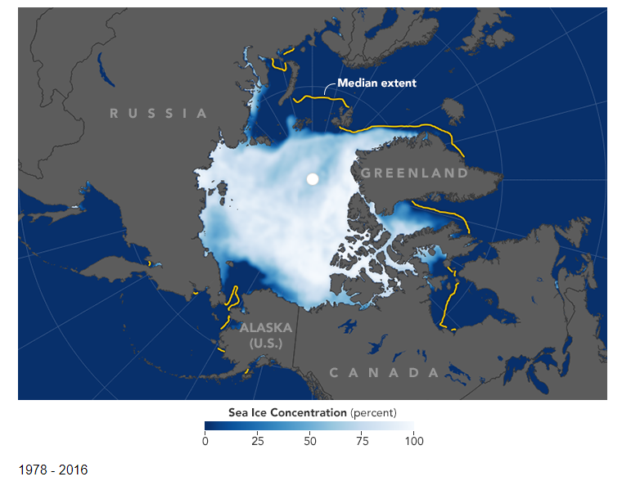

LESSON ONE: FIGURE 1
What changes to the planet does this image show us?
SEA ICE AT THE ARCTIC CIRCLE IS CHANGING
What is this bar graph telling us?
Link to website: Growing Pains: Arctic Sea Ice at Record Lows (nasa.gov)

Slide 13


LESSON ONE: FIGURE 2
AMOUNT OF CARBON DIOXIDE IN EARTH’S ATMOSPHERE
Carbon dioxide
is a gas that
traps heat
This is the amount of carbon in the atmosphere.
Notes:
Shows the change in the amount of carbon dioxide over time as measured at the National Oceanic and Atmospheric Administration's Research Laboratory in Hawaii over time, beginning in 1958. This is measured in parts per million or PPM.

Slide 14



LESSON ONE: FIGURE 3
Sources are activities that add GHGs to the atmosphere.
Sinks are things that remove them.
This means carbon is absorbed or removed from air on land by photosynthesis.

Slide 15
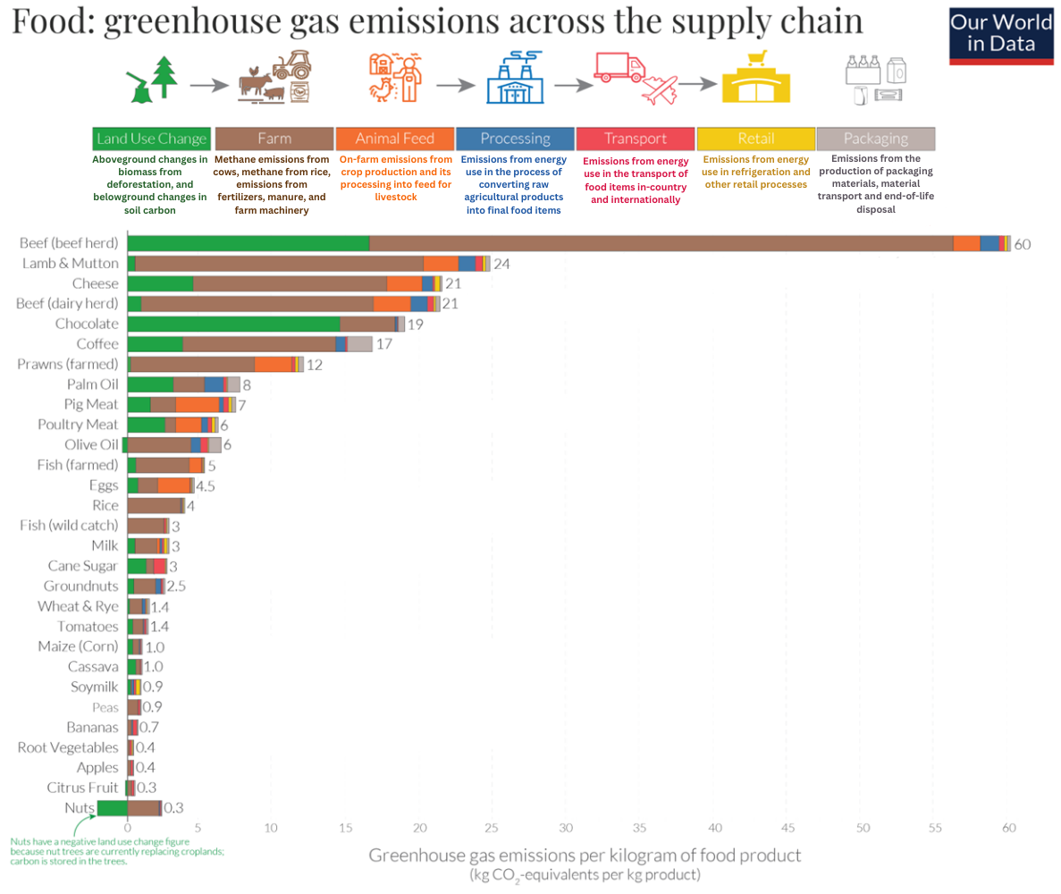
LESSON ONE: FIGURE 4

Slide 16
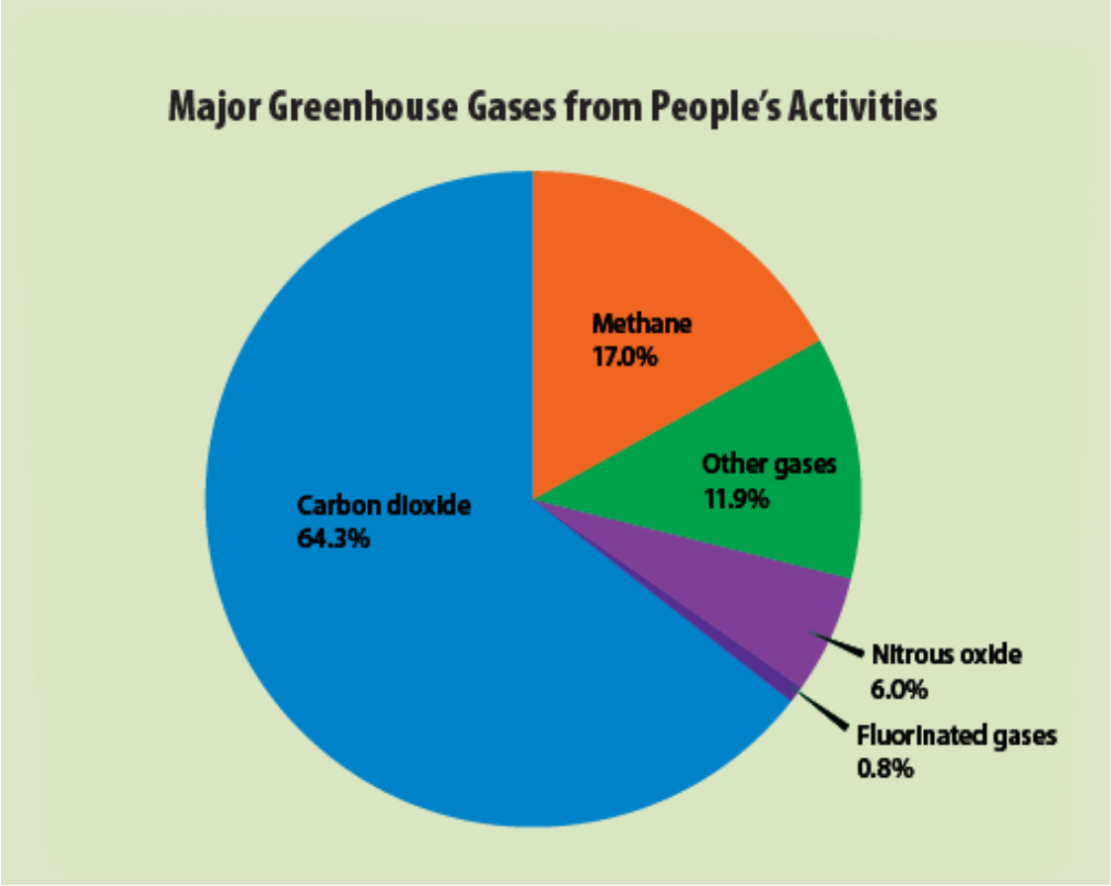
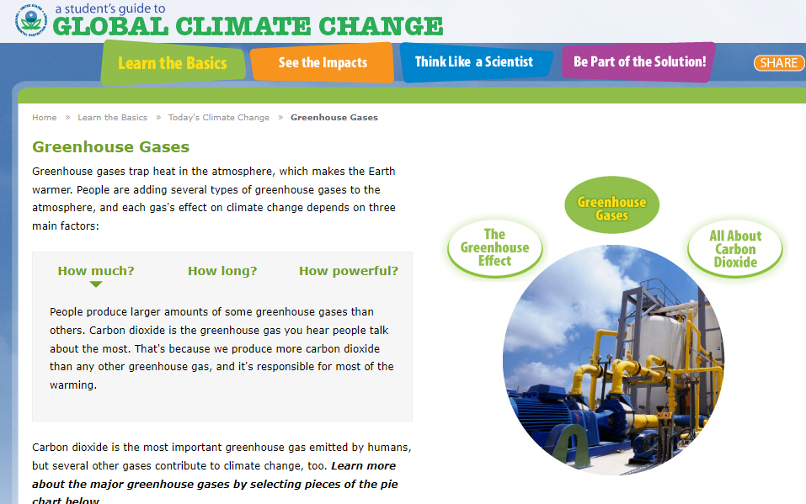
LESSON ONE: FIGURE 5
What does this figure tell us about Greenhouse Gases?
Check out more fun & learning here!
FROM: https://archive.epa.gov/climatechange/kids/basics/today/greenhouse-gases.html
ORIGINAL SOURCE: Intergovernmental Panel on Climate Change, Fifth Assessment Report (2014).
Greenhouse Gases | A Student's Guide to Global Climate Change | US EPA

Slide 17
LESSON ONE: FIGURE 6
How are greenhouse gas emissions created from food and farming?
What does the figure tell us about it?
"End of life" means when food gets throw away or wasted.
FROM: Foodplanetprize.org
ORIGINAL SOURCE: Crippa, et al, Journal Nature Food, March 2021

Slide 18





Directions for Jigsaw Activity
Using the Jigsaw Method, students start in their Expert Groups, discussing their assigned figure. Have them decide on their answers to the questions assigned and then bring back their answers to their Home Groups.
Students move back to their Home Groups and take turns sharing what each figure tells us. As a group they should decide on a big idea, or the main takeaway from the figure. They should talk about what they are learning and if they have any questions.
Have each group share out their big idea. Place these on the board or chart paper to go with the unit.

Slide 19

Share your Big Ideas

Slide 20

WRAP UP
On your EXIT TICKET write...
Notes:
Once the students have completed the index card, collect them and make minor adjustments (if needed) to the next lesson based on the data received

